Slide 1
China & Japan
The Tang’s influence on Japanese Pre-modern States

Slide 2
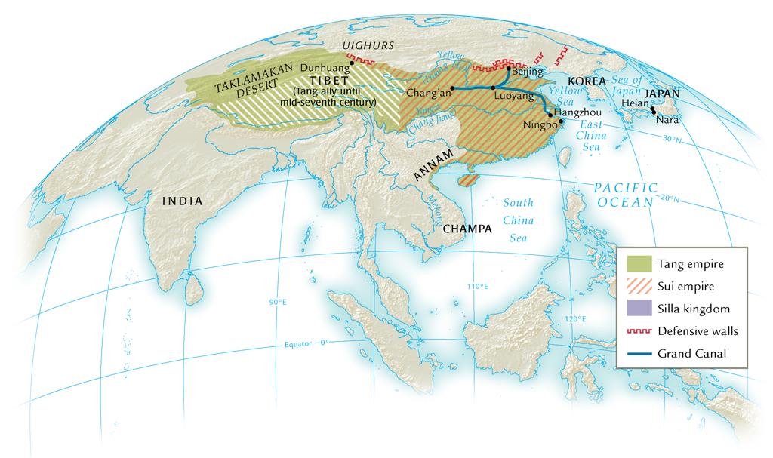
The Sui and Tang Dynasties, 589-907 C.E.

Slide 3
The Tang Dynasty (618-907 C.E.)
Beginnings:
Wide discontent over forced labor in Sui dynasty
Military failures in Korea prompt rebellion
Tang Dynasty begins in 618 C.E. when Emperor is killed

Slide 4
Tang Dynasty: Overview
Second Classical Chinese Age
Very similar to the Han Dynasty
Confucianism again dominates gov't leaders
Civil Service Exams used to hire administrators
Extended its influence throughout East Asia (Japan and Korea)
Re-built the new capital at Xi’an

Slide 5
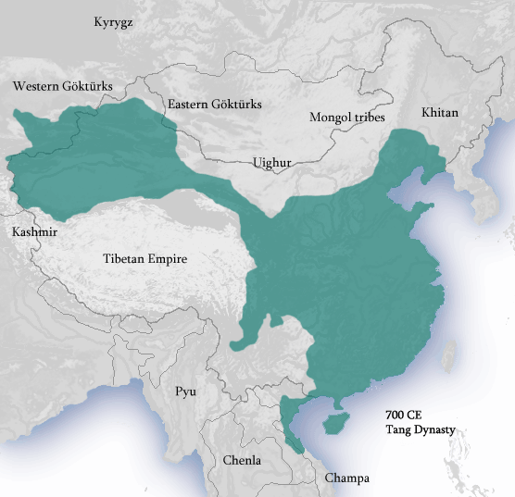
Tang Expansion
Powerful military state
Extended the boundaries of China through Siberia
Korea in the east
Tibet & Manchuria
Vietnam in the South.
One of the largest expansions of China in its history

Slide 6
Tang Economy
Reestablished the safety of the Silk Road.
Silk Road trade with Middle East and Constantinople
New Inventions:
Printing press using moveable print
Porcelain used for dishes and decoratives
Gunpowder originally for fireworks but eventually for weapons
Mechanical clocks

Slide 7
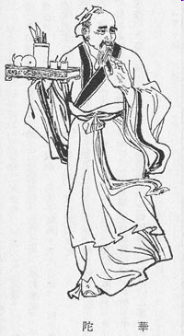
Tea
Tea comes into China from Southeast Asia
Tea and Horse Trade Route to Tibet increases tea availability in China

Slide 8
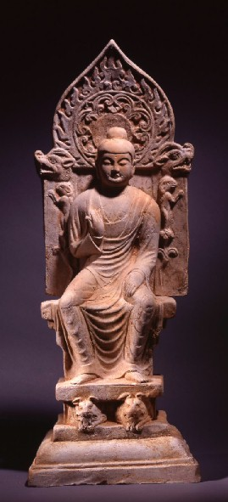
Tang Religion/Philosophy
Liberal attitude towards all religions at first.
First big spread of Buddhism in China
Later during the Tang, Confucianism becomes more aggressive in fighting Buddhist influence in China

Slide 9
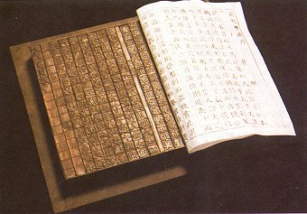
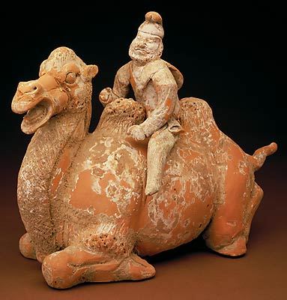
Tang Social Life
Trade brings people from all over the world to China; especially in cities
Cities have a great social life with live music and drama
Tang people loved poetry and landscape painting
Confucian social hierarchy dominates

Slide 10
Tang: Persecution of Buddhists
Daoist and Confucian persecutions supported in late Tang dynasty
840s begins systematic closure of Buddhist temples, expulsions
Zoroastrians, Christians, Manichaeans as well
Economic motive: seizure of large monastic landholdings

Slide 11
Major Achievements of Tang Dynasty
Transportation and communications
Extensive postal, courier services
Equal-field system
20% of land, hereditary ownership
80% redistributed according to formula
Family size, land fertility
Worked well until eighth century
Corruption, loss of land to Buddhist monasteries

Slide 12
Tang Decline
Governmental neglect: Emperor obsessed with music & his favorite concubine
775 C.E. rebellion under An Lushan, former military commander
Captures Chang’an, but rebellion crushed by 763
Nomadic Uighur mercenaries invited to suppress rebellion, sacked Chang’an and Luoyang
Tang decline continues, rebellions in ninth century, last emperor abdicates 907

Slide 13
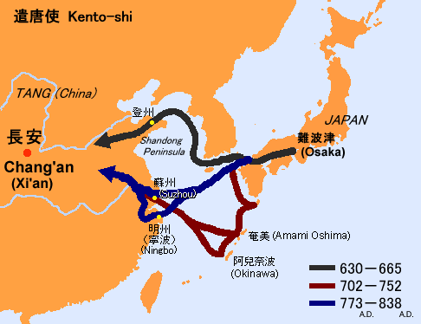
Japan’s Interactions with China

Slide 14
Kentoshi Vessel

Slide 15
Trade/Technology: Silk
Silk embroidery panel with flowers and ducks
British Museum, http://www.britishmuseum.org/explore/highlights/highlight_objects/asia/e/earthenware_tile_with_a_monste.aspx

Slide 16
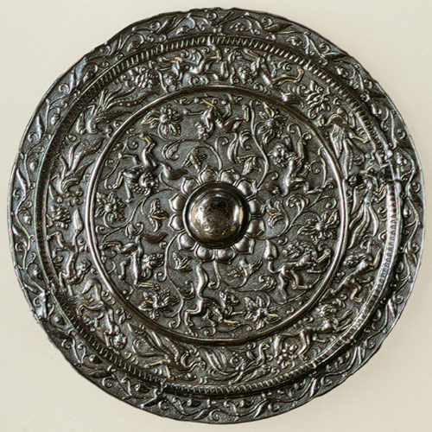
Trade/Technology: Mirrors
Silver Mirror back, Tang dynasty (618–906), 8th century
The Metropolitan Museum of Art
http://www.metmuseum.org/toah/works-of-art/1985.214.22

Slide 17
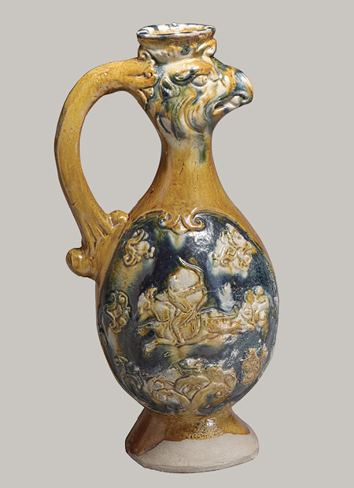
Trade/Technology: Earthenware
Phoenix-headed ewer, Tang dynasty (618–906), late 7th–first half of 8th century
Earthenware with three-color (sancai) glaze
The Metropolitan Museum of Art
http://www.metmuseum.org/toah/works-of-art/1991.253.4

Slide 18
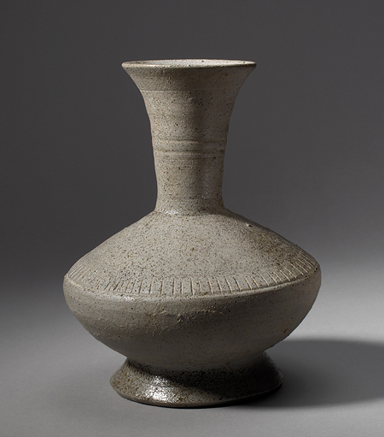
Stoneware in Japan
Long-necked bottle, Nara period (710–794), 8th century Japan Stoneware with natural ash glaze and incised decoration (Sue ware)
Influenced by Korea and China, the Japanese began to use the potter’s wheel during this period, and fire pottery at high temperatures.
The Metropolitan Museum of Art
http://www.metmuseum.org/toah/works-of-art/1975.268.425

Slide 19
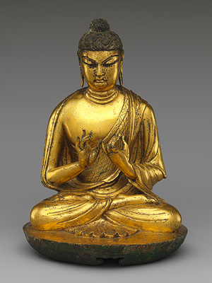
Culture: Buddhism
Buddha Vairocana (Dari),
Tang dynasty (618–906), early 8th century China Gilt leaded bronze, lost-wax cast
The Metropolitan Museum of Art
http://www.metmuseum.org/toah/works-of-art/43.24.3

Slide 20
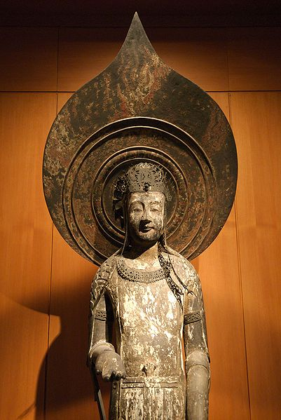
Culture: Buddhism
Replica of Kudara Kannon (actual from 7th Cent.) in the British Museum.
The British Museum
http://www.britishmuseum.org/research/collection_online/collection_object_details.aspx?objectId=772962&partId=1

Slide 21
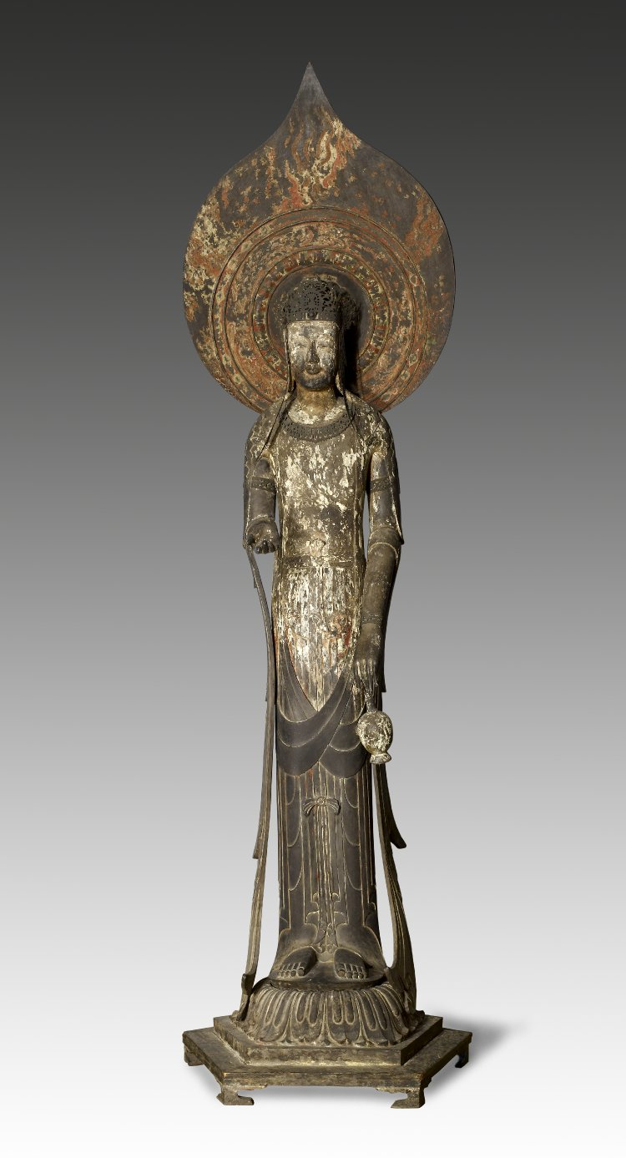
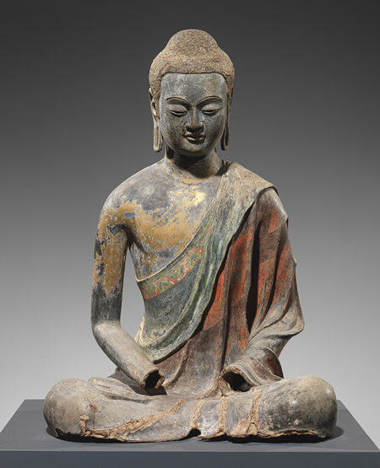

Slide 22
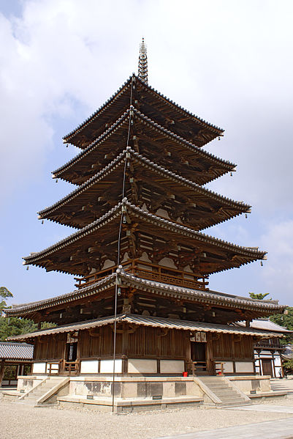
Buddhism in Japan: Horyuji
Built near Nara c. 616
The temple was constructed on a square plan surrounded by a double wall.
Inside were a number of buildings: The main hall containing a sculpture of the Buddha, a lecture hall, a library, and a bell tower.

Slide 23
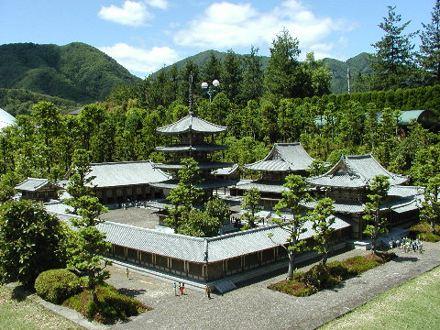

Slide 24
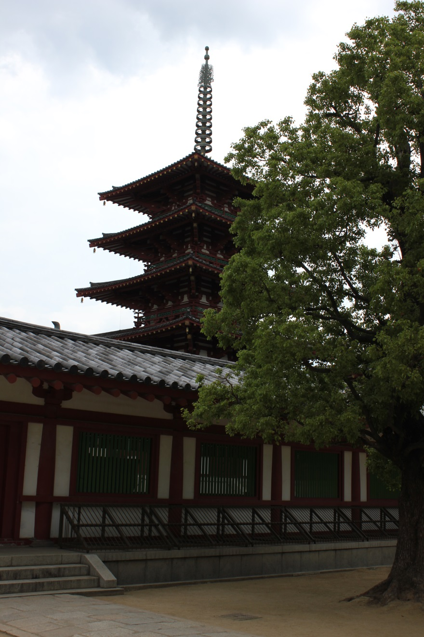
Buddhism in Japan: Shitennō-ji
Constructed by Prince Shotoku in 593
Used Korean carpenters, built along Chinese models

Slide 26
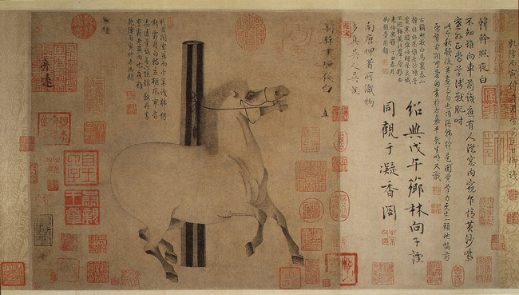
Culture: Art
Night-Shining White, Tang dynasty (618–906), ca. 750 Han Gan (Chinese, active 742–56), Handscroll; ink on paper
The Metropolitan Museum of Art
http://www.metmuseum.org/toah/works-of-art/1977.78

