Slide 1
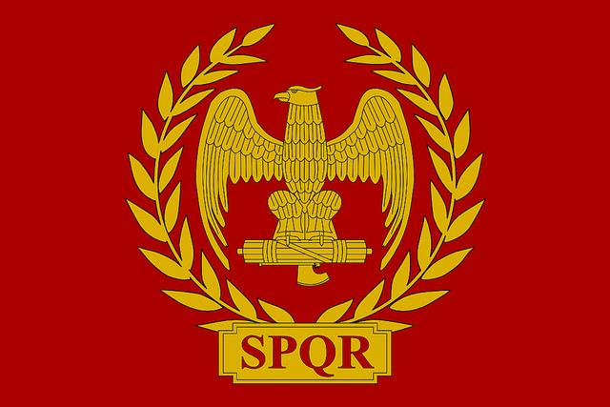
UNIT 2 REVIEW
Sam, Vishnu, and Dohi

Slide 2
Politics
Rome
-Usually ran by Senate and two consuls who shared power and control
-Established a sense of patriotism and
duty to the country
-Several transitions to dictatorships in times of crisis
-Aristocratic government -Considerable tolerance for local customs
- Strong military organization
-Equitable law
-A established branch of commerce
Greece
-Divided into many city-states, with different governments
-Direct Democracy in Athens
-Warrior Caste and Society supported by slaves in Sparta
-Aristocratic rule
-Many officials were elected by the people
-Women had almost no rights
Persia
-Ruled by Powerful Emperor
-Had a strong authoritarian government
-Very Tolerant Rulers
-Persian rulers developed a vital infrastructure -Centralized law and tax collection
Africa
-Carthage was a Oligarchic Republic
-Kingdoms ruled by wealthy kings and warlords.
-Rulers often considered godlike/divine
-Fragile Kingdoms often led to invasions and rebellions.
Japan
-Early Japan dominated by tribal chiefs and warlords.
-After contact established with China, tried to copy/mimic them
China
-Ruled by Qin and Han Dynasties -Emperors ruled, supported by a large bureaucracy.
-Laws were harsh (especially under the Qin)
-Large Army, usually crushed regional resistance and rebellion
-Often taxed peasants heavily
-In moments of weakness, massive peasant revolts occurred
-Scholar Gentry played a central and powerful role in China

Slide 3
Economic
Rome
-Slaves were used for mining and precious metals
- Good roads and urban amenities fostered trade
-Grants of land and rank were often used as payment to military/soldiers
-Relient on continuous conquest of new regions
-Little technology discovered to improve the agricultural or manufactured goods
Greece
-Farming was not
efficient because soil conditions weren’t ideal
-Great position in Mediterranean allowed for extensive trade
-They traded with India and China and got products and luxury goods.
-Slaves were very important because they were used to work many manual jobs, supporting Greek specialists
Persia
-Persia made roads from the west to china, this enabled them to trade with china and india, and gave them a lot of luxury goods.
-They were a link between Asia, Europe, and Africa
Africa
-Usually through the sub saharan trade routes, the Africans mainly traded gold, ivory, and slaves.
-Carthage was an important port in the Mediterranean, many African goods were traded through Carthage to the rest of the world.
Japan
-Lack of centralization led to a primarily agricultural society.
-Fishing and Luxuries (like silver) were also economic focuses, though on a smaller scale.
China
-The Chinese economy was supported by a massive rural peasant class.
-China discovered how to make silk, a luxury that they often traded
-Do to many, many unique natural resources and land, the Chinese almost never had to import goods from surrounding peoples.

Slide 4
Religion/Belief Systems
Rome
-Originally has a Pantheon almost identical to the Greeks
-Toward the end of the Roman Empire, Christianity is established and eventually embraced
Greece
- Had a Pantheon of Greek Gods, who were usually associated with emotion or nature
-Very Human-like and relatable unlike many gods at the time
Persia
-Believed in Zoroastrianism
-Belief in a single supreme god, Ahura Mazda
-Established a concept of “good and evil”
-Emphasis on Fire
Africa
-Had many polytheistic tribal religions
Japan
-Shinto dominated early Japan
-Worship of Kami spirits and powers
-Does not explain the world like other religion, but is more based around happiness and rituals
China
-Confucian ideas and traditions dominate Chinese culture
-Buddhism also introduced from India, adapted for Chinese values
-Confucian Ideas established a Patriarchal, hardworking, and dutiful society

Slide 5
Cultural
Rome
-The Romans created a distinct Roman culture (Much like the Greeks), and did all they could to recreate it in the nations that they conquered.
-Created a patriotic attitude and duty to the further “Glory of Rome”
-In times of unease, “bread and games” were used to keep people entertained and preoccupied
Greece
-Athens was a center of cultural advances.
-Fostered great thinkers such as Aristotle and Socrates.
-Athens was one of the first cities to operate like a democracy, individual freedom and voice were highly valued
-Alexander the Great’s Conquests led to the formation of true Hellenic culture, a mix of Greek, African, and Persian Cultures
-Woman were very objectified and sidelined
Persia
-Were very cultured for their time, building massive temples and palaces filled with art.
-The core of the empire practiced Zoroastrianism, but were tolerant of other faiths in conquered places.
Africa
-Dominated by a variety of Tribal traditions and beliefs dominated African culture until the introduction of Islam.
Japan
-Shinto led to the reverence of nature and spirits.
-Often concerned with personal glory and honor as well as power.
-Often mimicked the Chinese culture, though they were selective in what they adopted.
China
-Chinese culture dominated by Confucian ideals and beliefs
-Everyone was part of a social hierarchy with set superiors and inferiors
-Distrust and xenophobia caused a lot of disdain for outside cultures
-The elite scholar gentry of China held a lot of power
-Very patriarchal, woman were reduced to playing almost no role in society outside of being wives.

Slide 6
Declines
Rome
-The Romans over extended their empire into too many regions.
-Toward the empire’s decline, many mercenaries were recruited into the army, meaning their forces fought for money instead of Rome
-Cultural difference and assimilation of many different conquered people led to unrest
-Due to its many problems Rome eventually broke apart
-Promises of land and estates made the Romans dependent on more new conquests
Greece
-After the breakup Alexander the Great's kingdom, Greek City-States returned to fighting each other, before being conquered by the Romans.
Persia
-Though Persia continued to exist for a long time, most of the power at its height was lost due to many invasions, especially from Alexander the Great
Africa
-Carthage was sacked by the Romans at the end of the 3rd Punic War.
-Many African Kingdoms fell to internal power struggles between war lords/nobles.
Japan
-Japanese tribal lords and shoguns were rarely able to remain in power for long due to constant power struggles between the higher class.
China
-Nomadic Steppe raiders raided and attacked China throughout the Classical Period
-With the death of the powerful Xi Huang Di, the Qin dynasty quickly collapsed under a series of peasant uprising
-After years of peace under the Han Dynasty, more internal power struggles, unrest, weak leadership, and corruption all contributed to the collapse of the dynasty and a long period of Warring States within China.

Slide 7
Summary
Rome
-Rome had an aristocratic government that was centralized on a strong military, patriotism, and infrastructure
-Considerable tolerance for other customs
-Roads and Slaves helped supported economy
-Originally the Romans followed a Pantheon, but eventually became Christian
-Over extension led to many problems and the fall of Rome
Greece
-Was divided into many city states
-Farming was hard and unreliable
-Relatable and Human-like Gods
-After the break up of Alexander’s kingdom, Greek
city states fought each other, and were weakened and conquered by the Romans.
i und
Persia
-Strong Authoritarian Government
-Tolerant of conquered cultures
-Traded with the West and Eastern Civilizations
-Zoroastrianism
-Belief in a single god
-Persia faded due to foreign invasion
Africa
-Carthage was a Oligarchic Republic
-Many small scale kingdoms ruled by warlords/kings
-Traded Gold, Ivory, and Slaves
-Had many polytheistic tribal religions
Japan
-Many warlords and chiefs struggling for power
-Shinto, the worship of Kami spirits
-Often mimicked Chinese culture, though somewhat selective
China
-Emperors ruled, supported by a large bureaucracy.
-The Chinese economy was supported by a massive rural peasant class.
-Confucian ideas and traditions dominate Chinese culture
-Everyone was part of a social hierarchy with set superiors and inferiors
-Distrust and Xenophobia caused a lot of disdain for outside cultures

