Slide 1
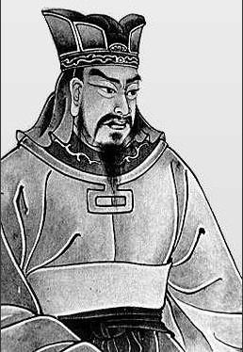
“In all history, there is no instance of a country having benefited from prolonged warfare. Only one who knows the disastrous effects of a long war can realize the supreme importance of rapidity in bringing it to a close.”
Sun Tzu

Slide 2
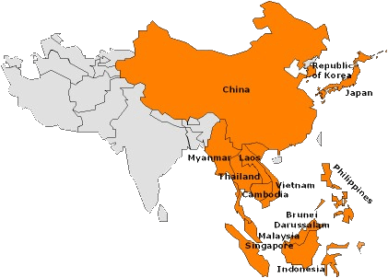
China and its Neighbors
Also involved in tributary relationships with China during the postclassical era were the newly emerging states and civilizations of Korea, Vietnam, and Japan
These societies were thoroughly agricultural and sedentary
Proximity to China shaped the histories of these new East Asian civilizations, for all of them borrowed major elements of Chinese culture
However, unlike the native peoples of southern China who largely became Chinese, they retained distinctive identities into modern times

Slide 3
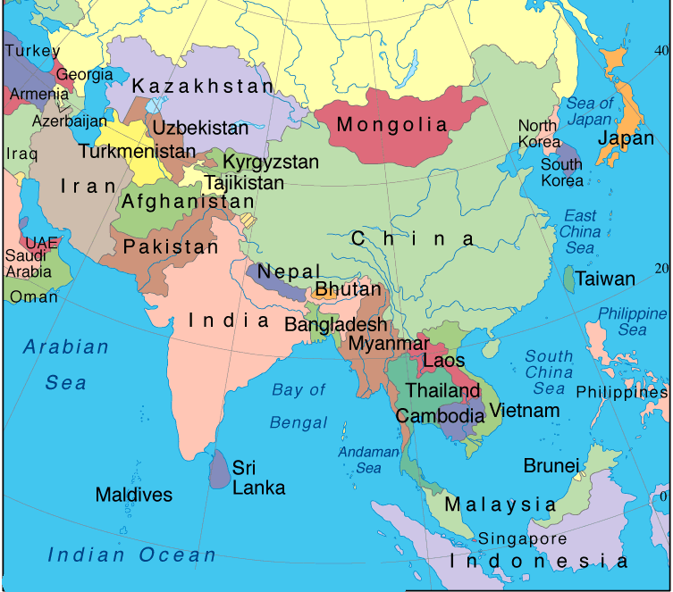
Korea, Vietnam, and Japan borrowed aspects of Chinese culture while maintaining unique cultural identities.

Slide 4
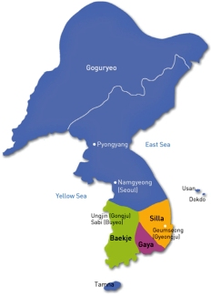
Korea and China
Immediately adjacent to northeastern China, the Korean peninsula and its people have long lived in the shadow of China
Temporary Chinese conquest of northern Korea during the Han dynasty and some colonization by Chinese settlers
Chinese cultural influences, particularly in the form of Buddhism
But early Korea states, which emerged in the fourth through seventh centuries CE, all resisted Chinese political control, except when it helped to join China against a local enemy

Slide 5
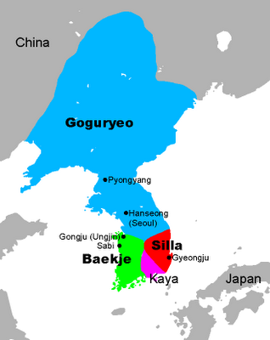
The early Korean states were bitter rivals with one another.

Slide 6
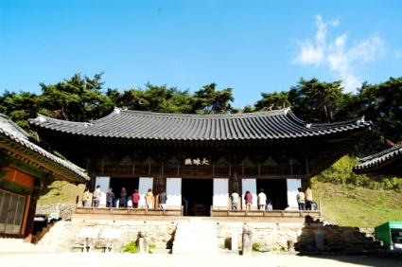
In the seventh century, one of these states – the Silla kingdom- allied with China’s Tang dynasty to bring some political unity to the peninsula for the first time
But sharp military resistance from Koreans persuaded the Chinese to withdraw their military forces in 688 and to establish a tributary relationship with a largely independent Korea
But Korean scholars, monks, and aristocrats regularly traveled to China which led to Korea becoming a part of the expanding world of Chinese culture
And refugees from the peninsula’s many wars carried Chinese culture to Japan as well

Slide 7
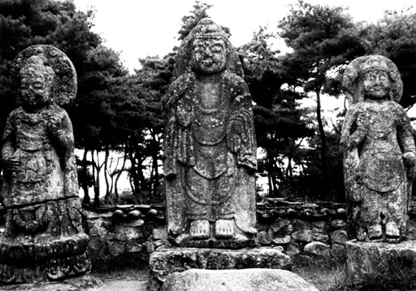
A new capital city of Kumsong was modeled directly on the Chinese capital of Chang’an.

Slide 8
Efforts to plant Confucian values and Chinese culture in Korea had a negative impact on Korean women, particularly after 1300
Chinese models of family life and female behavior, especially among the elite, replaced more flexible Korean patterns
Still Korea remained Korean and after 688, the country’s political independence, though periodically threatened, was largely intact
Chinese cultural influence, except for Buddhism, had little impact beyond the aristocracy and certainly did not penetrate the lives of Korea’s serflike peasants or its large slave population
A Chinese-style examination system never assumed the prominence it gained in China

Slide 9
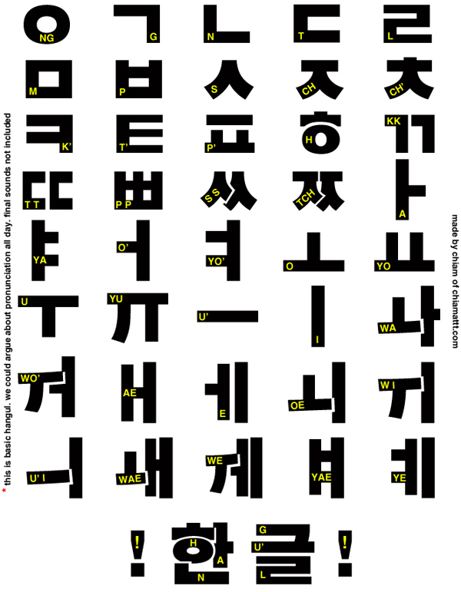
And in the 1400s, Korea moved toward greater cultural independence by developing a phonetic alphabet, known as hangul, for writing the Korean language. Korea remained a distinctive culture as well as a separate political existence.

Slide 10
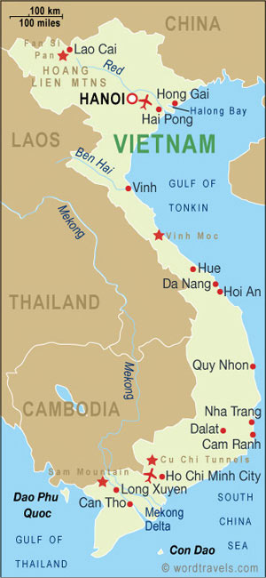
Vietnam and China
At the southern fringe of the Chinese cultural world
As in Korea, the elite borrowed heavily from China – adopting Confucianism, Daoism, Buddhism, administrative techniques, the examination system, and artistic and literary styles
But its popular culture remained distinctive
Vietnam also achieved political independence, while participating fully in the tribute system as a vassal state

Slide 11
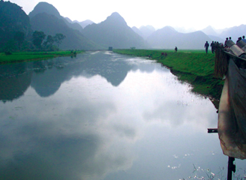
But the cultural heartland of Vietnam in the Red River valley was fully incorporated into the Chinese state for more than a thousand years (111 BCE -939 CE), far longer than corresponding parts of Korea.

Slide 12
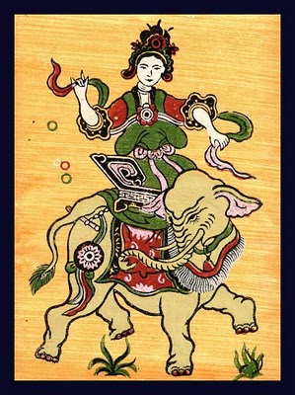
The heavy pressure of the Chinese presence generated periodic rebellions
In 39 CE, a short-lived but long-remembered uprising was launched by two sisters, daughters of a local leader deposed by the Chinese
-One of them, Trung Trac, whose husband had been executed, sought to avenge this death
-When the rebellion was crushed several years later, the Trung sisters committed suicide rather than surrender to the Chinese
-But the sisters long remained powerful symbols of Vietnamese resistance to Chinese aggression
The weakening of the Tang dynasty in the early tenth century CE finally enabled a particularly large rebellion to establish Vietnam as a separate state

Slide 13
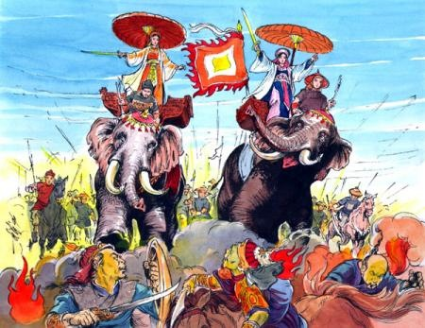
But Vietnam carefully maintained its tributary role with China and Vietnamese dynasties claimed the Mandate of Heaven.

Slide 14
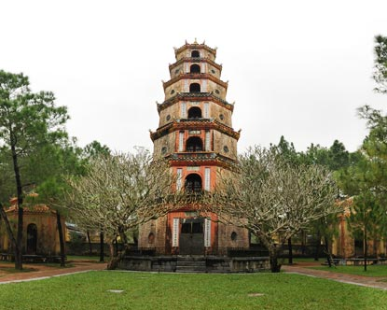
More so than in Korea, a Chinese-based examination system in Vietnam functioned to undermine an established aristocracy, to provide some measure of social mobility for commoners, and to create a merit-based scholar-gentry class to staff the bureaucracy
The Vietnamese elite class remained deeply committed to Chinese culture, viewing their nation as a southern extension of a universal civilization
But beyond the elite, there remained much that was uniquely Vietnamese
-A greater role for women in social and economic life
-Like Korea, Vietnam developed a variation of Chinese writing called chu nom (“southern script”)

Slide 15
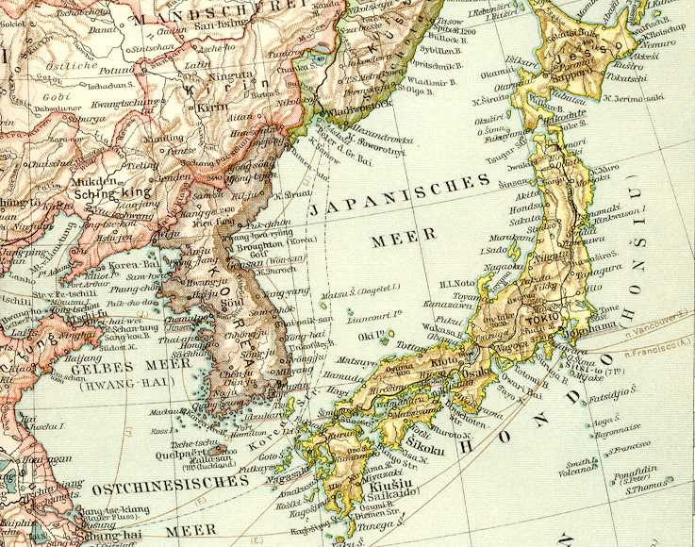
Unlike Korea and Vietnam, the Japanese islands were physically separated from China by 100 miles or more of ocean and were never successfully invaded or conquered by their giant mainland neighbor.

Slide 16
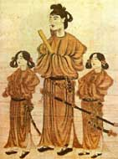
Japan and China
Japan’s extensive borrowing from Chinese civilization was wholly voluntary
The high point of borrowing took place during the seventh to ninth centuries CE
-As the first more or less unified Japanese state began to emerge from dozens of small clan-based aristocratic chiefdoms
-That state set out to transform Japan into a centralized bureaucratic state on the Chinese model
Prince Shotoku Taishi (572-622) launched a series of missions to China

Slide 17
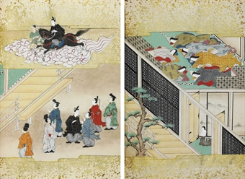
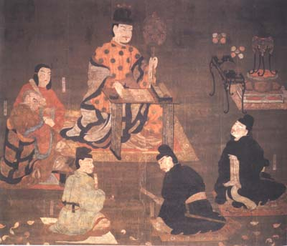
Hundreds of Japanese monks, scholars, artists, and students went to China and put into practice what they learned upon their return.

Slide 18
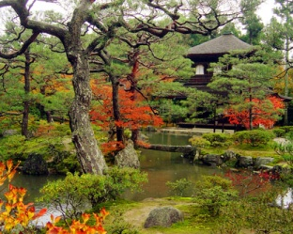
In the Seventeen Article Constitution, the Japanese ruler was proclaimed as a Chinese-style emperor and Buddhism and Confucianism were encouraged.
Two capital cities, first Nara and then Heian (Kyoto) were modeled on the Chinese capital of Chang’an
The absence of any compelling threat from China made it possible for the Japanese to be selective in their borrowing
Japan also never succeeded in creating an effective centralized and bureaucratic state to match that of China
-Competing aristocratic families diminished the political authority of the emperor

Slide 19
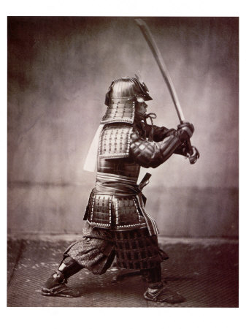
As political power became increasingly decentralized, local authorities developed their own military forces, the famous samurai warrior class of Japanese society.

Slide 20
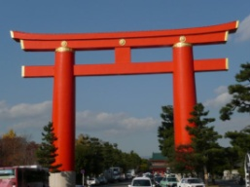
The way of the warrior, bushido, the samurai and a celebration of military virtues contrasted sharply with China’s emphasis on intellectual achievements and political officeholding, which were accorded higher prestige than bearing arms
Although Buddhism took hold in the country, it never completely replaced the native beliefs and practices, which focused attention on numerous kami, sacred spirits associated with natural forces and human ancestors
-Much later, referred to as Shinto, this tradition provided legitimacy to the imperial family, based on claims of descent from the sun goddess
Also developed a unique writing system that combined characters with phonetic symbols

Slide 21
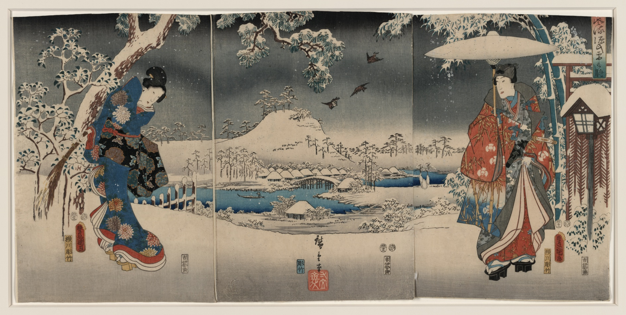
A highly stylized Japanese poetic form, known as tanka, developed and The Tale of the Genji, a Japanese novel written by the woman author Murasaki Shikibu around 1000, revealed the intrigues and romances of court life.

Slide 22
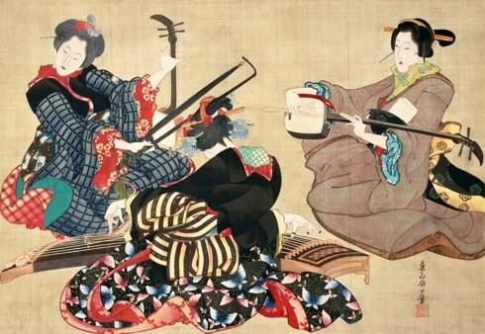
Japanese women, unlike those in Korea, largely escaped the most oppressive features of Chinese Confucian culture, such as the prohibition of remarriage for widows, seclusion within the home, and foot binding, partly because Chinese influence on Japan occurred during the Tang dynasty when Chinese elite women enjoyed considerable freedom.
When Japanese women did begin to lose status in the twelfth century, it had less to do with Confucian pressures than with the rise of a warrior culture.
-In a warrior culture, the influence of women in political life was reduced, but this was an internal Japanese phenomenon

Slide 23
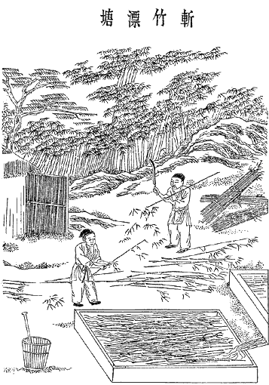
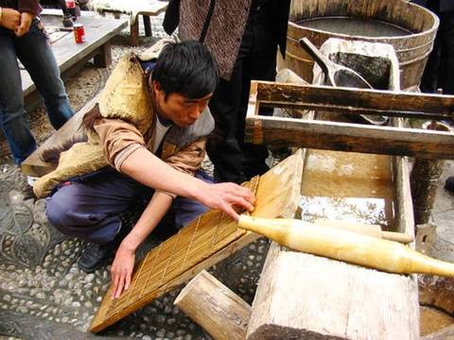
Chinese technological innovation also spread to other areas, including the Islamic world and later Christian Europe. Papermaking from the Han dynasty spread to Korea, Vietnam, India, the Islamic world, Muslim Spain, France, Germany, and England.

Slide 24
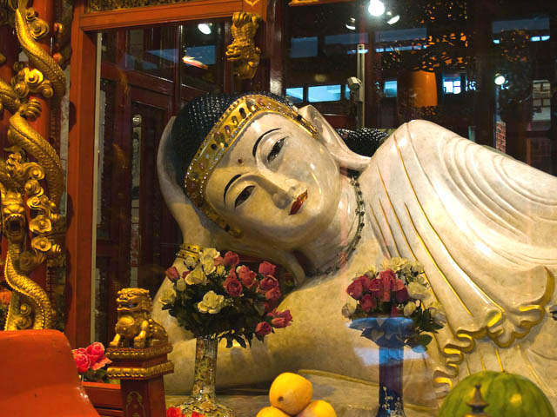
But China also learned from its neighbors
-Learned about the cultivation of cotton and sugar from India
-Learned about fast-ripening and drought-resistant rice from Vietnam
-Awareness of Persian windmills encouraged the development of a distinct but related device in China
-Printing arose from China’s growing involvement with the world of Buddhism which put a spiritual premium on the reproduction of the Buddha’s image and of short religious texts which were carried as charms

Slide 25
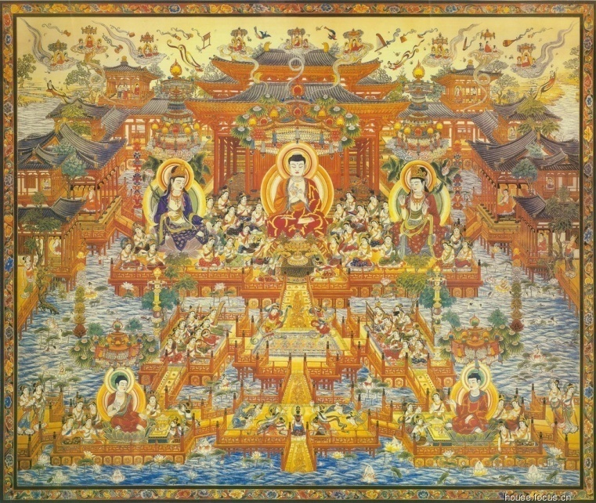
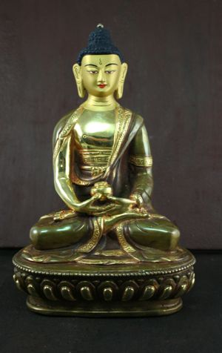
But Buddhism was the only large-scale cultural borrowing in Chinese history. While Buddhism entered via the Silk Roads during the Han dynasty, it was the collapse of the Han dynasty around 200 CE that increased its popularity. One of the most popular forms of Buddhism in China was the Pure Land School, in which faithfully repeating the name of an earlier Buddha, the Amitabha, was sufficient to ensure rebirth in a beautiful heavenly realm.

Slide 26
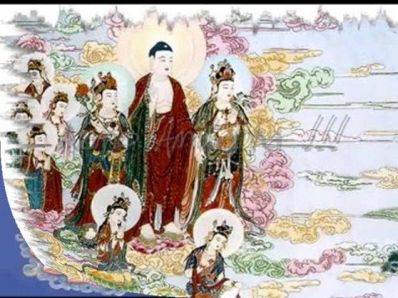
In what different ways did Korea, Vietnam, and Japan experience and respond to Chinese influence?
In what different ways did Japanese and Korean women experience the pressures of Confucian orthodoxy?
In what ways did China participate in the world of Eurasian commerce and exchange, and with what outcomes?
What facilitated the rooting of Buddhism within China?

