Slide 1
The Communist Revolution in China
AP World History
Chapter 22
“The Rise and Fall of Communism”
(1917 – Present)

Slide 2
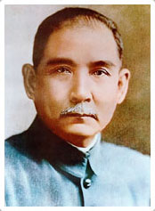
Review: Collapse of the Imperial System in China
1911 = End of the last (Qing) dynasty
1912 = China became the Republic of China
Republic of China ruled from 1912 until 1949
First president of the Republic of China = Sun Yat-sen

Slide 3
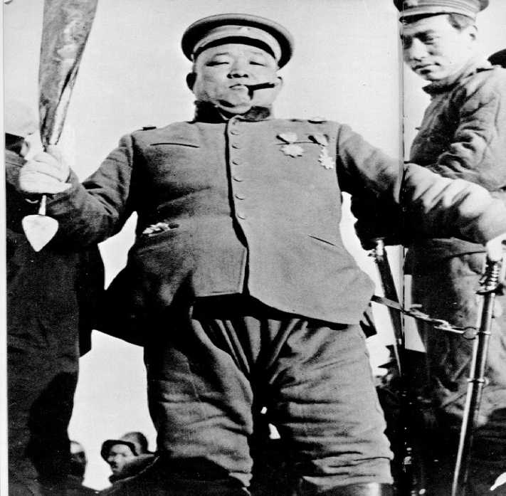
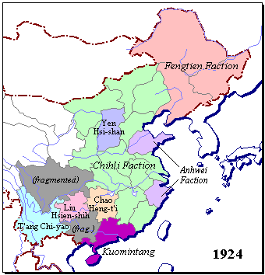
Warlords in the 1920s
1916 – 1928 = China’s central government fractured and various warlords ruled different sections of China
(Like Yuan Shi-kai)
China in 1924

Slide 4
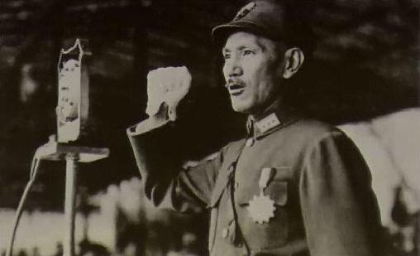
The Nationalist Party
1928 = The Nationalist Party gained control of China and reestablished a unified central government
Under the leadership of Chian Kai-shek = a military officer
He led the Nationalist Party until 1949

Slide 5
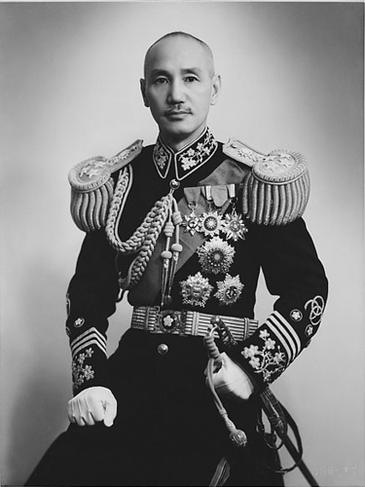
The Nationalist Party
Promoted modern development
Railroads, banking, airline services, etc.
Problem #1: Impacts of these achievements only in the cities → rural areas (where most of the population lived) were still impoverished
Problem #2: Left the Nationalist Party with a limited base of support
Urban elites; rural landlords; Western powers
Chiang Kai-shek

Slide 6
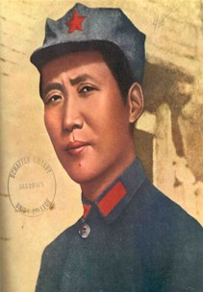
The Nationalist Party
Constantly faced opposition from the newly developed Chinese Communist Party (CCP)
Founded in 1921
Grew enormously over the next 28 years
Found a charismatic leader in Mao Zedong
Mao Zedong as a young revolutionary

Slide 7
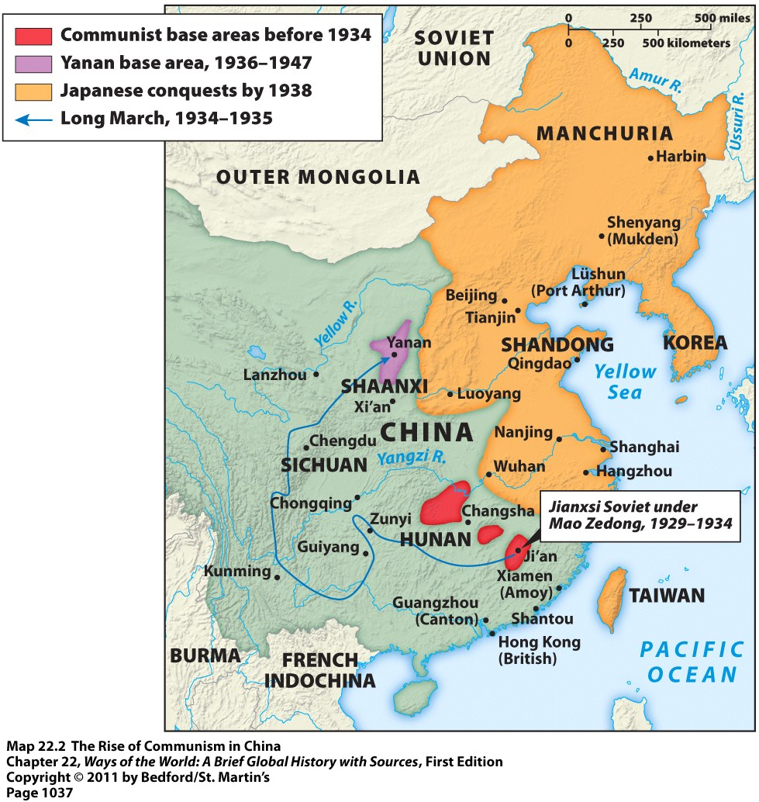
The Nationalist Party
1927 = Nationalist Party chased the CCP out of China’s cities
CCP developed a new strategy = appeal to China’s peasants for support

Slide 8
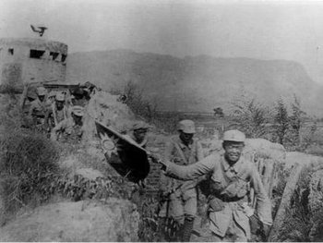
Chinese Communist Party
Slowly gained the respect and support of the peasants by:
Using guerrilla warfare tactics against the Nationalist Party
Experimenting with land reform in areas under communist control
Efforts to empower women
Creation of a communist military force to protect against Nationalist Party attacks
Chinese Communist Guerrillas

Slide 9
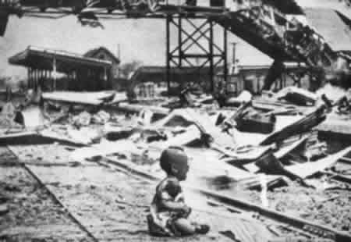
Chinese Communist Party
CCP gained an enormous amount of support during Japan’s brutal invasion of China
Nationalist Party lost control over most of China and was forced to retreat to the interior
Nationalist Party seemed more concerned with eliminating the CCP than fighting Japan
Japanese Invasion of China, 1937

Slide 10
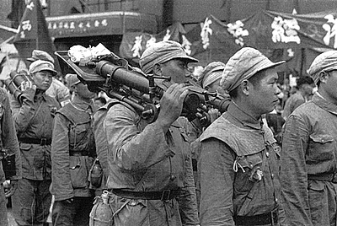
Chinese Communist Party
CCP, with its communist-led People’s Liberation Army, fought the Japanese vigorously
Offered security to many Chinese faced with Japanese atrocities
CCP membership grew from 40,000 in 1937 to 1.2 million in 1945
The People’s Liberation Army (late-1940s)

Slide 11
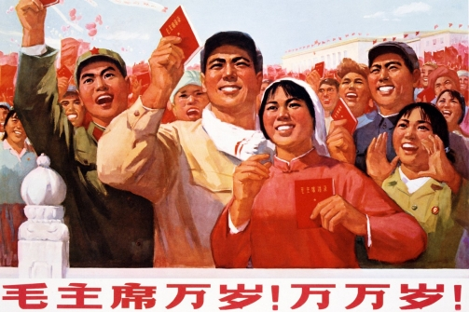
Chinese Communist Party
The CCP gained even more support by doing the following in areas it controlled:
Reduced rents, taxes, and interest rates for peasants
Taught literacy to adults
Mobilized women for the struggle
Encouraged peasants to fight back against their landlords

Slide 12
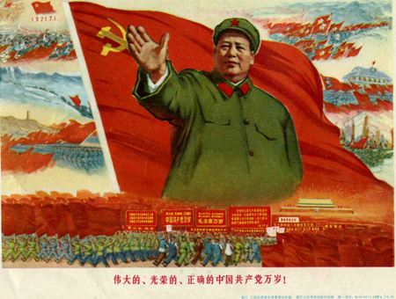
Chinese Communist Party
In 1949, 4 years after WWII, the CCP swept to victory over the Nationalist Party
Most of the Nationalist Party’s leaders fled to Taiwan
New leader of communist China = Mao Zedong

Slide 13
Building Socialism in China and the Soviet Union

Slide 14
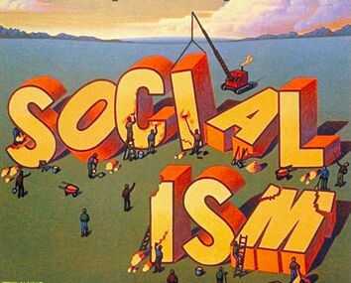
Building Socialism
1st step in building socialism = modernization and industrialization of their “backward societies”
Simultaneously wanted to eliminate inequalities of class and gender, prevent the growth of new inequalities as they modernized, and promote values of selflessness and collectivism
In order to do this, government had to be completely dominated by the Communist Party

Slide 15
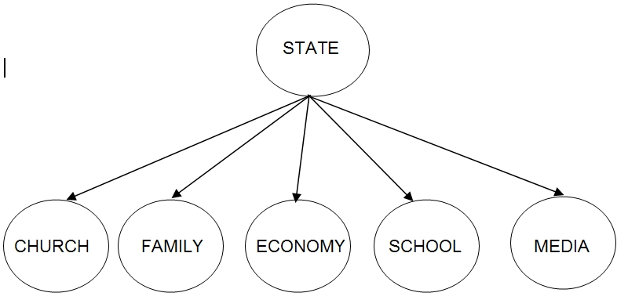
Building Socialism
Communist governments in China and the Soviet Union, therefore, became totalitarian:
Other political parties forbidden
Government controlled almost the entire economy
Government ensured that the arts, education and media conformed to approved ways of thinking
Organizations for women, workers, students, and professional groups operated under party control

Slide 16
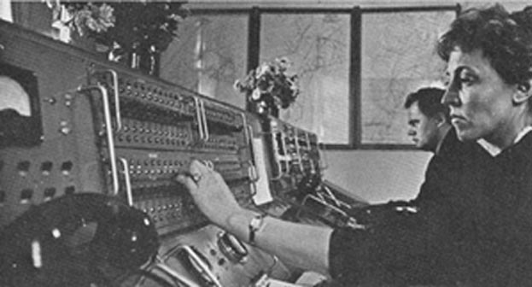
Communist Feminism
Both communist regimes took steps to liberate and mobilize their women
State-directed women’s initiatives
A man and woman working side-by-side as power plant operators in the Soviet Union

Slide 17
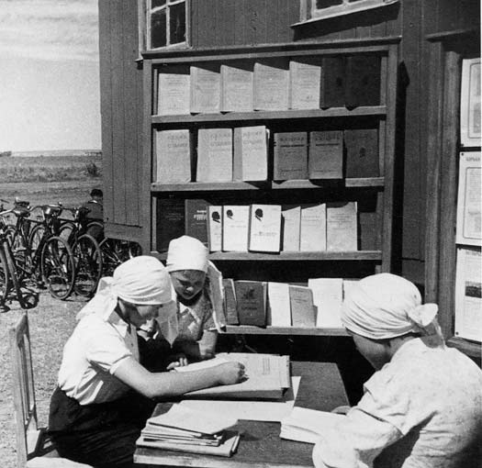
Communist Feminism in the USSR
As a result of laws and decrees passed by the Soviet Union:
Women were granted full legal and political equality
Divorce was legalized and made easier
Abortions were legalized and made easier
Marriage became a civil procedure among freely consenting adults
Illegitimacy was abolished
Women no longer had to take their husbands’ last names
Pregnancy leave for employed women was mandated
Women were actively mobilized as industrial workers
Soviet women reading and studying

Slide 18
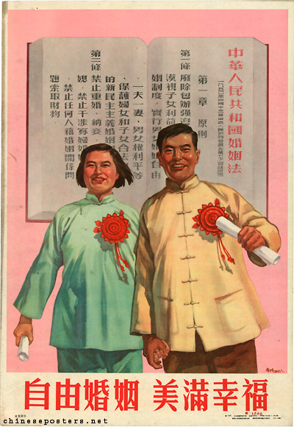
Communist Feminism in China
The Marriage Law of 1950 in China implemented:
Free choice in marriage
Relatively easy divorce
The end of concubines and child marriages
Permission for widows to remarry
Equal property rights for men and women
Chinese women also became more involved in industrial production

Slide 19
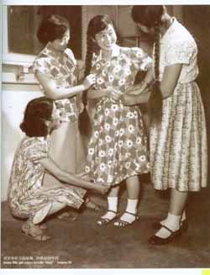
Communist Feminism
Problems for women:
Still expected to take care of the children and the housework → now had the double burden of that PLUS paid employment
Women appeared only very rarely in the top political leadership
Communist feminism did not continue and faded within a decade of its beginning in each country

Slide 20
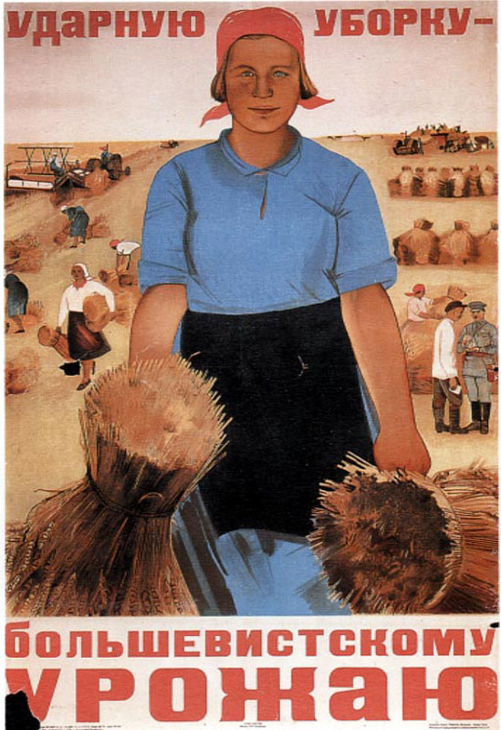
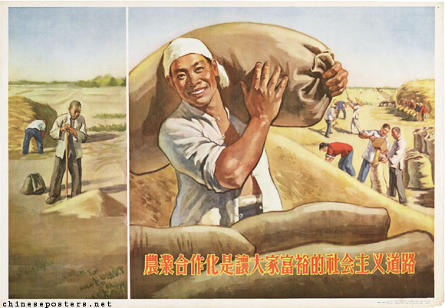
Socialism in the Countryside
1st stage of socialism in the countryside = involved taking over landlords’ estates and redistributing that land equally among the peasants
2nd stage of socialism in the countryside = collectivization of agriculture
Designed to completely end private property

Slide 21
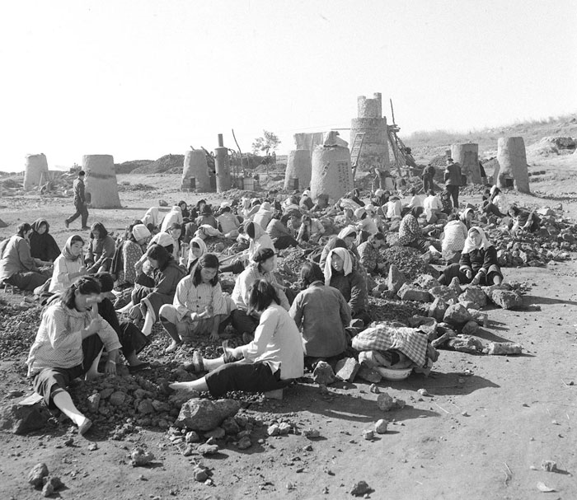
Collectivization in China
Peaceful process → due to the close relationship between the CCP and the peasantry
“Great Leap Forward” in the late-1950s = an effort to mobilize China’s population for rapid development
Created “people’s communes”
Designed to move toward a more fully communist society with more social equality and collective living
Massive famine caused by administrative chaos and bad weather killed 20 million Chinese between 1959 and 1962
Some communes had up to
2,000 households

Slide 22
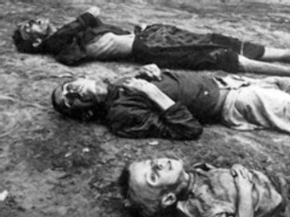
Collectivization in the Soviet Union
Much more violent process → Soviet communists did not have much support in the countryside
Peasants were forced into collective farms
A lot of resistance from the peasants → example: many of them slaughtered and consumed hundreds of thousands of animals because they didn’t want to surrender them to the collectives
Terrible famine ensued → caused about 5 million deaths
Victims of the Famine

Slide 23
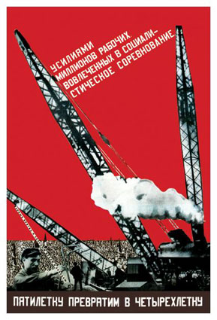
Communism and Industrial Development
China used the same model for industrial development that the Soviet Union had developed decades earlier:
A series of five-year plans = brought all agricultural and industrial production under government control
State ownership of property
Priority = heavy industry
Massive mobilization of the nation’s human and material resources
Poster highlighting industrialization in the Soviet Union

Slide 24
Pros & Cons of Industrial Development (In both China & the Soviet Union)
Pros
Cons
Increased literacy rates
More educational opportunities
More social mobility
Rapid urbanization
Exploitation of the countryside to provide resources for industries in the cities
Growth of a bureaucratic and technological elite class with more privileges

Slide 25
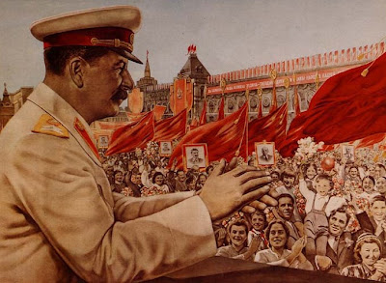
Responses to these Social Outcomes: Joseph Stalin
Largely accepted these outcomes
Stalin had created a conservative society that had abandoned much of its revolutionary legacy
Commitment to full equality = abandoned
Endorsed: Russian patriotism, traditional family values, individual competition, and differences in wages to stimulate production

Slide 26
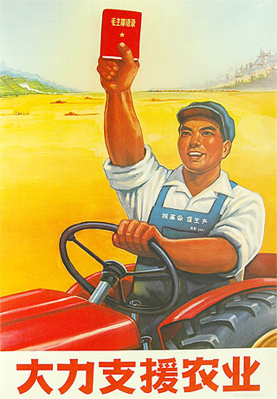
Responses to these Social Outcomes: Mao Zedong
Did not accept these outcomes → continuously strove to combat these inevitabilities of industrialization
Tried to preserve the “revolutionary spirit” of China
Mid-1960s = launched the Great Proletarian Cultural Revolution
Designed to combat the capitalist elements that had “infiltrated” China

Slide 27
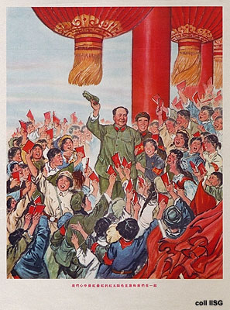
The Cultural Revolution (1966-1976)
A campaign against the “Four Olds” = old thoughts, old culture, old habits, and old customs
Message = revolution and rebellion is good
Wanted to put “intellectuals” in their place
Many schools were shut down
Wanted to establish a more equitable society
Brought healthcare, education, and rural industrialization to the countryside

Slide 28
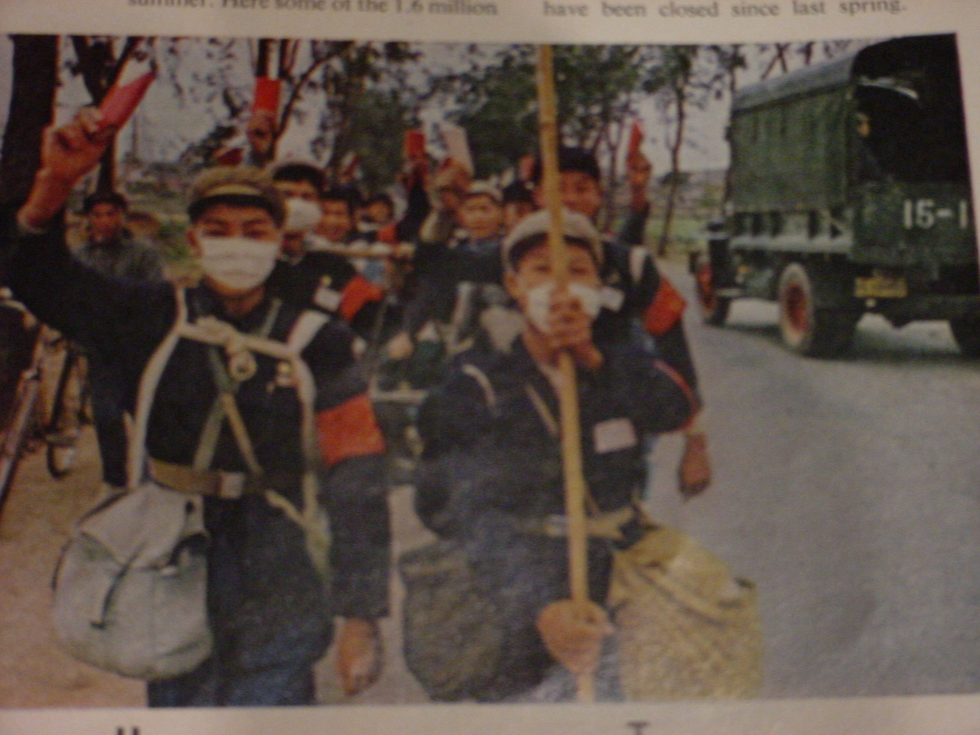
The Search for Enemies
Mao Zedong = convinced that many within the Communist Party had been “seduced” by capitalist values
Called for rebellion against Communist Party itself
Red Guards = students and other young people that responded
Red Guards attacked local party and government officials, teachers, intellectuals, factory managers, and others they defined as “enemies” that had embraced capitalism

Slide 29
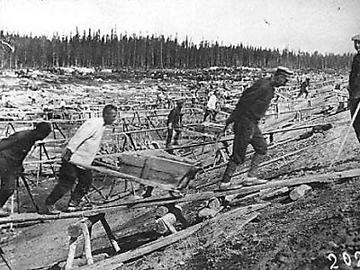
The Search for Enemies
Stalin used secret police to find “enemies” within the Soviet Union and his own Communist Party
Late 1930s = “The Terror” or “The Great Purges” → millions of people were arrested for treason/disloyalty (usually in the dead of night)
Tried and sentenced either to death or to long years in harsh and remote labor camps, known as the “gulag”
Workers at a Soviet Labor Camp

Slide 30
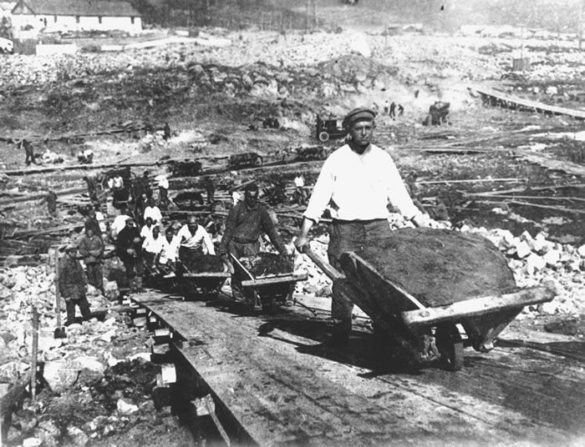
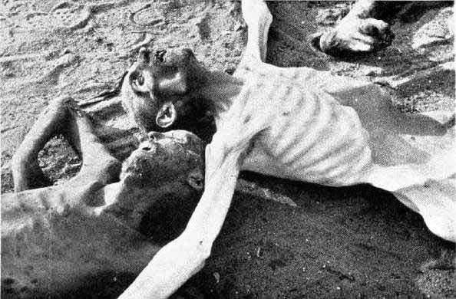
The Search for Enemies
Stalin had close to 1 million people executed between 1936 and 1941
About 5 million were sent to the gulag, where they died in appalling numbers
Throughout Stalin’s entire dictatorship, approximately 20 million people died in the Soviet Union

