Slide 1
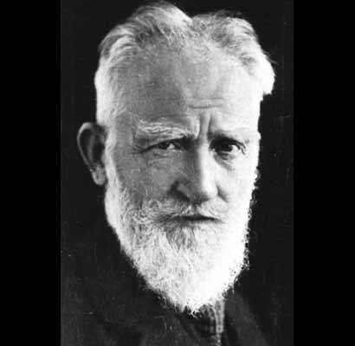
“Revolutions have never lightened the burden of tyranny: they have only shifted it to another shoulder”
George Bernard Shaw

Slide 2
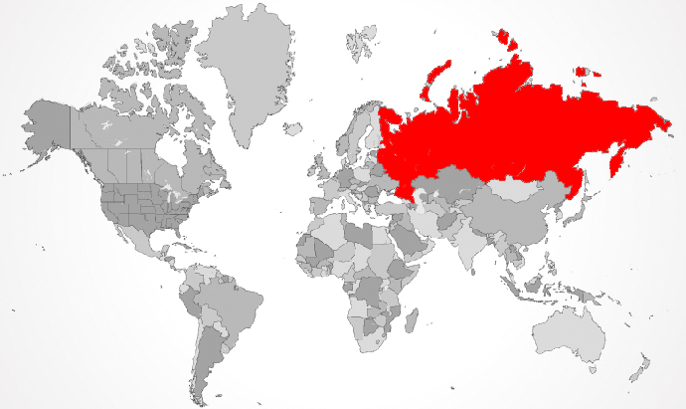
Industrialization progressed differently in different places but nowhere were the variations more apparent than in the United States and Russia
The United States was a young, vigorous, democratic, expanding country, populated largely by people of European descent, along with a substantial number of slaves of African origin
Russia was a country with its Eastern Orthodox Christianity, an autocratic tsar, a huge population of serfs, and an empire stretching across all of northern Asia
American industrialization began in the textile industry of New England during the 1820s but grew explosively in the half century following the Civil War (1861-1865)

Slide 3
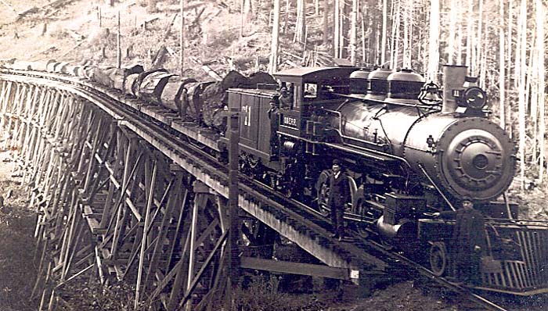
The sheer size of the United States coupled with its ready availability of natural resources, a growing domestic market, and relative political stability combined to make the United States the world’s leading industrial power by 1914. But industrialization in the U.S. was closely linked to that of Europe. About one-third of the capital investment that financed its remarkable growth came from British, French, and German capitalists. But the overall economic strength of the U.S. was sufficient to avoid dependency.

Slide 4
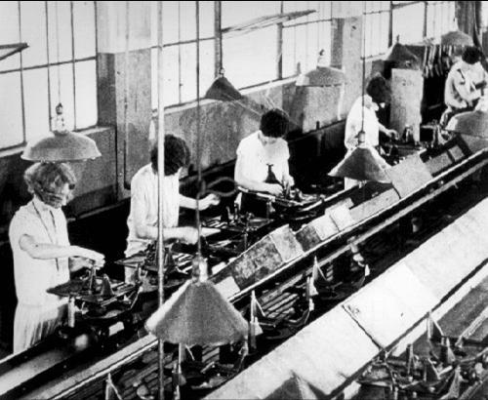
The U.S. government played an important role in industrialization, though less directly than in Germany or Japan
Tax breaks, huge grants of public land to railroad companies, laws enabling the easy formation of corporations, and the absence of much overt regulation of industry all fostered the rise of very large business enterprises
The U.S. also pioneered techniques of mass production, using interchangeable parts, the assembly line, and “scientific management” to produce for a mass market
The nation’s advertising agencies generated a middle-class “culture of consumption”
But by the 1850s and even more so by the 1890s, a growing gap had opened between the classes

Slide 5
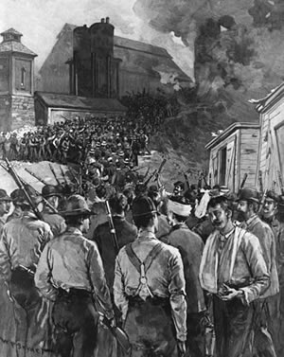
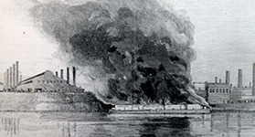
Employees worked every day of the year except Christmas and the Fourth of July, often for twelve hours a day. In every large city, slums existed within walking distance of the mansions of the well-to-do. As elsewhere, such conditions generated much labor protest, the formation of unions, and strikes, sometimes leading to violence. In 1892, the entire National Guard of Pennsylvania was sent to suppress a violent strike at the Homestead steel plant near Pittsburgh. Class consciousness and class conflict were intense in the industrial America of the late nineteenth and early twentieth centuries.

Slide 6
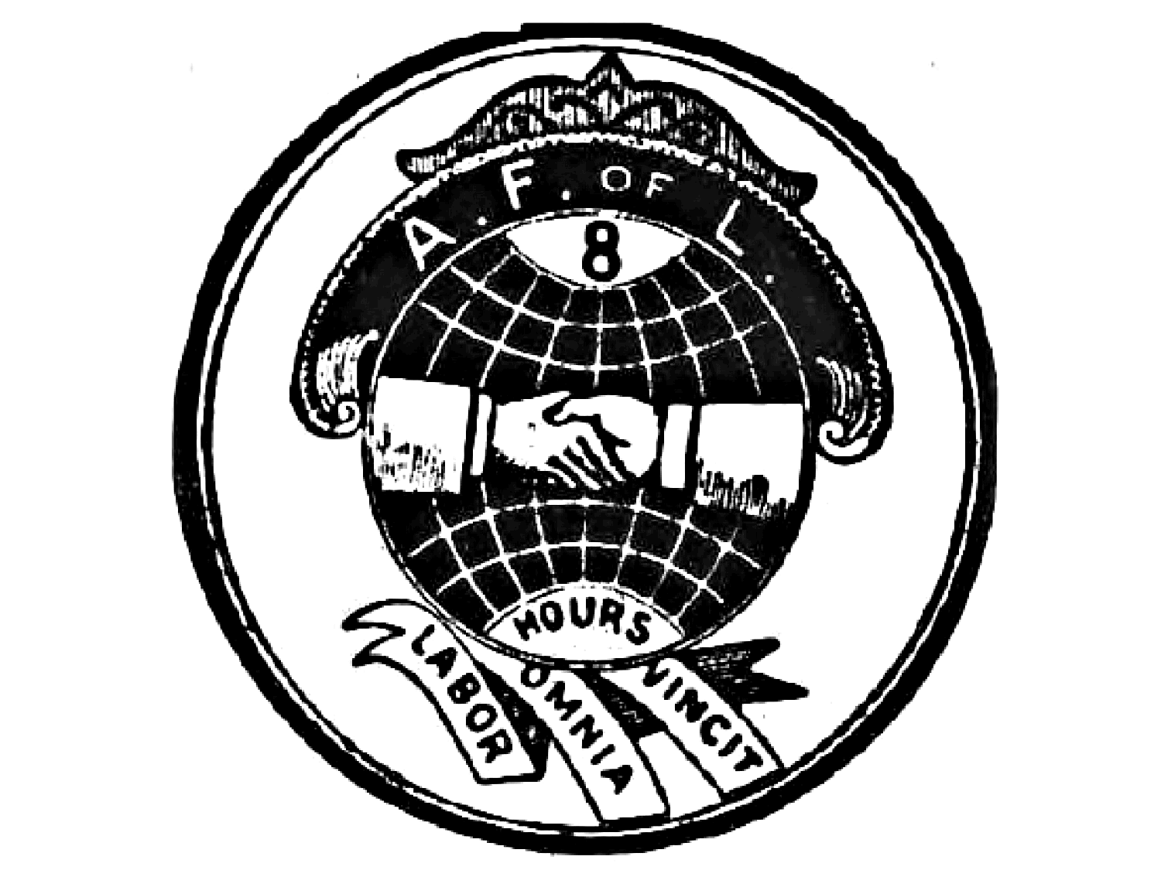
But, unlike many European countries, no major political party emerged in the United States to represent the interests of the working class
Nor did the ideas of socialism, and especially Marxism, appeal to American workers as much as they did in Europe
Even in the depths of the Great Depression of the 1930s, no major socialist movement emerged to champion American workers
Perhaps an answer lies in the relative conservatism of major American union organizations, especially the American Federation of Labor
Its focus on skilled workers excluded the more radical unskilled laborers and its refusal to align with any party limited its political influence

Slide 7
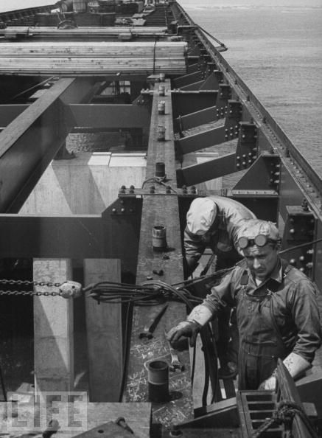
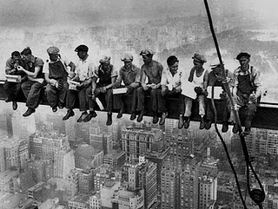
Furthermore, the immense religious, ethnic, and racial divisions of American society contrasted sharply with the more homogeneous populations of many European countries. These differences undermined the class solidarity of American workers. Moreover, the country’s remarkable economic growth generated on average a higher standard of living for American workers than their European counterparts experienced. Land was cheaper, and home ownership was more available. Workers with property generally found socialism less attractive.

Slide 8
By 1910, a particularly large group of white-collar workers in sales, services, and offices outnumbered factory laborers
Middle-class aspirations diluted impulses toward radicalism
But there were “populists,” whose ideas echoed most loudly among small farmers
Populists denounced banks, industrialists, monopolies, the existing money system, and both major political parties, which they saw as being controlled by the corporate interests of the eastern part of the country
But after reaching a high point in the mid-1890s, populism found little support in the growing industrial areas

Slide 9
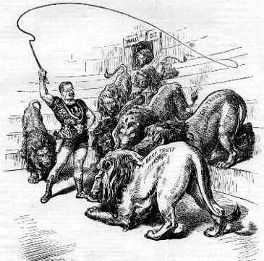
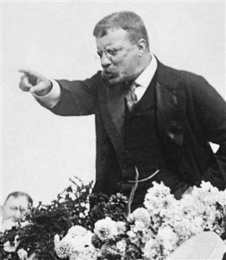
More successful, especially after 1900, were the Progressives, who sought to remedy the ills of industrialization through reforms such as wages-and-hours legislation, better sanitation standards, antitrust laws, and greater governmental intervention in the economy. Presidents Theodore Roosevelt and Woodrow Wilson championed the ideas of Progressives. While progressives experienced popularity, socialism came to be defined as fundamentally “un-American” in a country that valued individualism and feared “big government.”

Slide 10
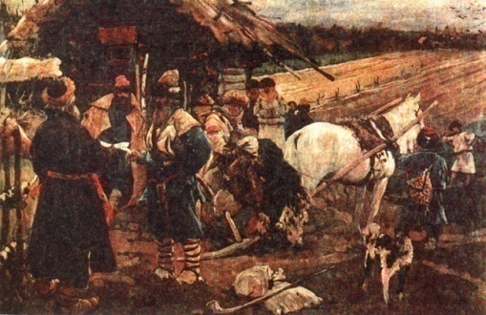
But while the United States was the Western world’s most exuberant democracy in the nineteenth century, Russia remained the sole outpost of absolute monarchy
At the beginning of the twentieth century, Russia still had no national parliament, no legal political parties, and no nationwide elections
The tsar, answerable to God alone, ruled unchecked
Russian society was dominated by a titled nobility of various ranks
Until 1861, most Russians were peasant serfs, bound to the estates of their masters, subject to sale, greatly exploited, and largely at the mercy of their owners

Slide 11
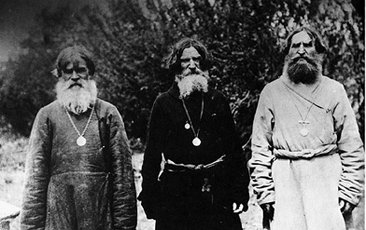
In Russia, serfdom approximated slavery. A vast gulf separated these two classes. Many nobles were highly Westernized, some speaking French better than Russian, whereas serfs were steeped in a version of Orthodox Christianity that incorporated pre-Christian spirits, spells, curses, and magic.

Slide 12
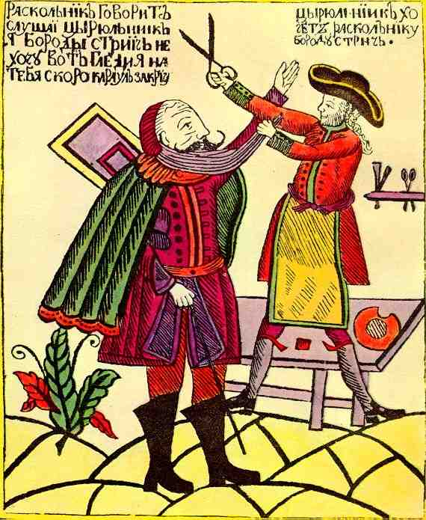
In autocratic Russia, change was far more initiated by the state in its continuing efforts to catch up with the more powerful and innovative states of Europe
Peter the Great (reigned 1689-1725) was an early example of this
Peter enlarged and modernized Russia’s military forces, established a new educational system for the sons of noblemen, and organized dozens of manufacturing enterprises
Russian nobles were instructed to dress in European styles and to shave their sacred and much-revered beards
The newly created capital of St. Petersburg was to be Russia’s “window on the west”

Slide 13
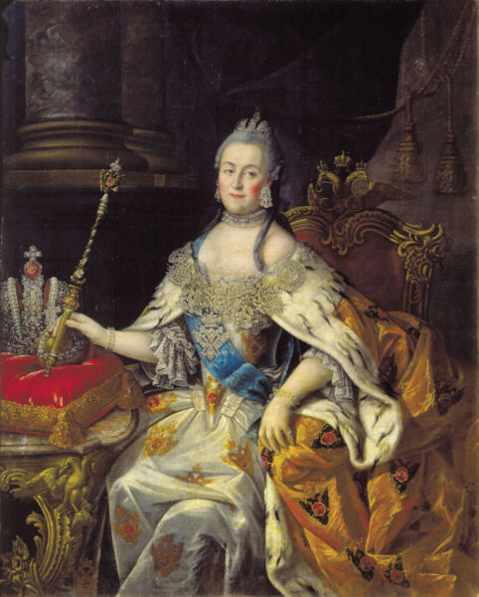
One of Peter’s successors, Catherine the Great (reigned 1762-1796), continued Peter’s efforts to modernize and westernize Russia. The tsarina viewed herself as an heir to the European Enlightenment. However, Catherine would not part with her absolute power and ruled as an Enlightened Despot.

Slide 14
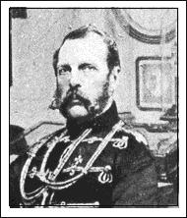
State-directed change continued in the nineteenth century with the freeing of the serfs in 1861, an action stimulated by military defeat at the hands of the British and French in the Crimean War (1854-1856)
To many thoughtful Russians, serfdom seemed incompatible with modern civilization
Thus, beginning in the 1860s, Russia began a program of industrial development, which was more heavily directed by the state than in Western Europe or the United States
By the 1890s, Russia’s Industrial Revolution was launched and growing rapidly
It focused particularly on railroads and heavy industry and was fueled by a substantial amount of foreign investment

Slide 15
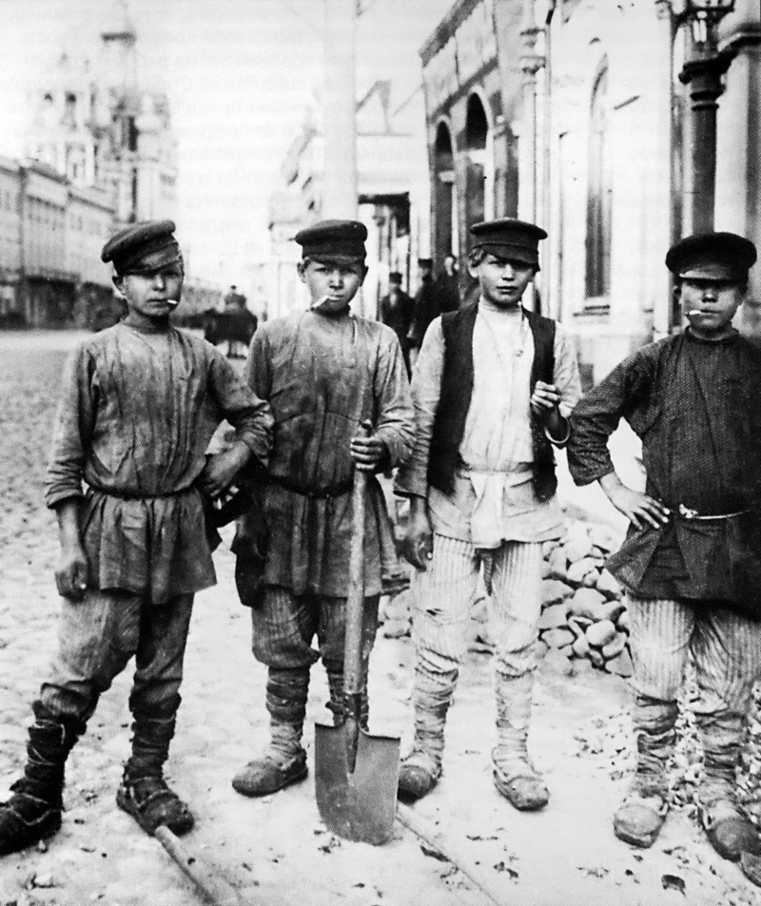
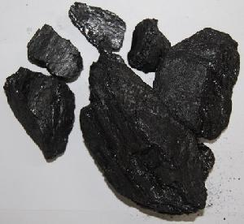
By 1900, Russia ranked fourth in the world in steel production and had major industries in coal, textiles, and oil. Its industrial enterprises, still modest in comparison to those of Europe, were concentrated in a few major cities – Moscow, St. Petersburg, and Kiev – and took place in factories far larger than in most of Western Europe.

Slide 16
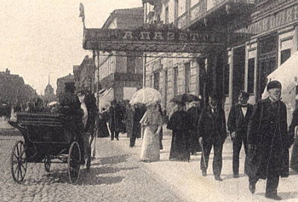
All of this contributed to the explosive social outcomes of Russian industrialization
A growing middle class of businessmen and professionals increasingly took shape
Many in the middle class objected to the conservatism of tsarist Russia and sought a greater role in political life
But they were also dependent on the state for contracts and jobs and were required to suppress the growing radicalism of the workers, a radicalism which they feared
Although factory workers constituted only about 5 percent of Russia’s total population, they quickly developed an unusually radical class consciousness, based on harsh conditions and the absence of any legal outlet for grievances

Slide 17
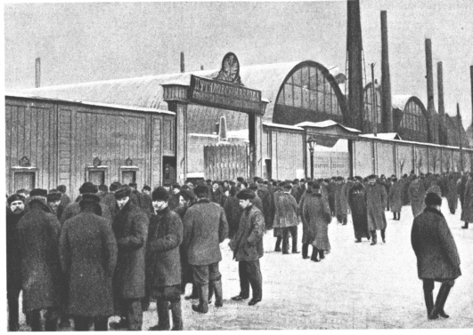
Until 1897, a thirteen-hour working day was common. Ruthless discipline and overt disrespect from supervisors created resentment, while life in large and unsanitary barracks added to workers’ sense of injustice. In the absence of legal unions or political parties, these grievances often erupted in the form of large-scale strikes.

Slide 18
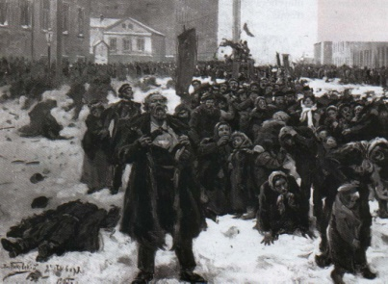
In these conditions, a small but growing number of educated Russians found in Marxist socialism a way of understanding the changes they witnessed daily and hope for the future in a revolutionary upheaval of workers
In 1898, they created an illegal Russian Social-Democratic Labor Party
In 1905, following Russia’s defeat in a naval war with Japan, spontaneous insurrection erupted
Workers in Moscow and St. Petersburg went on strike and created their own representative councils called soviets
While the 1905 revolution was brutally suppressed, the tsar was forced to make more substantial reforms

Slide 19
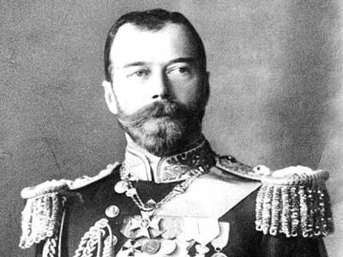
A constitution was granted, trade unions and political parties were legalized, and the election of a national assembly, called the Duma, was allowed. But by 1914, some 1,250,000 workers, representing about 40 percent of the entire industrial workforce, went out on strike. Thus, the tsar’s limited political reforms failed to tame the working-class radicalism or to bring social stability to Russia. In 1906-1907, when a newly elected Duma refused to cooperate with the tsar’s new political system, Tsar Nicholas II twice dissolved the elected body and finally changed the electoral laws to favor the landed nobility.

Slide 20
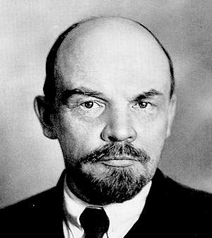
World War I provided revolutionary groups an opportunity
The enormous hardships of the war, coupled with the tensions of industrialization within an autocratic political system, sparked the Russian Revolution of 1917
This upheaval quickly brought to power the most radical of the socialist groups, the Bolsheviks under the charismatic leadership of Vladimir Ulyanov, better known as Lenin
Only in Russia was industrialization associated with violent social revolution
And only in Russia was a socialist political party, inspired by the teachings of Karl Marx, able to seize power, thus launching the modern world’s first socialist society

Slide 21
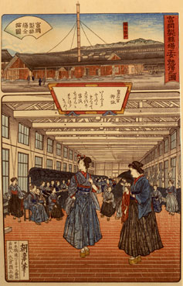
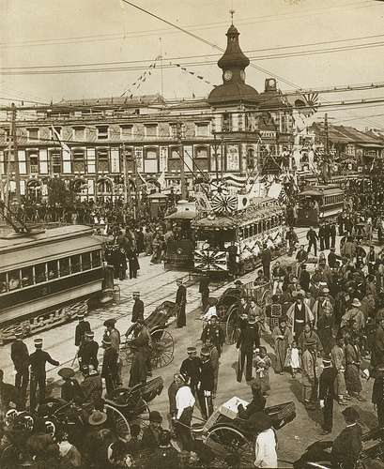
Beyond the world of Europe and North America, only Japan during the Meiji Restoration (1868-1912) underwent a major industrial transformation during the nineteenth century, which was part of that country’s overall response to the threat of European aggression (Commodore Perry’s arrival and the ending of isolationism in Japan).

Slide 22
However, even in societies that did not experience their own Industrial Revolution, the profound impact of European and North American industrialization was hard to avoid
After independence was achieved in the Spanish colonies, political life was turbulent and unstable in the new countries of Latin America
Conservatives favored centralized authority and sought to maintain the social status quo of the colonial era in alliance with the Catholic Church, which at independence, owned perhaps half of all productive land
Their bitter opponents were liberals, who attacked the Church in the name of the Enlightenment and sought modest social reforms and federalism

Slide 23
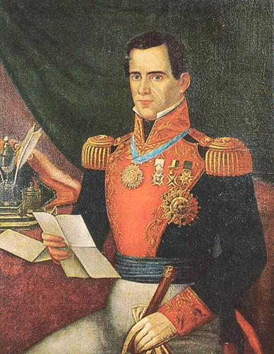
In many countries, conflicts between these factions, often violent, enabled military strong men known as caudillos to achieve power as defenders of order and property.

Slide 24
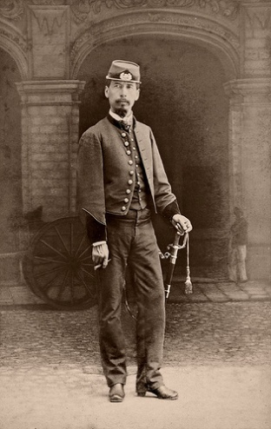
Social life did not change fundamentally in the aftermath of independence
Slavery was abolished but it persisted in both Brazil and Cuba until the late 1880s
But while legal distinctions among various racial categories disappeared after independence, productive economic resources remained overwhelmingly in the hands of creole whites, who were culturally oriented toward Europe
The military provided an avenue of mobility for a few skilled and ambitious mestizo men, some of whom subsequently became caudillos
Other mixed-race people found a place in a small middle class as teachers, shopkeepers, or artisans

Slide 25
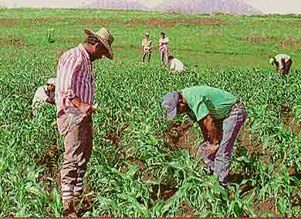
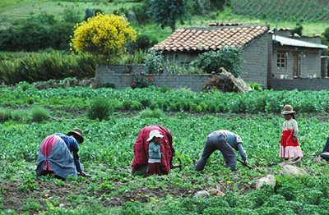
The vast majority – blacks, Indians, and many mixed-race people – remained impoverished, working small subsistence farms or laboring in the mines or on the haciendas (plantations) of the well-to-do. Only rarely did the poor and dispossessed actively rebel against their social betters. One such case was the Caste War of Yucatán (1847-1901), a prolonged struggle of the Maya people of Mexico, aimed at cleansing their land of European and mestizo intruders.

Slide 26
During the second half of the nineteenth century, Latin America became more closely integrated into a world economy driven by industrialization in Western Europe and North America
The new technology of the steamship cut the sailing time between Britain and Argentina almost in half, while the underwater telegraph instantly brought the latest news and fashions of Europe to Latin America
The most significant economic outcome of this growing interaction was a rapid growth of Latin American exports to the industrializing countries, which now needed the food products, raw materials, and markets of these new nations
Mexico continued to produce large amounts of silver

Slide 27
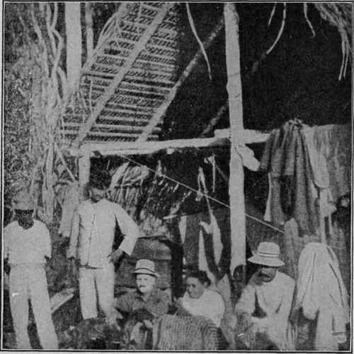
Now added to the list of raw materials flowing out of Latin America were copper from Chile, a metal that the growing electrical industry required, tin from Bolivia, and nitrates from Chile and guano from Peru, both of which were used for fertilizer. Wild rubber from the Amazon rain forest was in great demand for bicycle and automobile tires, as was sisal from Mexico, used to make binder twine for the proliferating mechanical harvesters of North America.

Slide 28
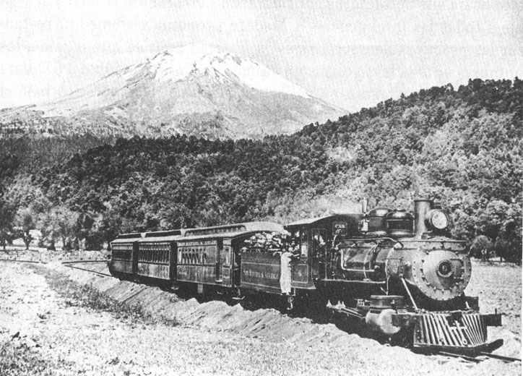
In return for these primary products, Latin Americans imported textiles, machinery, tools, weapons, and luxury goods of Europe and the United States
Accompanying this commerce was large-scale investment of European capital in Latin America, $10 billion alone between 1870 and 1919
Most of this capital came from Great Britain, which invested more in Argentina in the late nineteenth century than in its colony of India
By 1910, U.S. business interests controlled 40 percent of Mexican property and produced half of its oil
Much of this capital was used to build railroads, largely to funnel Latin American exports to the coast

Slide 29
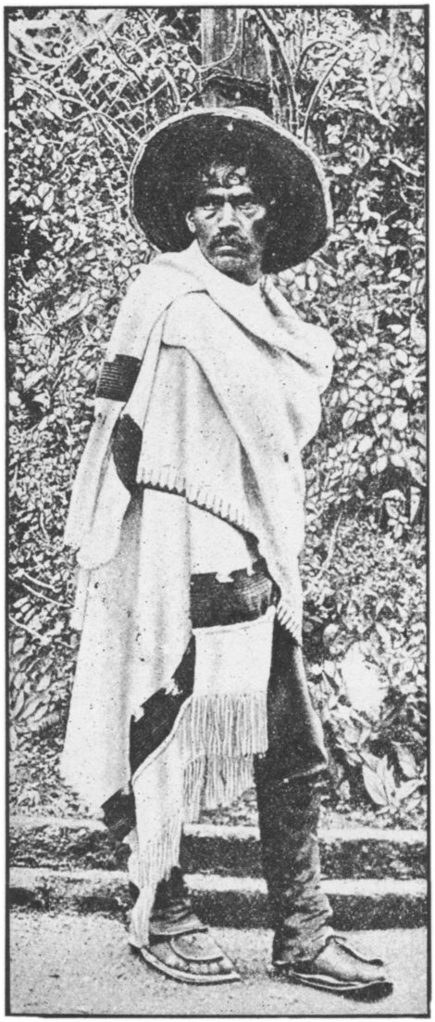
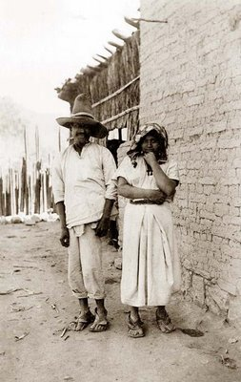
While urbanization proceeded rapidly in Latin America, the vast majority of the lower classes lived in rural areas, where they suffered the most and benefitted the least from the export boom. Peasant indebtedness to wealthy landowners combined to push many farmers off their land or into remote and poor areas where they could barely make a living. Many ended up as dependent laborers or peons on the haciendas of the wealthy.

Slide 30
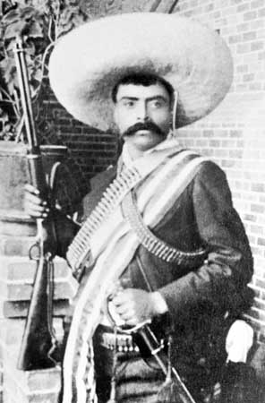
Yet only in Mexico did these vast inequalities erupt into a nationwide revolution
In the early twentieth century, middle-class reformers joined with workers and peasants to overthrow the dictatorship of Porfirio Díaz (1876-1911)
What followed was a decade of bloody conflict (1910-1920) that cost Mexico some 1 million lives, or roughly 10 percent of the population
Huge peasant armies under charismatic leaders such as Pancho Villa and Emiliano Zapata helped oust Díaz
But Villa and Zapata were unable to seize state power because they were hobbled by factionalism which focused on local or regional issues

Slide 31
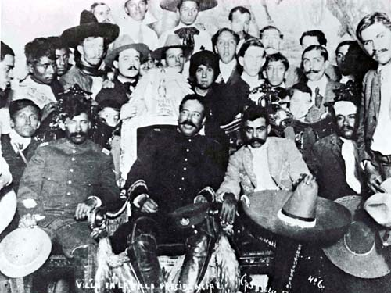
When the dust finally settled, Mexico had a new constitution (1917) that proclaimed universal suffrage; provided for the redistribution of land; stripped the Catholic Church of any role in public education and forbade it to own land; announced unheard-of rights for workers, such as a minimum wage and an eight-hour workday; and placed restrictions on foreign property ownership.

Slide 32
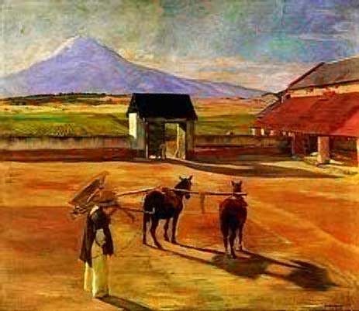
Perhaps the most significant outcome of the export boom lay in what did not happen
For nowhere in Latin America did it jump-start industrialization
A social structure that regulated some 90 percent of its population to an impoverished lower class generated only a very small market for manufactured goods
Latin America developed a form of economic growth that was largely financed by capital from abroad and dependent on European and North American prosperity and decisions
Later critics saw this “dependent development” as a new form of colonialism, expressed in the power exercised by foreign investors

Slide 33
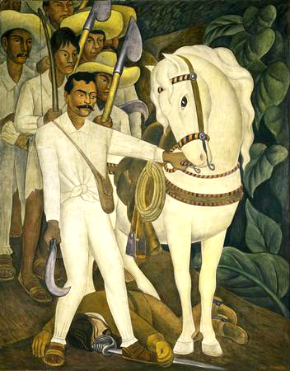
Strayer Questions
What were the differences between industrialization in the United States and that in Russia?
Why did Marxist socialism not take root in the United States?
What factors contributed to the making of a revolutionary situation in Russia by the beginning of the twentieth century?
In what ways and with what impact was Latin America linked to the global economy of the nineteenth century?
Did Latin America follow or diverge from the historical path of Europe during the nineteenth century?

