Slide 1
Europe in the Middle Ages
AP World History

Slide 2
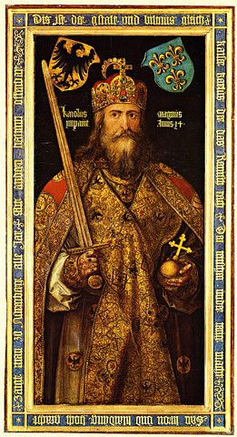
Quest for Political Order
Fall of roman Empire
Germanic Successors
The Franks
External invasions
Emperor Charlemagne

Slide 3
Fall of the Western Roman Empire

Slide 4
Germanic Successor States
Decentralized Society
German chieftains replace Roman rule
Germanic tradition replaced Roman law
Peasants turn to local lords for safety
Subsistence Agriculture
Power shifts from Italy to France

Slide 5
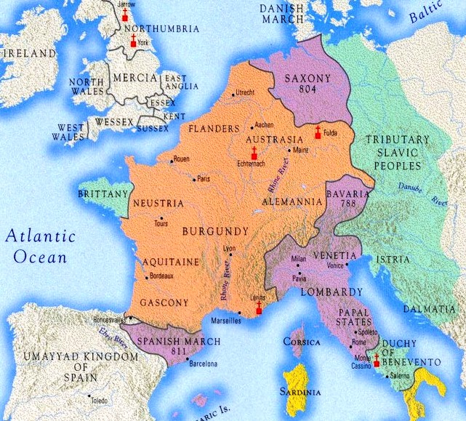
The Franks
Clovis I (466-511)
United the Franks
Converted to Christianity
Charles Martel (688-741)
Defeated Muslim at Tours
Charlemagne (742-814)
Centralized authority
Temporary revival of learning
Empire fell less than 30 years after his death
Battle of Tours, 732

Slide 6
External Invasions
External invasions by Vikings (purple), Magyars (green), and Muslims (red) completed the destruction of centralized rule in Western Europe.
European lords built a system of military and political relationships to protect their land. This system is called feudalism.

Slide 7
Medieval Society (600-1000)
Feudalism
Serfs and manors
The medieval Christian Church

Slide 8
European Feudalism
Kings and nobles gave land (fief ) to vassals (nobles) in exchange for military service
Control of land was hereditary
Vassals gave land to knights in exchange for military service
Knights were bound by a code of chivalry

Slide 9
European Feudalism

Slide 10
Knights and Castles
The Knight
The Castle
Castle Rising in England was built in 1138

Slide 11
Serfs and Manorialism
Agricultural manors were essential for maintaining the feudal system
Manors included a mill, church, workshops, and a village
Serfdom
Bound to the land
Cultivated land for lords in exchange for protection and a small plot of land
Also were responsible for weaving, building, etc.
Serfs were required to work their lords land three days a week. The rest of the time they could work the small plots of land provided to them by their lord.

Slide 12
Manorialism

Slide 13
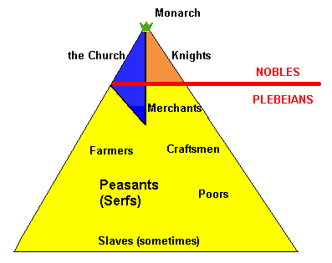
The Christian Church
Created moral standards
Owned extensive land throughout Western Europe
Struggled with secular rulers to be the dominant authority in Europe
Supported monasticism
Monks preserved literacy and learning
Nuns provided an additional opportunity for women

Slide 14
The Pope
Papal authority grew during early medieval period
Canon law
Excommunication
Investiture
Frequent power struggles between monarchs and the papacy
Henry IV and Gregory VII
A symbol of papal authority, Pope Gregory VII declared the church infallible and capable of removing emperors

Slide 15
Expansion of Europe
Vikings
Spanish Reconquista
The Crusades

Slide 16
Viking Expansion

Slide 17
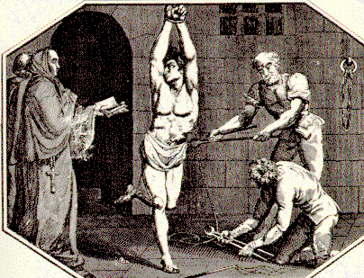
Spanish Reconquista
Began in small Christian states in northern Spain
By 1150 Christians had recaptured over half of Muslim Spain
Aided by organization and wealth of Catholic Church
Ended in 1492 with conquest of Granada
Drove Jews and Muslims from Spain
The Spanish Inquisition

Slide 18
The Crusades

Slide 19
High Middle Ages (1000-1500)
Establishment of regional states
European Economic Revival
social developments
Christianity during the high middle ages

Slide 20
Rise of Regional States
Holy Roman Empire (Germany)
“neither holy, nor Roman, nor an empire”
Conflicts with church prevented creation of a powerful state
France
Capetian dynasty consolidated feudal estates into a centralized government
Feudal monarchy
Italy
Dominated by powerful city-states: Rome (papal state), Florence, Genoa, Milan, Venice, etc.

Slide 21
Europe in the High Middle Ages

Slide 22
Rise of Monarchy in England
William of Normandy conquered England in 1066
Feudalism with centralized approach
Magna Carta signed by King John in 1215
Created parliamentary system
Parliament must approve changes in taxation
Does NOT create a democratic system
King John, enemy of Robin Hood, was forced to sign the Magna Carta in 1215

Slide 23
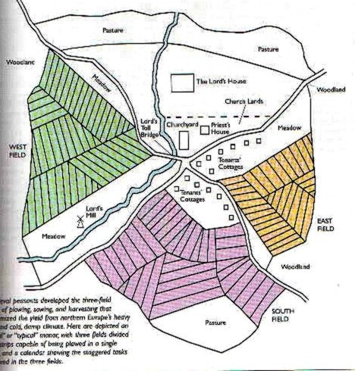
European Economic Revival
Changing Agricultural Economy
Technology: improved plows, watermills, the horse collar, and the horseshoe
Crop rotation and the three-field system
Population growth
800 CE—29 Million
1100 CE—44 Million
1300 CE—79 Million
Population growth led to urbanization
London, Paris, Toledo, etc.
Some towns challenged the authority of their feudal lord

Slide 24
European Economic Revival
Urbanization increased specialization of labor
Guilds created regulations between craftsmen
Protect prices, regulate production, etc.
Specialized labor increased manufacturing
Manufacturing focused on wool textiles
Woolen textiles dominated by Italy and Flanders (Belgium)
Increased manufacturing led to increased trade
Italian merchants dominated trade in the Mediterranean
Increased involvement in the Afro-Eurasian trade network
Silk Roads, Trans-Saharan, etc.
Hanseatic League promotes trade in northern Europe

Slide 25
Trade in the High Middle Ages
Venetian and Genoese merchants established colonies in major trade ports of Alexandria, Constantinople, Cairo, Damascus, etc.

Slide 26
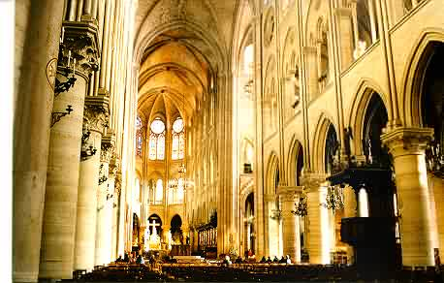
Social Developments
Status of women improved
Chivalry promoted respect for women
Urbanization created more job opportunities for women
All-female guilds
Worked same jobs as their husbands
Increased veneration of the Virgin Mary
Mary symbolized ideals of womanhood, love, & sympathy
Cathedral of Notre Dame or “Our Lady”

Slide 27
Christianity in the High Middle Ages
Cathedral schools become universities
University of Paris, Oxford University, etc.
Rediscovery of works of Aristotle
Increased commerce with Muslims provided the West with access to Greek works
New intellectual movements
Thomas Aquinas and scholasticism
Combining Aristotle’s logic with Christianity to create the most truthful system of thought possible
Some reformers within in the church were worried about the materialism of the church

Slide 28
End of the Middle Ages
Bubonic Plague
Hundred Years War
The Italian Renaissance

Slide 29
Bubonic Plague
Silk Roads spread bubonic plague across Eurasia in the 14th century
In October 1347 a ship from the Crimea sailed into Messina. The crew had a "sickness clinging to their very bones.“
Rats carrying fleas got on shore spreading disease
Increased trade helped spread the plague
Close proximity, unsanitary conditions facilitated the spread into cities
25 million people died in the next several years, 1/4 to 1/3 of the population of Europe
Population rebounded within 200 years

Slide 30
Spread of Bubonic Plague

Slide 31
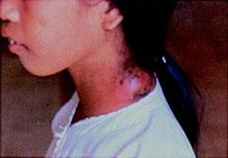
The Black Death
Victims “ate lunch with their friends and dinner with their ancestors in paradise”
-Geovanni Boccaccio

Slide 32
Impact of the Bubonic Plague
Profound impact on manorial economy
Labor became scarce in some places
Tenants, rent payers, made gains as feudal obligations were lowered
Some serfs were freed to keep them from running away to better opportunities
Wages rose in towns to keep workers happy
“The path to the Industrial Revolution began with the Black Death. The population fall increased labor mobility by creating many vacant farms, and that mobility undermined serfdom.” - Robert Allen

Slide 33
Hundred Years War (1337-1453)
A series of periodic military campaigns between England and France
New technology
Crossbows, longbows, pikes, firearms, and cannons
Castles & knights outdated
Monarchs maintain permanent militaries
Burning of Joan of Arc, 1431

Slide 34
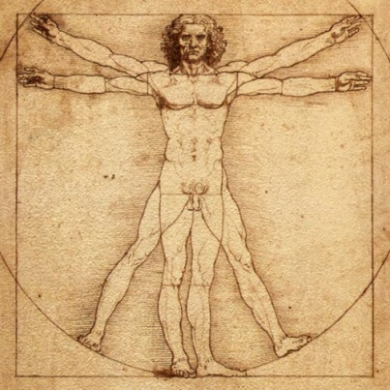
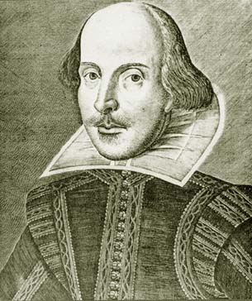
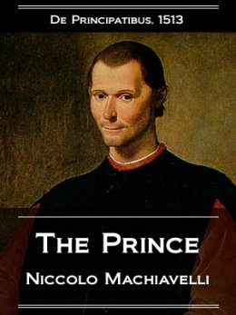
Italian Renaissance
Started in Italy during the 13th century
Why Italy?
Urban Growth & Wealth
Merchant Class Values
Classical Heritage
Main Idea: humanism
Study of human beings and human potential
Celebration of human life
Many different approaches to humanism
It is better to be feared than loved, if you cannot be both.

