Slide 1
Making sense of ISIS
Overview of the Threat of ISIS

Slide 2
What do you know?
With the people around you discuss the following:
What have you read, watched, or heard about the Islamic State (ISIS/ISIL)?
Terms and people associated with the group?
History and background?

Slide 3
Outline
Background and definition of group
Tracing the origins and rise of ISIS
Ideology
Goals
Organizational Structure
Establishment of a caliphate
Major players
Results, consequences, and costs
What now?

Slide 4
Conducting overview research on ISIS
Individually OR in a group of 3-4, address the following:
What and who is ISIS/ISIL? Difference?
Where do they operate? Where do they hold territory?
How do they operate and how are they organized?
Why did they rise to power and why do they continue to gain power? How are they financed? Weapons and military strategy?
What are their beliefs, ideology, goals, etc.? How do they hope to achieve these goals?
Who are the major players involved this global issue in the Middle East?
What has been the response to ISIS from nations/groups/organizations around the world?

Slide 5
Video Background
WSJ: ISIS Sparks a Crisis in the ME
NY Times: ISIS Goals and Tectics Worldwide
Crash Course ISIS
NY Times: Evolution of ISIS
NY times: Iraq's Factions and Their Goals
TED Talk: The surprising way groups like ISIS stay in power
TED Talk: A Global culture to fight extrememism

Slide 6
Map of the Middle East

Slide 9
Religious and ethnic groups in Iraq

Slide 11
Religious distribution in Syria

Slide 14
Definition of Terrorism
the use of violence and threats to intimidate or coerce, especially for political purposes.
the state of fear and submission produced by terrorism or terrorization.
a terroristic method of governing or of resisting a government.

Slide 15
Terrorist Organizations in ME
Hamas-Palestine, destruction of Israel, allegiance to Islam and jihad, rejection of negotiated peace settlement
Hizbollah-Lebanon, Party of God, anti-Israel, Shiite Islamic Ideology, work towards social and economic development in Leb.
Boko Haram-Nigeria, linked to Al Qaeda, Sunni, strict sharia law, wants Islamic state in Nigeria/West Africa
Al-Shabaab-Somalia affiliate of AQ, strict form of Salafism (like ISIS), Islamic State in Somalia free of foreigners and outside influence, anti-west
Taliban-Afghanistan and regions of Pakistan
Al Qaeda-global and militant, Salafist Sunni extremism

Slide 16
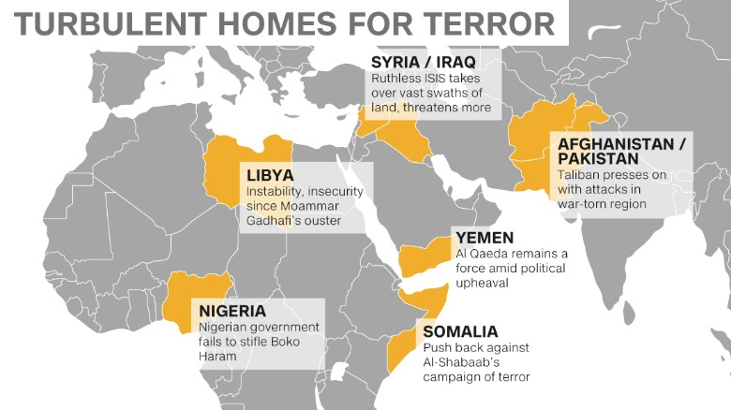

Slide 17
1. What is the Islamic State?
ISIS-Islamic State of Iraq and Syria OR ISIL-Islamic State of Iraq and the Levant
Terrorist group (from Western View)
Political and military organization with radical interpretation of Islam
Political philosophy that seeks to impose worldview by force on Muslims and non-Muslims alike
Expelled from Al-Qaeda b/c too extreme
Claims to be legitimate ruler of all Sunni Muslims worldwide
Established a “state” includes swaths of territory in Syria and Iraq, governed from Raqqa in Syria

Slide 18
1. What is the Islamic State?
Advances theological opinions to advance its claims
Adherents claim to be practicing Islam fully, those who disagree are takfir (heretics).
Religious justification for killing State’s opponents (slaughtering)
Originally founded by Abu Musab al-Zarqawi (Al-Qaeda in Iraq)
Participated in war in Iraq against America forces after fall of Saddam Hussein
2013 joined Syrian Civil War→ focused on building Islamic State
June 29, 2014 Islamic State declared establishment of Islamic caliphate with leader Abu Bakr al-Baghdadi

Slide 19
2. origins-Tracing the rise of isis
Began as group called Jamaat al-Tahwid wa-i-Jihad,1999
Focused on regime change in Jordan
Founder-Abu Musab al-Zarqawi
Poor background
Post 2003 invasion of Iraq by US, Zarqawi prominent Figure against American insurgency
Brutality, hatred of Shiites
JTWJ’s attacks include:
UN compound in Baghdad killed 22, August 2003
Simultaneous attacks kill 150 in Baghdad and Shiite holy city (Karbala) during festival, Feb. 2004
Beheadings of hostages, Sept. 2004

Slide 20
Abu musab al-Zarqawi

Slide 21
2. origins-Tracing the rise of isis
2004 became Al-Qaeda in Iraq (AQI)
Generational and class differences between jihadists aligned with Osama Bin Laden (Afghanistan) and AQI who fought with Zarqawi in Iraq
2006-Zarqawi absorbed smaller jihadists groups in Iraq
Focused on enforcing sharia law as a state, killed in 2006
2006 group became the Islamic State in Iraq (ISI)
Focused on conquering territory and forming sharia-based state
Local population turned against them (Anbar Province)
American forces and tribal militias pushed ISI out of Fallujah and Anbar→ many militias join Islamic State
Shiite Prime Minister, Maliki, sees threat to Shiite majority

Slide 22
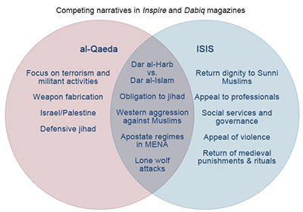

Slide 23
2. origins-Tracing the rise of isis
2010 Abu Bakr al-Baghdadi took over ISI rebuilding some popular support
Expansion into Syrian Civil War in 2013 (ISIS/ISIL)
Official split between AQ and ISIS-differed in methodology
ISIS-direct approach, seize territory, enforce sharia law immediately
AQ-willing to work with factions and attempt to build Isamic state later
2013-2014 ISIS built its power base in Syria (Raqqa)
Empowering allies and crushing enemies
Divide and rule=sustain territory
January 2014-Iraq, took parts of Fallujah and Ramadi in Anbar province, then Mosul
June 29, 2014 ISIS declared itself a caliphate and Abu Bakr al Baghdadi as Caliph Ibrahim
Called fro immediate loyalty of Muslims throughout the world

Slide 25
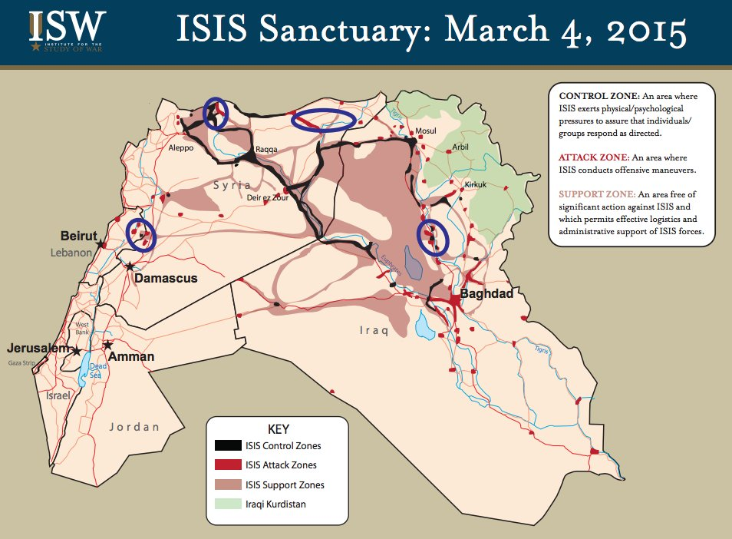

Slide 26
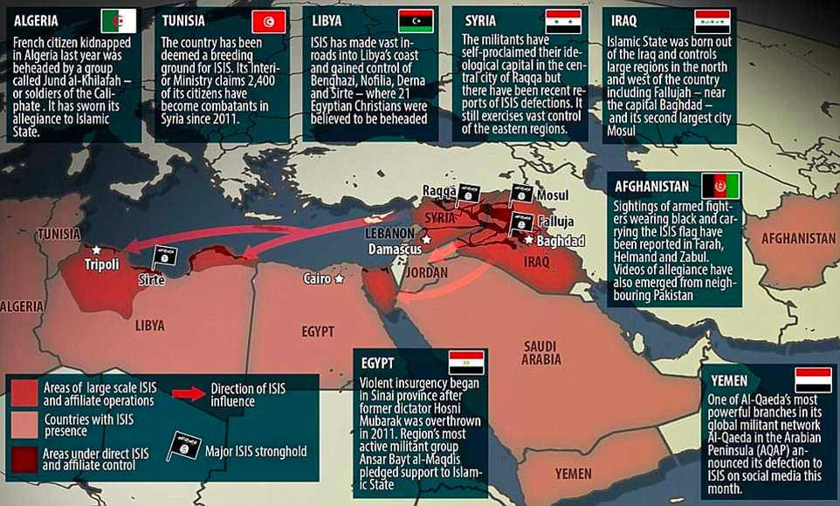

Slide 27
3. Ideology
Salafist-jihadism
no distinction between religion and state
Hardline interpretation of Sharia law, brutally enforced
Almost the same as AQ and Taliban but differs in approach, conditions, and timing to establish caliphate
Major Concepts
Return to original pure form of Islam practiced by Muhammad and earliest Muslims
Rejects alter additions as bid’ah (innovation) and un-Islamic
Doctrine allows proclamation of takfir (heretics) Muslims who stray from strictly defined Islam
Penalty is death
Infidels deserve death as stated in Quran and hadiths

Slide 28
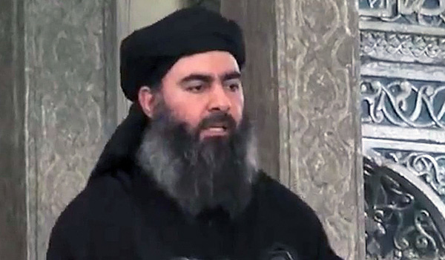
“My dear [Muslim] community: As we did not lie against God when we announced the Islamic State, so we do not lie against God when we say that it will persist…It will persist upon its creed (‘aqida) and its path (manhaj), and it has not, nor will it ever, substitute or abandon these”
–Abu Bakr al-Baghdadi, leader of the Islamic State, July 21, 2012

Slide 29
3. Ideology: doctrine
“Salafism focuses on eliminating idolatry (shirk) and affirming God’s Oneness (tawhid). Salafis view themselves as the only true Muslims, considering those who practice so-called “major idolatry” to be outside the bounds of the Islamic faith. Those worshiping—or perceived to be worshiping—stones, saints, tombs, etc., are considered apostates, deserters of the religion. These include the Shi‘a and, for many Salafis, democrats, or those participating in a democratic system. The Shi‘a are guilty of shirk on account of their excessive reverence of the Prophet Muhammad’s family, among other things, while democrats err in assigning “partners” to God in legislation, deemed the prerogative of the Divine Legislator.”
The Brookings Project on U.S. Relations with the Islamic World
Analysis Paper | No. 19, March 2015

Slide 30
3. ideology: development
Began in Egypt (Muslim Brotherhood) and concurrently with Wahhabism (state doctrine in Saudi Arabia)
Salafism and Wahhabism are closely connected and draw from early Islamic writing and practices
Jahiliyya- concept that Arabs were in a state of ignorance prior to the appearance of Muhammad and Islamic teachings and becomes a political philosophy
Anything other than strict adherence to sharia law
Calls for violent overthrow of of all contemporary Muslim regimes and replace with Islamic state

Slide 31
3. Ideology: The Apocalypse
Quran as tool of God’s plan and future
Shares some political goals as AQ-expulsion of non-Muslims from Arabian Pen. , abolishment of state of Israel, and end of support for dictatorship sin Muslims lands
End of Days beliefs
Arrival of Mahdi-messianic figure destined to lead Muslims to victory before the end of the world
“12 legitimate caliphs, and Baghdadi is eighth; that the armies of Rome will mass to meet the armies of Islam in northern Syria; and that Islam’s final showdown with anti-Messiah will occur in Jerusalem after a period of renewed Islamic Conquest (What Isis Really Wants?).”

Slide 32
4. Goals: What isis really wants
Short Term
Consolidate areas that it already controls and capture more territory in Syria and Iraq
Sectarian war in Iraq between Sunnis and Shiites (usually massacred)
Shiites=heretics and deserve death
Causing reprisal attacks from Shiite militia groups→ Sunnis run to Islamic State

Slide 33
4. Goals: What isis really wants
Medium term goal
Consolidate and expand control of its territory in Iraq and Syria and in the next stage to advance into neighboring Sunni countries (Saudi Arabia and Jordan)
Long Term
Building a manageable and defensible state
Total world domination (eventually)

Slide 34
5. Organizational Structure
Abu Bakr al-Baghdadi is leader and declared himself the caliph
Rarely appears in public due to security concerns
Appointed a team of advisors, ministers, and military commanders to run the caliphate
Mostly from Saddam Hussein’s Ba’ath party and team
Sophisticated hierarchy of commanders with specific responsibilities
Cabinet staffed with ministers with a role and salary
Treasury, transport, security, prisoners
specialized war office manages logistics
Approximately 1000 medium to top level field commanders, salaries range from $2000/month, depending on the job

Slide 35
5. Organizational structure
Each province has its own governor responsible for administration of region
Builds institutions and infrastructure of statehood
Govern territory and provide services for the population in order to build a “state”
Raqqa, Syria as de facto capital
Healthcare, education and keeps public order
Operates courts, based on sharia law
Gender segregation enforced and women must wear burqa in public
Morality police (Hisbah) to monitor sharia law
Alcohol, tobacco, and drugs are banned
Punishments include-floggings, amputation, and death (in town square)

Slide 36
5. Organizational Structure
Propaganda tactics
Gruesome videos of beheadings and mass executions
Online strategy- to ensure visibility, using social media effectively, effective and integral part of Islamic State’s operations
Publication of Dabiq-glossy English magazine highlighting Islamic State’s millenarian appeal
Financing and funding
Richest terrorist organization in the world
Donations, ransoms, oil seizure and selling of black market, ransoms form kidnapping, and taxes
$6 million/day
Ability to delivery services and paychecks=better option than Iraqi gov’t

Slide 37
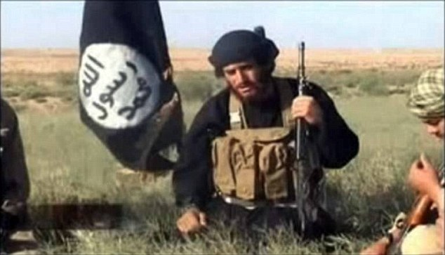
6. The Establishment of a caliphate
“We took it forcibly at the point of a blade.
We brought it back conquered and compelled.
We established it in defiance of many.
And the people’s necks were violently struck,
With bombings, explosions, and destruction,
And soldiers that do not see hardship as being difficult,
And lions that are thirsty in battle,
Having greedily drunk the blood of kufr [infidel].
Our khilafah has indeed returned with certainty”
– From the declaration of the caliphate entitled “This is the Promise of Allah” delivered by the Islamic State’s spokesman al-Adnani.

Slide 38
6. Establishment of a Caliphate
First attempt to resurrect the governmental system of the early Muslims in the modern era
Caliphate
System of gov’t, divinely sanctioned monarchy
Sole authority and power in hands of caliph
Declaration of jihad and interpretation of Islamic texts
Caliphate has sole religious and political jurisdiction over ENTIRE Muslim ummah (nation)
Last established caliphate-Ottoman Empire
Abolished in 1924 by Mustafa Kemal Ataturk→ secular nation of Turkey

Slide 39
Ottoman Empire/Caliphate

Slide 42
6. Establishment of a caliphate
Longstanding goal of all Islamists and jihadist groups
Spiritual successor to the prophet Muhammad
Abu Bakr al-Baghdadi claims legitimacy and descent from Muhammad’s tribal ties to the Qurayshi
Expansion of the caliphate
Demands allegiance from ALL Muslims-submit or not submit to caliphate (jihadists groups as well as civilians)
Allegiance from groups in Egypt, Libya, Yemen, Saudi Arabia
Original form of gov’t used by successors of Muhammad of areas under Islamic rule→First four caliphs oversaw rapid expansion
Romanticized by jihadists (time of power) and try to replicate
Anything else is bid’ah ( later innovation)
Many prominent Muslim leaders and terrorists groups have rejected claim, b/c does not meet religious preconditions required to be valid caliphate

Slide 43
Allied with ISIS

Slide 44
Allegiance and future caliphate

