Slide 1
Latin America in the 20th Century
Revolution and Reaction

Slide 2
Overview
LA continued to hold an intermediate position between nations of the North Atlantic and the developing countries of Asia and Africa
Shared problems however more Western in social and political structures=distinct
Post 1945→ LA elites led nations into closer ties to capitalistic economy (criticism within nations)
Economy concentrates on exports to US and Western nations
Vulnerable to changes in the financial system
Problem of finding a basis for social justice, cultural autonomy, and economic security
Decolonization in LA is one of economic disengagement and a search for political and cultural forms appropriate to LA realities not political separation and independence in Asia and Africa
Industrialization → workers’ organizations as political force, emigration, and urban growth, growing middle class

Slide 3
Latin America After WWII
The end of World War II was not a critical event since the region was only modestly involved.
Brazil helped the U.S. steel industry during the war and that sector grew to compete directly with the U.S. by the 1970s.
A new round of political agitation occurred after the war.
Several authoritarian regimes were challenged; one key example was Argentina.

Slide 4
Radical options in the 1950s
Desire for reform builds up in many countries
Venezuela and Costa Rica
Guatemala and Brazil
Inequitable distribution of resources and large Indian Majority
Land reform to counter foreign companies like US Fruit Company
Us moves in to protect assets from more radical/communist
CIA invasion force to bring in pro-US regime
Guatemala’s problem continue and guerilla movement emerges
Cuba-Unlike Brazil and Guatemala
Population mostly descended from Europeans and African slaves
1950s-in US sphere of influence (protectorate)
Batista ruled from 1934-1944 moving towards dictatorship, corruption
Cuban Revolution

Slide 5
Cuba: Revolt and Revolution
Fidel Castro
Launched unsuccessful attack on Cuban military
Fled to Mexico
Castro and Ernesto “Che” Guevara raises troops to invade Cuba in 1956 and by 1958 were in control
Movement became more radical
US opposition pushes Castro to USSR
part of Cold War→ Bay of Pigs, Cuban Missile Crisis
Reforms
Social welfare was successful-education, healthcare, housing
Economy required Soviet support (dependent) and relied on sugar
Collapse of USSR=economic distress
Nationalization of foreign property, collectivization, socialist economy
Attractive model for LA countries

Slide 6
Reform and the Military option
Revolution continued to be likely option to resolve problems
Mexico
stability in one-party system
Repression until 1980s
Christian Democrats (Chile, Venezuela)
Support of the church for social reforms and protection of human rights
Liberation Theory
Catholicism and socialism mixed
Improve life for the poor
Military involvement in politics=tradition
Reaction to threat of reform
Stabilize economy
Brutality when necessary

Slide 7
Democratic Trends-1980’s
Some military gov’ts returned to civilian rule
Continued economic problems and growing internal dissent contributed to change
Threat of populist or communists gov’ts and US intervention declined
Elections in Argentina
Civilian rule returned in Bolivia and Guatemala
Democracy not universal
Venezuela’s Hugo Chavez
US intervention and foreign debts continued
International drug trade
HOWEVER by 1990s democratic trends well-established

Slide 8
Continuing presence: Us in LA
Major power post WWI
Direct involvement in Cuba and Puerto Rico
Intervened (militarily)over 30 times before 1933, in other lands
Armed resistance created Sandinista movement (Nicaragua)
Support for dictatorial and conservative governments- friendly to US
Establishment of Banana Republics (politically unstable country whose economy is largely dependent on exporting a limited-resource product)
Changes:
1933 FDR and Good Neighbor Policy
Post Cold War- 1961 Alliance for Progress
1970s and 80s- US protection of interests
Deal to relinquish control of Panama Canal

Slide 9
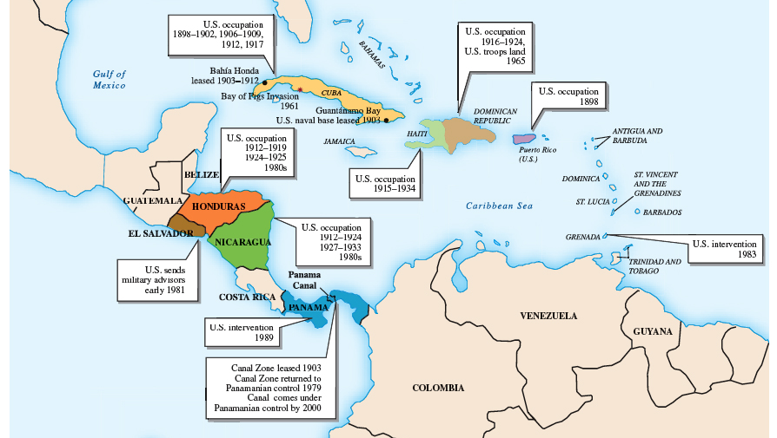
Us Intervention

Slide 10
Social Change
Societal relations changed slowly in Latin America.
Women’ s status was, however, closer to those of western Europe than Africa.
There were many changes, but discrimination against Indians and African Americans continues.
Population growth, urbanization, and worker migration continued as problems

Slide 11
Slow Change in Women’s Role
Women were denied the vote until 1929 in Ecuador.
By the 1950s, most of the region allowed female franchise.
Feminist movements pushed for inclusion into elected offices.
Industrial jobs expanded to include women. Shifts in attitudes about women’s roles developed more slowly.
Overall, as in many other areas, by the beginning of the 21st century, Latin America was in the intermediate position between industrialized and developing nations where the status of women was concerned.

Slide 12
Movement of People
Latin Americas population soared in comparison to North America.
At the beginning of the 20th century, the major population trend was immigration into Latin America, but long-term trends show migration within and through the region.
Illegal immigration from Central America into Mexico and from Mexico into the United States was a major regional issue.
Legal migration from Haiti and Cuba because of political dissatisfaction to the U.S. was another big event.
Rapid and massive urban growth was yet another common theme in Latin America is this era; in 1999, the region was the most urbanized of the developing world.
Problems related to this rapid growth remain. Nationalist and populist politics weakened the ability of the working class to operate effectively in politics.

Slide 13
Cultural Reflections
The vast majority of Latin Americans are Catholic, but Protestants are making inroads.
Music and dance are important parts of popular culture and are influential world-wide.
Writers gained world recognition, especially those who penned social criticism and/or employed “magical realism.”

Slide 14
Global Connections
As Latin America entered the 21st century, it continued to seek economic, social, and political growth and stability.
New forms of politics were tried, but many long-standing problems remained.
Nevertheless, Latin America was the most advanced region of the “developing” world and in the 1990s its economies grew considerably.
Cultural issues remained unresolved and Latin America’s global position became increasingly complex.

