Slide 1
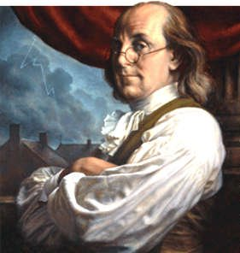
“No nation was ever ruined by trade.”
Benjamin Franklin

Slide 2
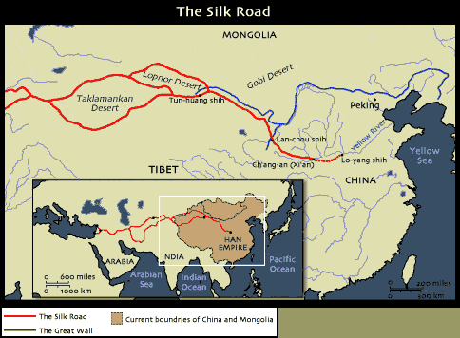
The Silk Roads
One of the world’s most extensive and sustained networks of exchange
Land-based trade routes that linked pastoral and agricultural peoples as well as the large civilizations on Eurasia’s outer rim
It was more of a “relay trade” in which goods were passed down the line, changing hands many times before reaching their final destination

Slide 3
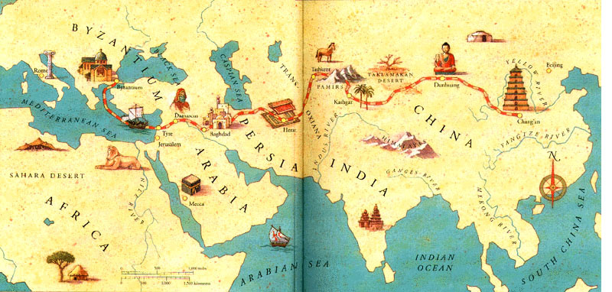

Slide 4
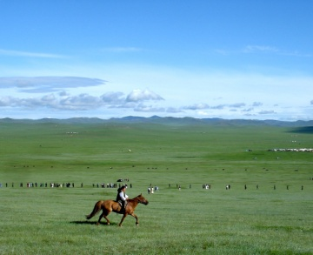
Outer Eurasia is relatively warm, well-watered, and suitable for agriculture (the civilizations of China, India, the Middle East, and the Mediterranean)
Inner Eurasia, the lands of eastern Russia and Central Asia, lies farther north and has a harsher and drier climate
-Not conducive to agriculture
-Long inhabited by pastoral peoples herding animals from horseback
-People had long traded with and raided their agricultural neighbors to the south
-Products of the forest and semi-arid northern grasslands known as the steppes included hides, furs, livestock, wool, and amber

Slide 5
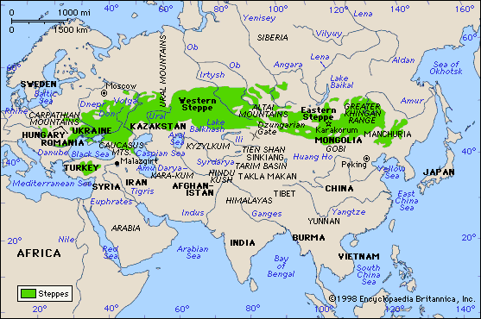
The movement of pastoral peoples also served to diffuse Indo-European languages, bronze metallurgy, horse-based technologies, and more all across Eurasia.

Slide 6
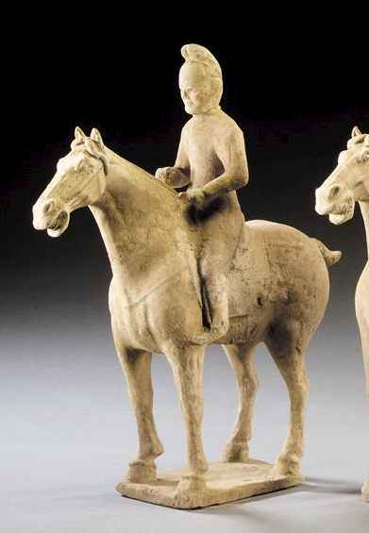
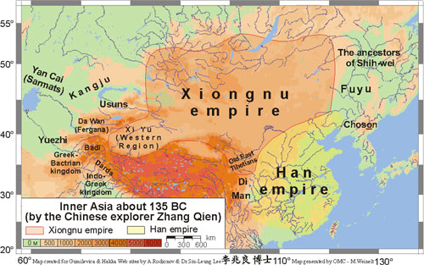
But from the south, the Persian Empire invaded the territory of pastoral peoples in present-day Turkmenistan and Uzbekistan
From the west, Alexander the Great’s empire stretched well into Central Asia
From the east, China’s Han dynasty extended its authority westward, seeking to control the nomadic Xiongnu and to gain access to “heavenly horses” that were so important to Chinese military forces

Slide 7
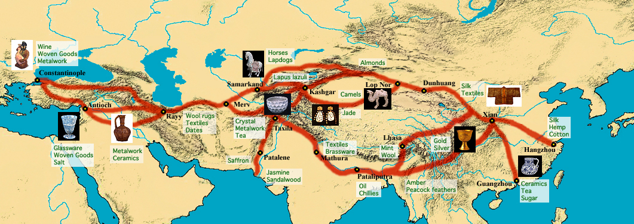
Silk Road trading networks prospered most when large and powerful states provided security for merchants and travelers.

Slide 8
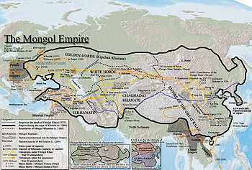
Trade flourished during the classical era when the Roman and Chinese empires anchored long-distance commerce at the western and eastern ends of Eurasia.
It flourished again during the seventh and eighth centuries CE as the Byzantine Empire, the Muslim Abbasid dynasty, and the Tang Dynasty in China created an almost continuous belt of strong states across Eurasia
In the thirteenth and fourteenth centuries, during the Pax Mongolia of the Mongol Empire when the Mongol empire encompassed almost the entire routes of the Silk Roads in a single state, a renewed vitality to long-distance trade occurred

Slide 9
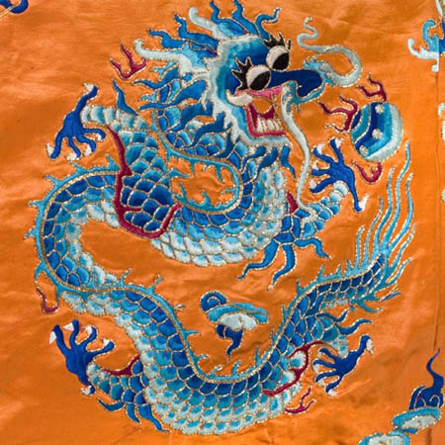
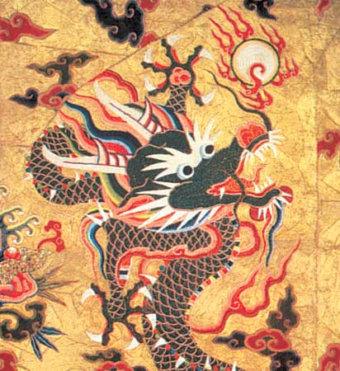
Most of the goods were luxury products destined for an elite and wealthy market rather than staple goods. Of course, silk came to symbolize this exchange system.

Slide 10
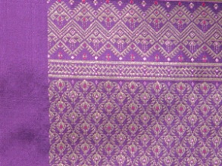
While the Chinese originally held a monopoly on silk-making, by the sixth century C.E., however, the knowledge and technology for producing raw silk had spread beyond China
Eventually, Byzantines, Koreans, Japanese, Indians, and Persians learned how to produce silk
Silk was used as currency in Central Asia
In China and the Byzantine Empire, silk became a symbol of high status and governments passed laws restricting silk clothing to members of the elite
Buddhist monks in China received silk robes from Tang dynasty emperors as a sign of high honor and silk was used for Christian vestments in Western Europe and in wall hangings

Slide 11
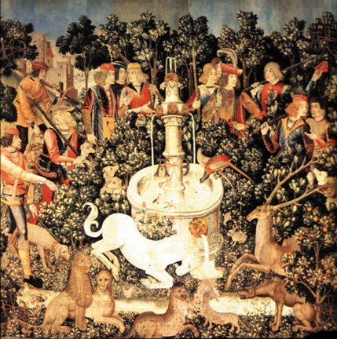
The splendor of Christian churches depended in part on silks imported from the Islamic world, silks which sometimes were even inscribed with passages in Arabic from the Quran, unbeknownst to their European buyers.

Slide 12
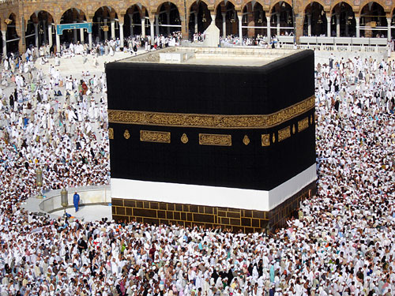
The twelfth-century Persian merchant Ramisht made a personal fortune from his long-distance trading business and with his profits purchased an enormously expensive silk covering for the Kaaba, the central shrine of Islam in Mecca.

Slide 13
More important than the economic impact of the Silk Roads was their role as a conduit of culture
Buddhism in particular, a cultural product of Indian civilization, spread widely throughout Central and East Asia, owing much to the activities of merchants along the Silk Roads
-Buddhism had appealed to merchants, who preferred its universal message to that of a Brahmin-dominated Hinduism that privileged the higher castes
-Indian traders and Buddhist monks, sometimes supported by rulers such as Ashoka, brought the new religion to the trans-Eurasian trade routes
But Persian Zoroastrianism largely blocked the spread of Buddhism to the west, except in the oasis cities of Central Asia, such as Merv, Samarkand, Khotan, and Dunhuang

Slide 14
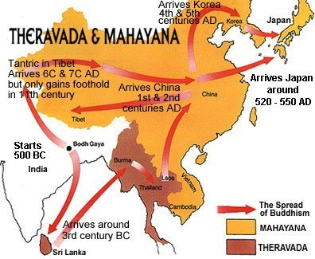
In China, Buddhism remained a religion of foreign merchants or foreign rulers. Only slowly did it become popular among the Chinese themselves.

Slide 15
As Buddhism spread across the Silk Roads from India to Central Asia, China, and beyond, it also changed
Its original message had shunned the material world, but Buddhist monasteries in the rich oasis towns of the Silk Roads found themselves very much involved in secular affairs
-Some monasteries became wealthy by receiving gifts from merchants and rulers
-The begging bowls of monks became a symbol rather than a daily activity
Doctrines changed as well
-The more devotional Mahayana form of Buddhism flourished on the Silk Roads rather than the more austere psychological teachings of the original Buddha

Slide 16
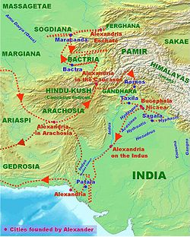
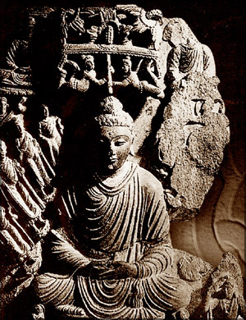
Buddhism also picked up elements of other cultures on the Silk Roads. In northwest India, statues of the Buddha reveal distinctly Greek influences from the invasions of Alexander the Great while many gods of diverse peoples along the Silk Roads were incorporated into Buddhist bodhisattvas.

Slide 17
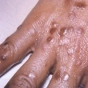
Diseases traveled the trade routes of Eurasia too
Smallpox and measles devastated populations of both the Roman Empire and Han dynasty, contributing to their political collapse
-Yet these diseases may have strengthened the appeal of Christianity in Europe and Buddhism in China
Bubonic plague ravaged the coastal areas of the Mediterranean Sea between 534 and 750 CE
-Disease played a role in preventing Byzantium from reintegrating Italy into its version of a renewed Roman Empire
-Repeated recurrence of disease weakened the ability of Christendom to resist the Muslim armies pouring out of Arabia in the seventh century CE

Slide 18
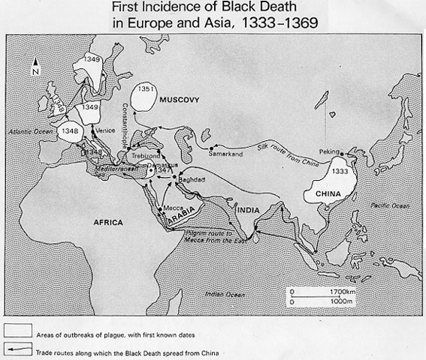
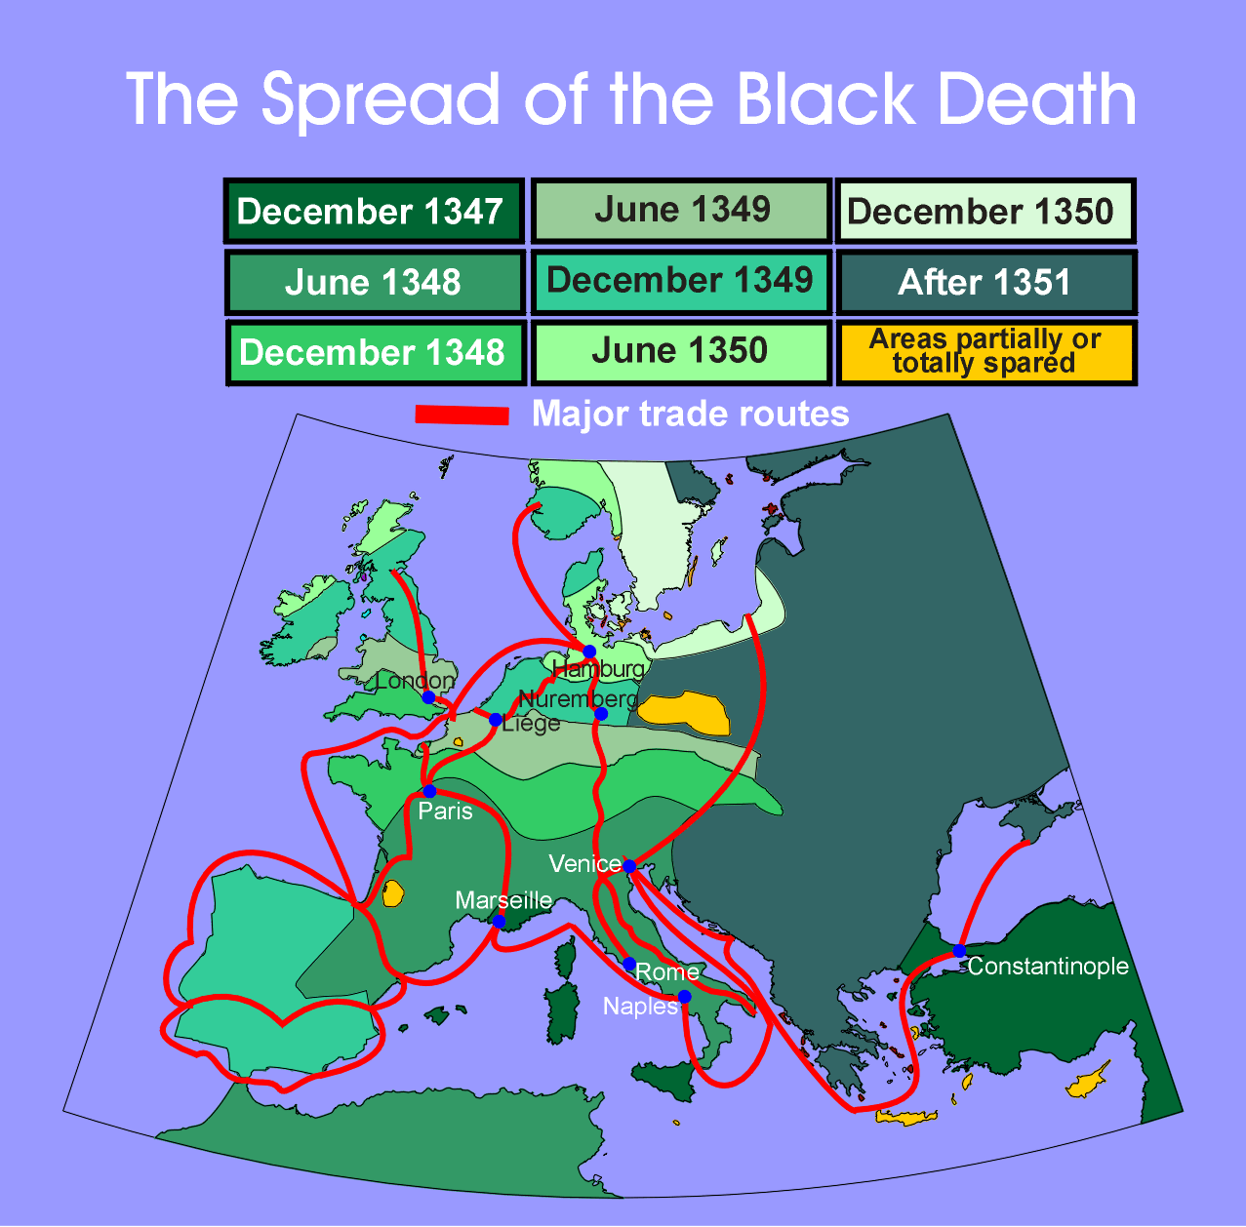
The most well-known dissemination of disease was associated with the Mongol Empire during the thirteenth and fourteenth centuries and the Black Death from China to Europe. Between 1346 and 1350, about one-third of the population of Europe perished from the plague.

Slide 19
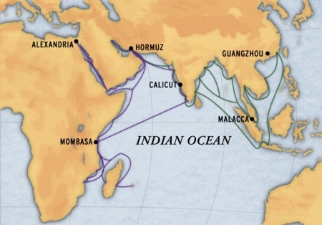
Indian Ocean Trade
Until the creation of a genuinely oceanic system of trade after 1500, the Indian Ocean represented the world’s largest sea-based system of communication and exchange, stretching from southern China to eastern Asia
Transportation costs were lower on the Sea Roads than on the Silk Roads, because ships could accommodate larger and heavier cargoes than camels
The monsoons with their alternative wind currents that blew predictably eastward during the summer months and westward during winter made sea-borne trade possible

Slide 20
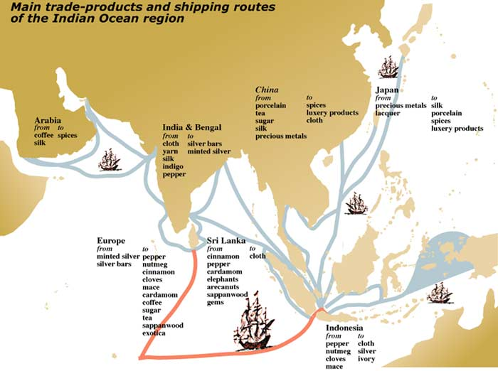
Indian Ocean trade operated across an “archipelago of towns” whose merchants had more in common with one another than with the people of their own hinterland.

Slide 21
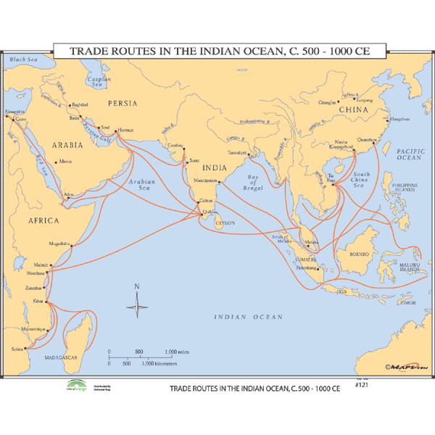
Indian Ocean commerce dates back to the time of the First Civilizations
Commerce increased in the era of the classical civilizations as mariners learned how to ride the monsoons
But the fulcrum of this growing commerce lay in India itself. Indian merchants were in touch with Southeast Asia by the first century CE
In the post-classical period, the economic and political revival of China under the Tang and Song dynasties (618-1279) actively promoted trade and the rise of Islam in the seventh century CE and its subsequent spread across much of Afro-Eurasia encouraged commerce within and beyond the creation of an Arab Empire

Slide 22
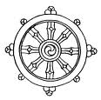
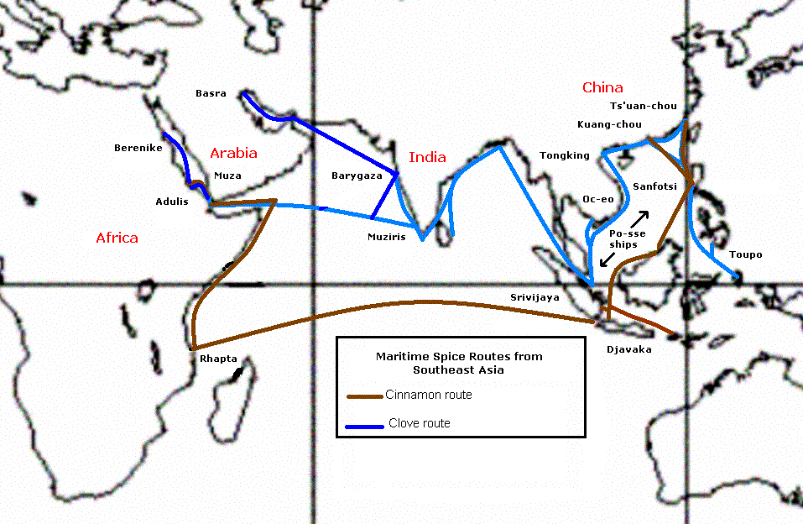
Oceanic commerce had a significant impact on Southeast Asia and East Africa, especially the introduction of Hindu, Buddhist, or Islamic beliefs.

Slide 23
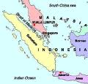
Malay sailors opened an all-sea route between India and China through the Straits of Malacca around 350 CE
The Malay kingdom of Srivijaya dominated this critical choke point of Indian Ocean trade from 670 to 1025
-Rulers imported Indian political ideas and Buddhist religious concepts
The Sailendra kingdom in central Java, an agriculturally rich region, mounted a massive building program between the eighth and tenth centuries featuring Hindu temples and Buddhist monuments (most famous, known as Borobudur, is the largest Buddhist monument in the world)

Slide 24
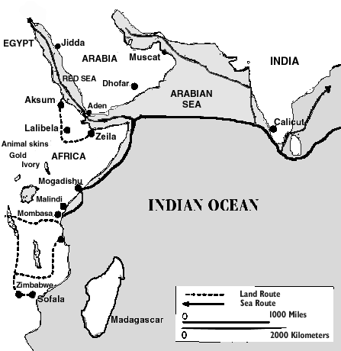
In East Africa, a civilization known as Swahili (also a language) emerged in the eighth century CE, stretching from present-day Somalia to Mozambique
But with rise of Islam, increased commerce on western Indian Ocean
Between 1000 and 1500 flourished
-Independent city-states
-Exchanged goods from interior and exchanged for products from distant civilizations
-Language was grammatically African within Bantu family but written in Arabic script and containing a number of Arabic loan words
-Culture rapidly became Islamic

Slide 25
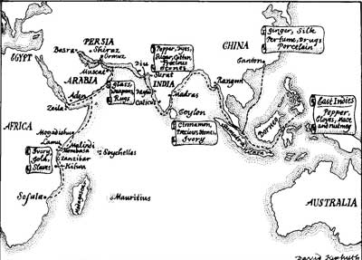
Ibn Battuta, the famous Muslim traveler, visited East Africa and West Africa and found many Muslims societies.

Slide 26
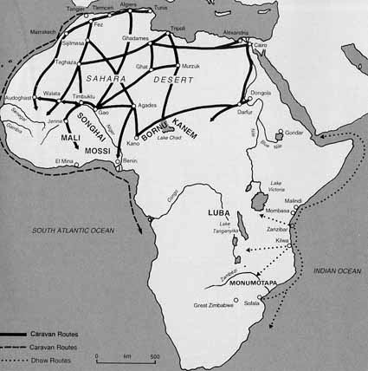
West Africa
Trans-African trade connected North Africa and West Africa, part of sub-Saharan Africa
Especially important salt for gold trade
Introduction of camel led to initiation of trans-Saharan commerce by 300 to 400 CE
Islam entered West Africa along trade routes
Sahara was no longer a barrier
The West African kingdoms of Ghana, Mali, and Songhai emerged
Sale of slaves from non-Islamic and stateless societies farther south

Slide 27
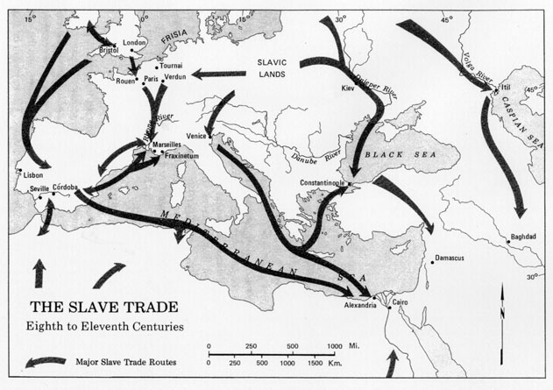
But far more significant in Europe were slaves from the Slavic-speaking regions along the northern coast of the Black Sea. They were so numerous that the word “slave” in many European languages derives from the term “Slav.”

Slide 28
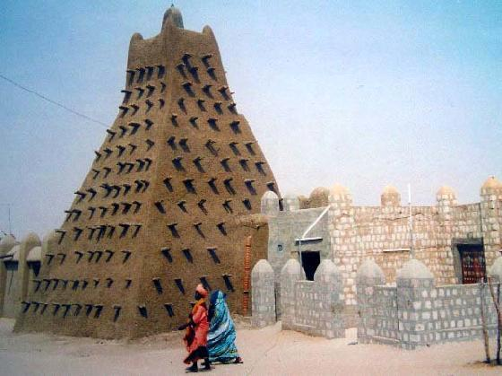
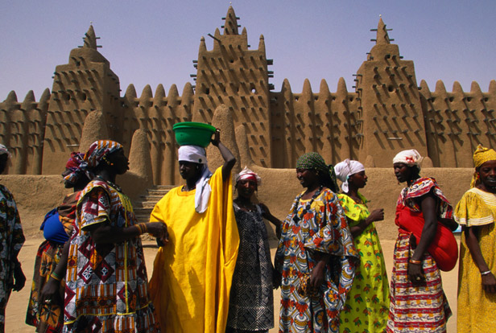
The states of Sudanic Africa developed substantial urban and commercial centers – such as Koumbi-Saleh, Jenne, Timbuktu, Gao, Gobir, and Kano.

Slide 29
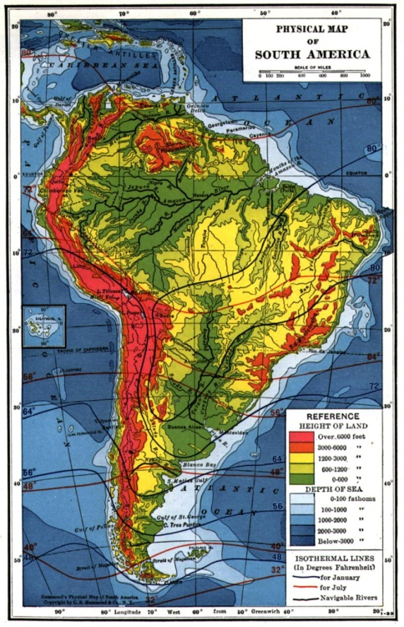
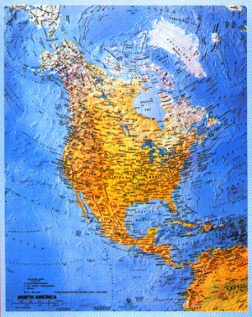
In the Americas, geographic factors (mountains and rain forests) added obstacles to trade. The north/south orientation of the Americas slowed the spread of agricultural products due to differing climatic zones but nonetheless, there was “a loosely interactive web stretching from the North American Great Lakes and upper Mississippi south to the Andes” and there were also trade within powerful empires (Mayas, Aztecs, Incas).

Slide 30
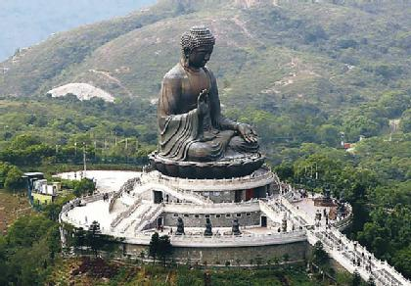
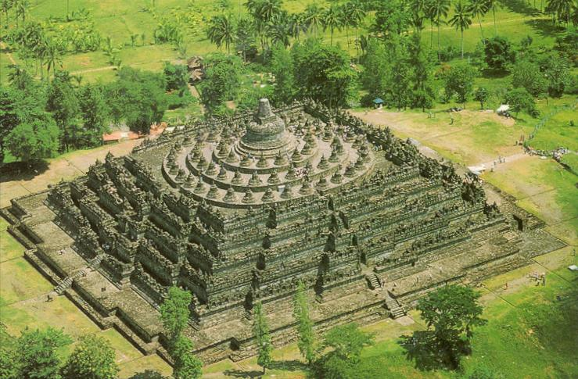
Strayer Questions
What lay behind the emergence of Silk Road commerce, and what kept it going for so many centuries?
What made silk such a highly desired commodity across Eurasia?
What were the major economic, social, and cultural consequences of Silk Road commerce?
What accounted for the spread of Buddhism along the Silk Road?
What was the impact of disease along the Silk Road?

Slide 31
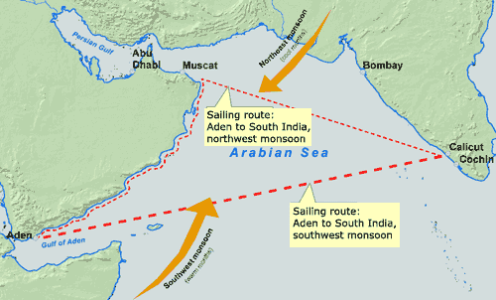
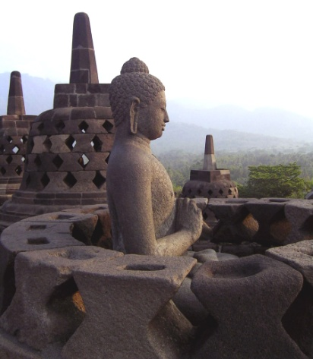
How did the operation of the Indian Ocean trading network differ from that of the Silk Roads?
What lay behind the flourishing of Indian Ocean commerce in the postclassical millennium?
What is the relationship between the rise of Srivijaya and the world of Indian Ocean commerce?
What was the role of Swahili civilization in the world of Indian Ocean commerce?
What changes did trans-Saharan trade bring to West Africa?
In what ways did networks of interaction in the Western Hemisphere differ from those in the Eastern Hemisphere?

