Slide 1
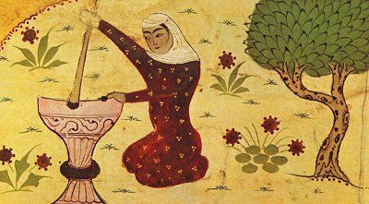
“True devotion is for itself: not to desire heaven nor to fear hell.”
Rabia al-Adawiyya

Slide 2
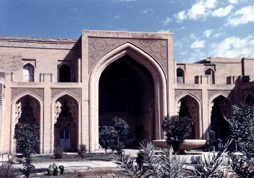
The Abbasid Dynasty (750-1258)
With a splendid new capital in Baghdad, the Abbasid caliphs presided over a flourishing and prosperous Islamic civilization in which non-Arabs, especially Persians played a prominent role
Persian cultural influence was reflected in a new title for the caliph, “the shadow of God on earth”
But the political unity of the Abbasid Empire did not last long
Beginning as early as the mid-ninth century, many local governors and military commanders asserted autonomy in their regions

Slide 3
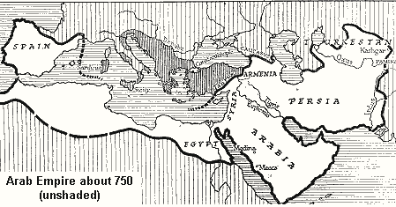
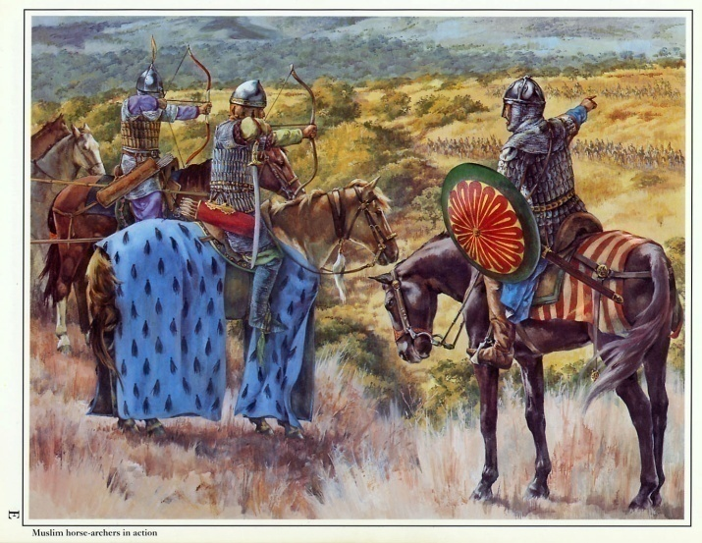
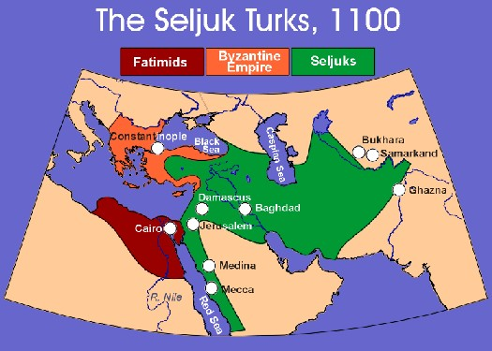
Although still giving formal allegiance to the caliph in Baghdad, the Islamic world had fractured politically into a series of “sultanates,” many ruled by Persian or Turkish military dynasties.

Slide 4
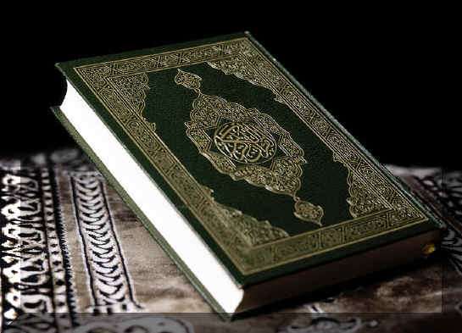
A further tension lay in the different answers to the central question: What does it mean to be a Muslim, to submit wholly to Allah?
One answer lay in the development of an extensive body of Islamic law, known as the sharia
-The sharia was the work of religious scholars, the ulama, primarily in the eighth and ninth centuries
-Based on the Quran, the life and teachings of Muhammad, deductive reasoning, and the consensus of scholars, the emerging sharia addressed in great detail practically every aspect of religious and social life
-It often focused on correct behavior

Slide 5
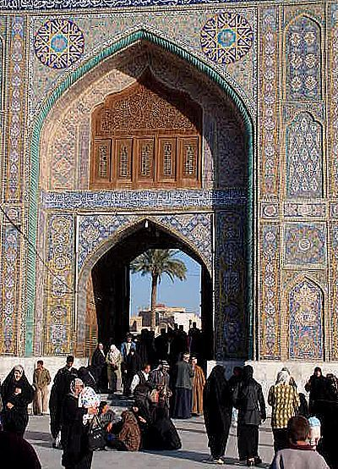
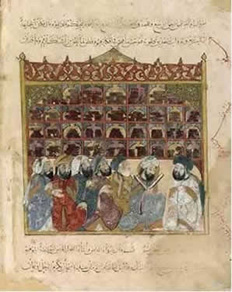
To the ulama and their followers, living as a Muslim meant following the sharia.

Slide 6
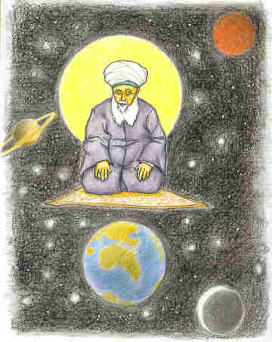
A second understanding of the faith emerged among those who saw the worldly success of Islamic civilization as a distraction and deviation from the purer spirituality of Muhammad’s time
-Known as Sufis, they represented Islam’s mystical dimension, in that they sought a direct and personal experience of the divine
-Through renunciation of the material world, meditation on the words of the Quran, the use of music and dance, the veneration of Muhammad and various “saints,” Sufis pursued the obliteration of the ego and spiritual union with Allah
-To describe that inexpressible experience, they often resorted to metaphors of drunkenness or the embrace of lovers

Slide 7
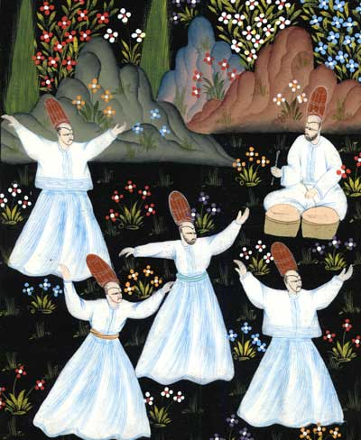
Sufism became widely popular by the ninth and tenth centuries and was sharply critical of the more scholarly and legalistic practitioners of the sharia. But for orthodox religious scholars, Sufi ideas and practices verged on heresy, as Sufis claimed to be one with God, to receive new revelations, or to incorporate religious practices from outside the Islamic world.

Slide 8
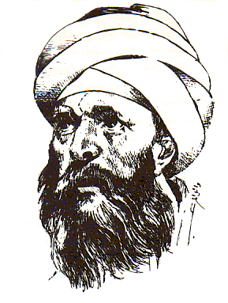
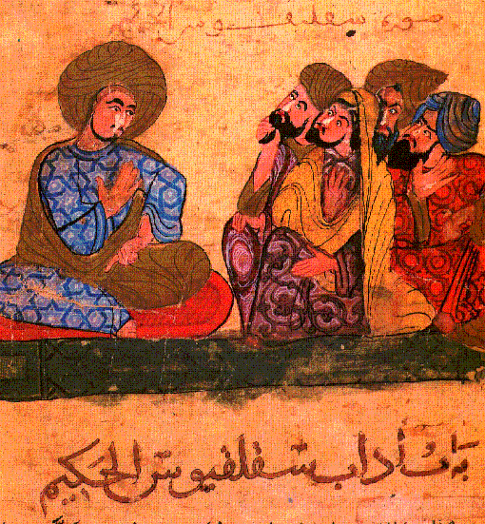
A major Islamic thinker, al-Ghazali (1058-1111), himself both a legal scholar and a Sufi practitioner, worked out an intellectual accommodation among the different strands of Islamic thought
-Rational philosophy alone could never enable believers to know Allah

Slide 9
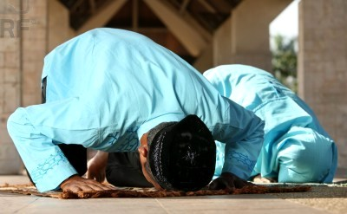
Men and Women in Islam
On a spiritual level, the Quran was clear, men and women were equal
But in social terms, women were inferior and subordinate
Yet the Quran provided a mix of rights, restrictions, and protections for women
-Female infanticide was forbidden
-Women were given control over their own property
-Women were granted rights of inheritance, although half the rate of male counterparts

Slide 10
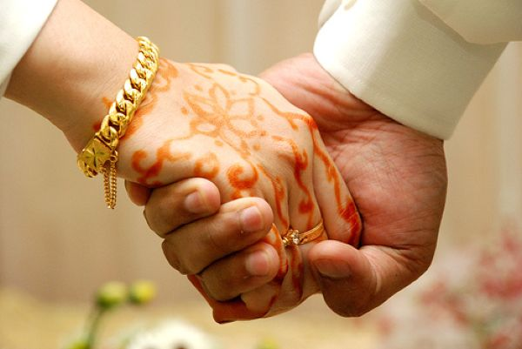
-Marriage was considered a contract between consenting parties
-Women could sue for divorce if they had not had sexual relations for more than four months
-But the practice of a woman taking several husbands was prohibited while polygyny, multiple wives for a man, was allowed (a man was limited to four wives as long as treated equally)
-Men were encouraged to marry orphans, widows, and slaves

Slide 11
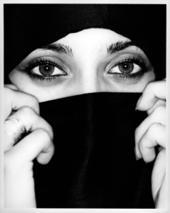
But as the Islamic “golden age” flourished, as in Athens and China, women, particularly upper class women, experienced growing restrictions
-Even the second caliph, Umar, asked women to offer prayers at home rather than the mosque
-Veiling and seclusion of women became standard practice among the upper and ruling classes, removing women from public life
-Such practices derived far more from established traditions of Middle Eastern cultures than from the Quran itself
-But they soon gained an Islamic rationale in the writings of Muslim thinkers
-Also “honor killing” of women by male relatives for violating sexual taboos

Slide 12
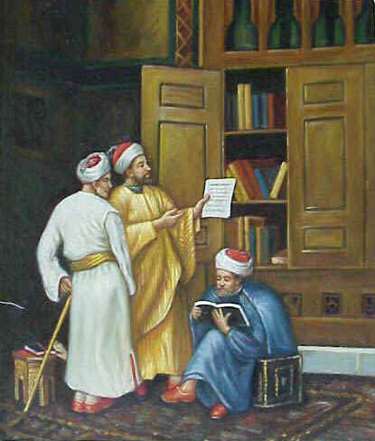
Negative view of women, presenting them as weak, deficient, and a sexually charged threat to men and social stability, emerged in the hadiths, traditions about the sayings or actions of Muhammad, which became an important source of Islamic law.

Slide 13
But like Buddhism and Christianity, Islam also offered new outlets for women in religious life. The Sufi practice of mystical union with Allah allowed a greater role for women than did mainstream Islam. Some Sufi orders had parallel groups for women, and a few welcomed women as equal members. Even within the world of Shia Islam, women teachers were termed mullahs, the same as their male counterparts and Islamic education, in the home or in Quranic schools, allowed some women to become literate and even achieve high levels of learning.

Slide 14
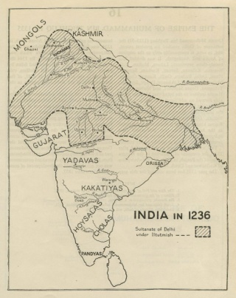
Islam and Cultural Encounters
In South Asia, Islam found a permanent place in a long-established civilization as invasions brought by Turkic-speaking warrior groups from Central Asia, recently converted to Islam, brought the faith to India
The Turks became the third major carrier of Islam, after the Arabs and Persians
-Their conquests gave rise to a series of Turkic and Muslims regimes that governed much of India until the British takeover in the eighteenth and nineteenth centuries

Slide 15
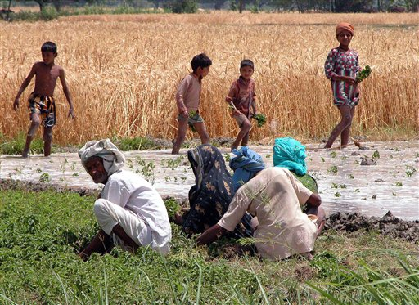
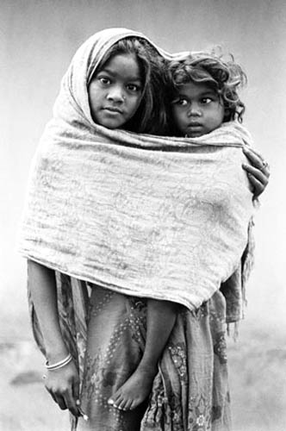
Disillusioned Buddhists as well as low-caste Hindus and untouchables found the more egalitarian Islam attractive.

Slide 16
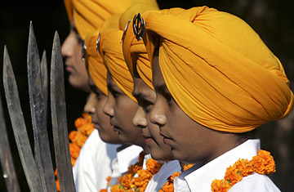
But in India, never more than 20 to 25 percent of the total population affiliated with Islam
-Perhaps due to the sharpness of the cultural divide between Islam and Hinduism
-Islam was radically monotheistic while Hinduism was surely polytheistic
-Islam’s equality of all believers contrasted with the Hindu caste system
But in the early sixteenth century, a new and distinct religious tradition emerged in India, known as Sikhism
-It blended elements of Islam, such as devotion to one universal God, with Hindu concepts, such as Karma and rebirth

Slide 17
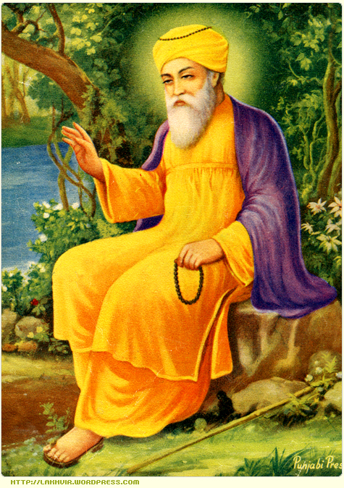
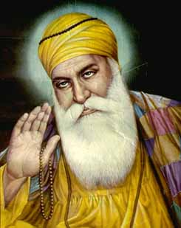
Guru Nanak (1469-1539), the founder of Sikhism, declared, “There is no Hindu and no Muslim. All are children of God.”

Slide 18
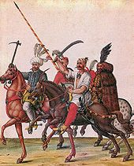
But in Anatolia, the population by 1500 was 90% Muslim and largely Turkic-speaking
Anatolia was the heartland of the powerful Turkish Ottoman Empire that had overrun Christian Byzantium
-But Anatolia’s population was significantly smaller than India’s
-The disruption of Anatolian society was more extensive as the Byzantine state had been fatally weakened
-Even though Christians were seldom forced to convert, they suffered many discriminations such as being forbidden to ride saddled horses or carry swords
-Some Christians came to believe that these disasters represented proof that Islam was the true religion (shared a common monotheism, too!)

Slide 19
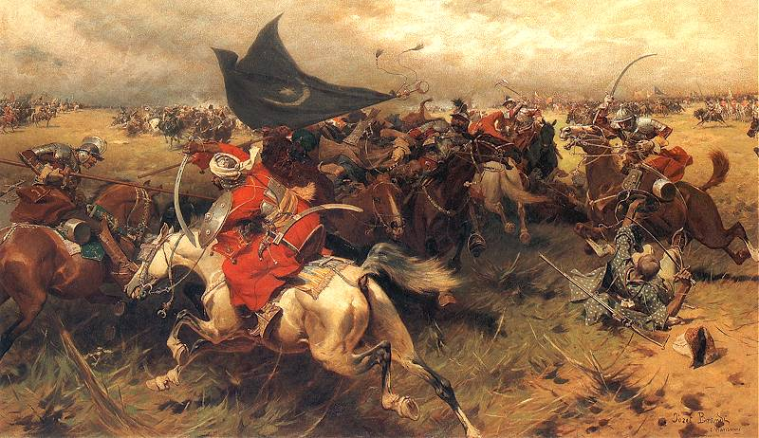
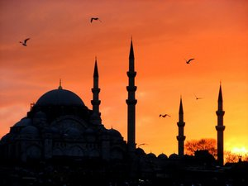
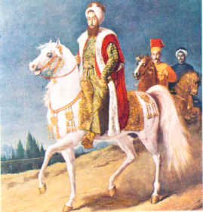
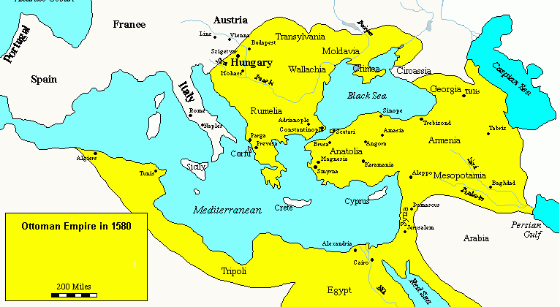
The Turkish rulers of Anatolia built a new society that welcomed converts and granted them material rewards and opportunity for high office.

Slide 20
But Islamization did not completely eliminate the influence of Turkish culture
-The tradition of a freer, more gender-equal life for women, common among pastoral people, persisted after the conversion to Islam
In West Africa, Islam accompanied Muslim traders across the Sahara rather than being brought by invading Arab or Turkic armies
Islam’s acceptance was largely peaceful and voluntary, lacking the incentives associated elsewhere with foreign conquest
For African merchant communities, Islam provided an important link to Muslim trading partners, much as Buddhism had done in Southeast Asia

Slide 21
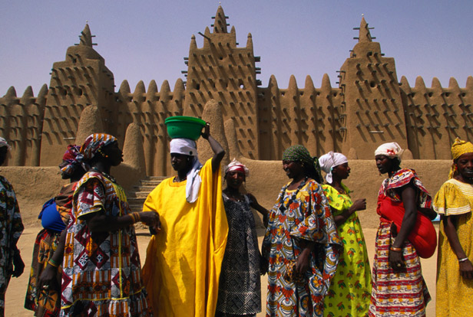
By the sixteenth century, a number of West African cities had become major centers of Islamic religious and intellectual life, attracting scholars from throughout the Muslim world. Timbuktu had more than 150 lower-level Quranic schools and several major centers of higher education with thousands of students from all over West Africa.

Slide 22
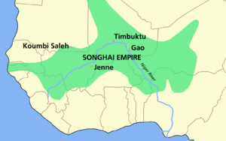
West Africa did not experience the massive migration of Arab peoples that had promoted Arabization of North Africa and the Middle East
Moreover, in contrast to India and Anatolia, Sufi holy men played little role until at least the eighteenth century
Scholars, merchants, and rulers, rather than mystic preachers, initially established Islam in West Africa
Ibn Battuta, a fourteenth-century Arab traveler, was appalled that practicing Muslims in Mali permitted their women to appear in public almost naked and to mingle freely with unrelated men
And Sonni Ali, a fifteenth-century ruler of Songhay, observed Ramadan and built mosques but consulted traditional diviners

Slide 23
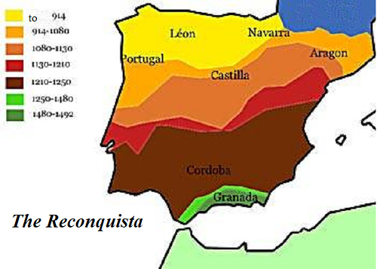
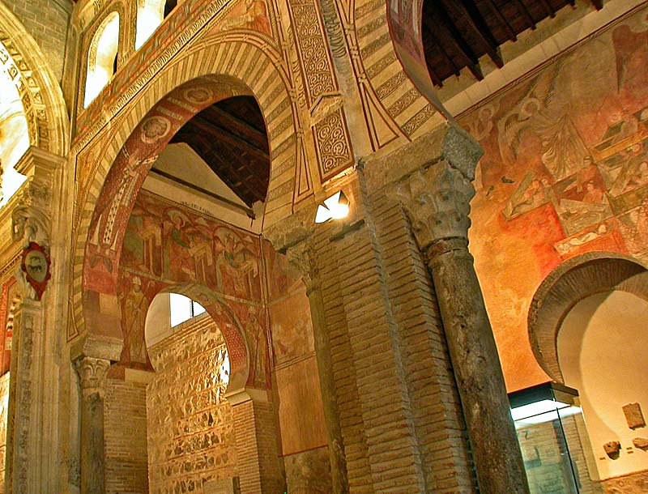
The chief site of Islamic encounter with Catholic Europe occurred in Spain (called al-Andalus by Muslims). Spain had been conquered by Arab and Berber forces in the early eighth century but Islam did not overwhelm Christianity in Spain. Early toleration between Muslims and Christians gave way to increasing religious intolerance. That intolerance was perpetuated as Muslims were forced out of Spain during the Reconquest and in 1492, all Jews were likewise expelled.

Slide 24
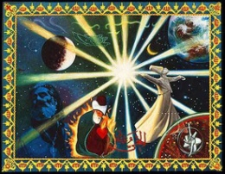
At the core of Islamic civilization was a common commitment to Islam
Beginning in the eleventh century, formal colleges called madrassas offered more advanced instruction in the Quran and the sayings of Muhammad as well as law
The ulama were an “international elite,” and the system of education they created served to bind together an immense and diverse civilization
Paralleling the educational network of the ulama were the emerging religious orders of the Sufis
-By the tenth century, particular Sufi shayks, or teachers, began to attract groups of disciples who were eager to learn their unique devotional practices and ways of achieving union with Allah

Slide 25
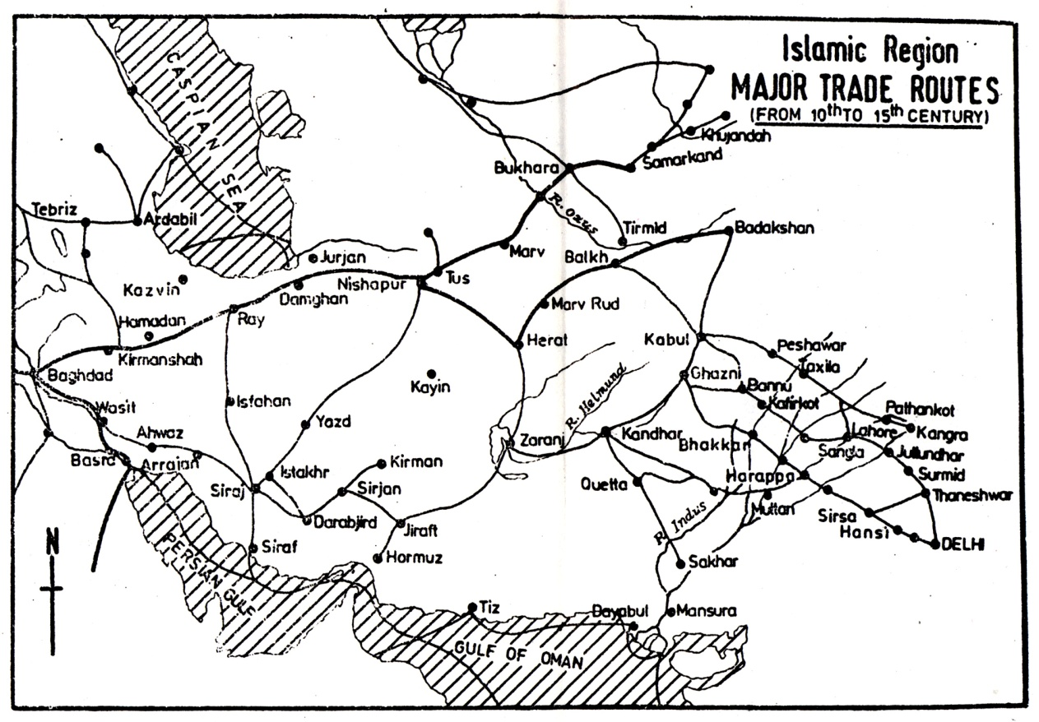
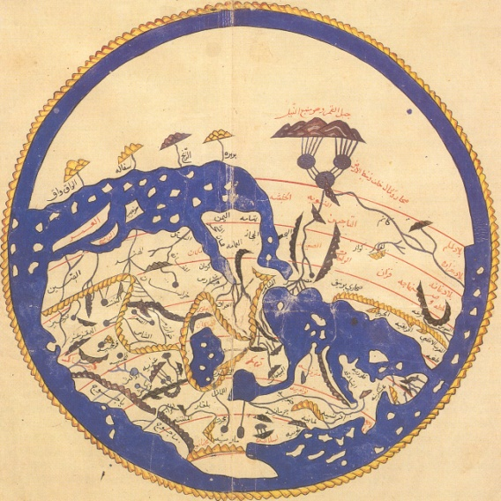
Like the madrassas and the sharia, Sufi religious ideas and institutions spanned the Islamic world and were yet another thread in the cosmopolitan web of Islamic civilization. In addition to the networks of the Sufis and the ulama, many thousands of people, from kings to peasants, made the pilgrimage to Mecca, no doubt gaining some sense of the umma.

Slide 26
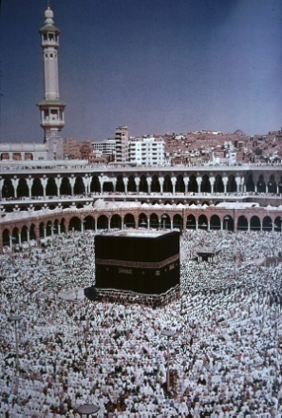
The world of Islamic civilization was a network of faith but also a network of trade
-In part, due to its central location in the Afro-Eurasian world
-Commerce was valued by the Prophet Muhammad who himself had been a trader
-The pilgrimage to Mecca also fostered commerce
-The extraordinary spurt of urbanization that accompanied the growth of Islamic civilization also promoted trade
Technology also diffused widely within the Islamic world
Philosophical texts, especially from ancient Greece and the Hellenistic world, were translated into Arabic

Slide 27
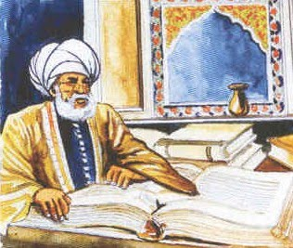
The blending of Islamic civilization and other civilizations led to new contributions to learning. Using Indian numerical notations, Arab scholars developed algebra. They also undertook original work in astronomy and optics. They furthered developments in medicine and pharmacology. The first hospitals, traveling clinics, and examinations for physicians and pharmacologists also were developed within the Islamic world. In the eleventh and twelfth centuries, this enormous body of Arab medical scholarship entered Europe via Spain.

Slide 28
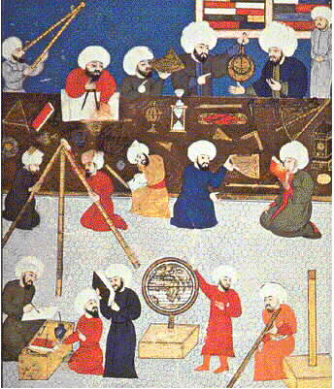
Strayer Questions
How did the rise of Islam change the lives of women?
What similarities and differences can you identify in the spread of Islam to India, Anatolia, West Africa, and Spain?
Why was Anatolia so much more thoroughly Islamized than India?
What makes it possible to speak of the Islamic world as a distinct and coherent civilization?
In what ways was the world of Islam a "cosmopolitan civilization"?

