Slide 1
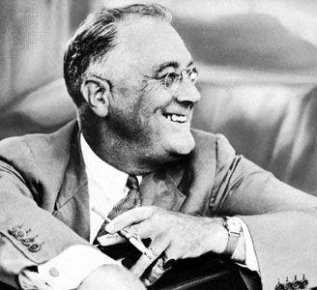
“If I went to work in a factory the first thing I'd do is join a union.”
Franklin Delano Roosevelt

Slide 2
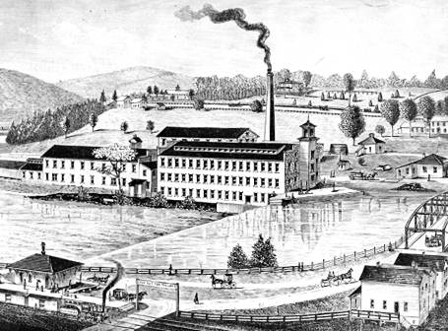
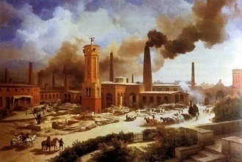
Since its beginning in Great Britain, the Industrial Revolution profoundly transformed society
Industrialization drew upon the Scientific Revolution and propelled Europe into a position of global dominance
The Industrial Revolution began independently in Western Europe, and specifically in great Britain
It spread far more rapidly than agriculture
At the heart of the Industrial Revolution lay a great acceleration in the rate of technological innovation
The Industrial Revolution led to an enormously increased output of goods and services

Slide 3
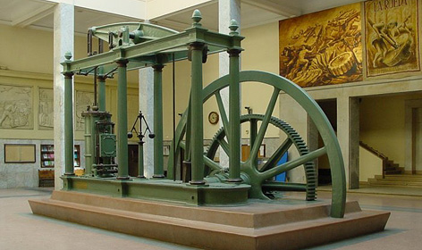
New sources of energy – coal-fired steam engines and later petroleum-fueled engines – transformed production. In Britain, where the revolution began, industrial output increased some fiftyfold between 1750 and 1900. Lying behind its increased productivity was not a single invention – the spinning jenny, power loom, steam engine, or cotton gin – but a “culture of innovation”.

Slide 4
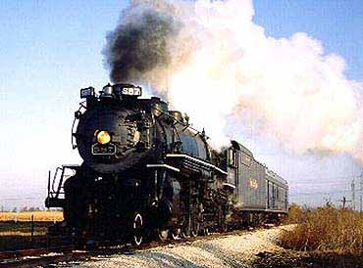
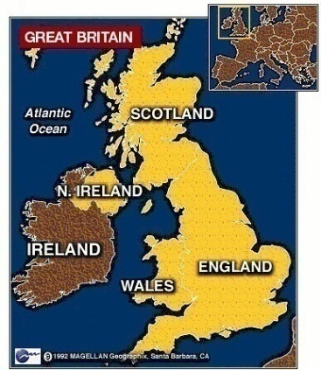
Yet until 1750 or even 1800, Europeans held no technological advantage over China, India, or the Islamic world
Early signs of technological creativity in Europe appeared in eighteenth century Britain, where a variety of innovations transformed cotton textile production
By the nineteenth century, Europeans in general and the British in particular forged ahead
The great breakthrough was the steam engine, which provided an inanimate and almost limitless source of power
The steam engine could be used to drive any number of machines as well as locomotives and oceangoing ships

Slide 5
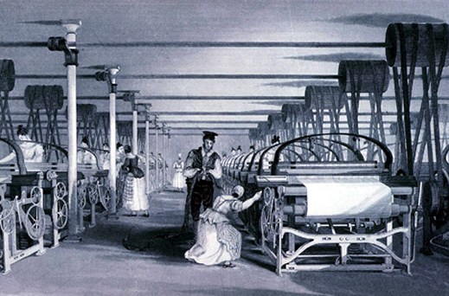
The Industrial Revolution could now spread beyond the textile industry to iron and steel production, railroads and steamships, food processing, construction, chemicals, electricity, the telegraph and telephone, rubber, pottery, printing, and much more. Agriculture was also affected as mechanical reapers, chemical fertilizers, pesticides, and refrigeration increased productivity and efficiency.

Slide 6
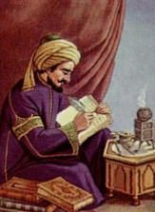
Industrialization then spread beyond Britain to continental Western Europe, and in the second half of the century to the United States, Russia, and Japan
By the twentieth century, industrialization went global
Yet a question remains: Why did the Industrial Revolution begin in Europe, especially when other regions had experienced times of great technological and scientific advances?
Between 1750 and 1100 C.E., the Islamic world generated major advances in shipbuilding, the use of tides and falling water to generate power, papermaking, textile production, chemical technologies, water mills, clocks, and much more

Slide 7
India had long been the world center of cotton textile production, the first place to turn sugarcane juice into crystallized sugar, and the source of many agricultural innovations and mathematical inventions. Even to the Arabs of the ninth century C.E., India was a “place of marvels.” Yet more than either the Arabs or the Indians, the Chinese clearly were the world leader in technological innovation between 700 and 1400 C.E. Yet by the early modern era, this technological creativity had slowed down or even stagnated in the Islamic world, India, and China.

Slide 8
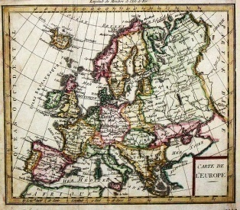
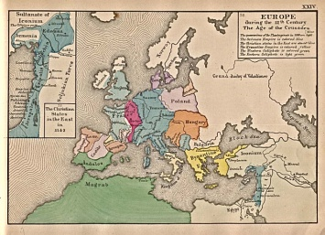
And the rapid spread of industrialization throughout the world also strongly suggests that Europe had no unique or inherent capacity for industrialization
So, again, why did the Industrial Revolution begin in Europe?
Historians are inclined to see the Industrial Revolution as erupting rather quickly and unexpectedly in Europe between 1750 and 1850
Yet perhaps Europe’s small and highly competitive states, states that took shape in the twelfth and thirteenth centuries, encouraged a spirit of inventiveness to ensure a competitive advantage

Slide 9
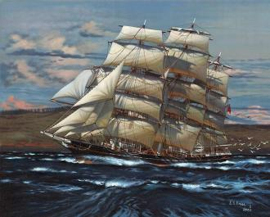
In addition, the relative newness of these European states and their monarchs’ desperate need for revenue in the absence of an effective tax-collecting bureaucracy pushed European royals into an unusual alliance with their merchant classes. Small groups of merchant capitalists might be granted special privileges, monopolies, or even tax-collecting responsibilities in exchange for much-needed loans or payments to the state. It was in the interest of governments to actively encourage commerce and innovation.

Slide 10
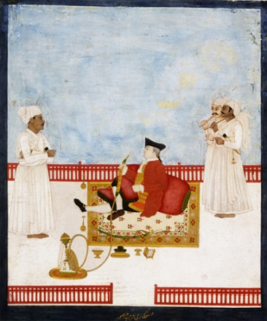
States granted charters and monopolies to private trading companies, and governments founded scientific societies and offered prizes to promote innovation
European merchants and other innovators from the fifteenth century onward gained an unusual degree of freedom from state control and in some places a higher social status than their counterparts in more established civilizations
In Venice and Holland, merchants actually controlled the state
By the eighteenth century, major Western European societies were highly commercialized and governed by states generally supportive of private commerce

Slide 11
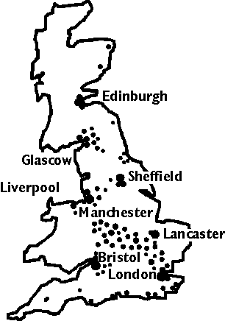
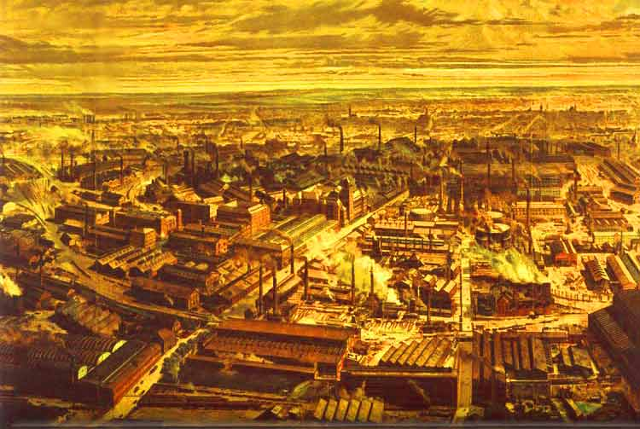
These internally competitive economies, coupled with a highly competitive system of rival states, fostered innovation in the new civilization taking shape in Western Europe.

Slide 12
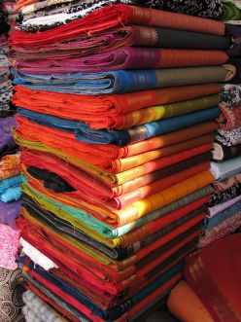
Of course, there were other factors to encourage industrialization
Widespread contact with culturally different peoples was yet another factor that generated change and innovation
This new global network, largely the creation of Europeans themselves, greatly energized European commerce and brought Europeans into direct contact with peoples around the world
For example, Asia, home to the world’s richest and most sophisticated societies, was the initial destination of European voyages of exploration
The competitive stimulus of Indian cotton textiles was one factor driving innovation in the British textile industry

Slide 13
The competition from desirable, high-quality, and newly, available Asian goods played a role in stimulating Europe’s Industrial Revolution. And in the Americas, Europeans found a windfall of silver that allowed them to operate in Asian markets. They also found timber, fish, maize, potatoes, and much else to sustain a growing population. Later slave-produced cotton supplied an emerging textile industry with its key raw material at low prices, while sugar, similarly produced with slave labor, furnished cheap calories to European workers.

Slide 14
The new societies of the Americas also offered a growing market for European machine-produced goods and generated substantial profits for European merchants and entrepreneurs
Commerce and cross-cultural exchange provided the tools necessary for impressive technological changes
Yes, but why did the Industrial Revolution begin in Britain?
Britain was the most highly commercialized of Europe’s larger countries
British landlords had long ago “enclosed” much agricultural land, pushing out the small farmers and producing for the market

Slide 15
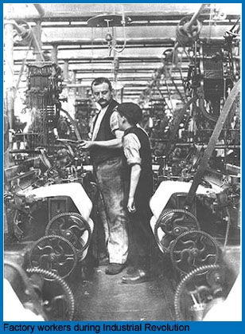
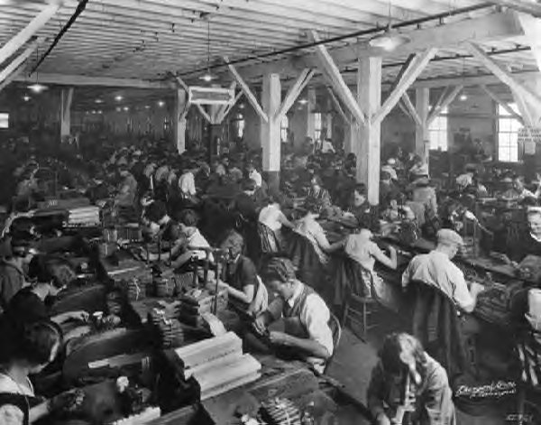
A series of agricultural innovations – crop rotation, selective breeding of animals, lighter plows, higher-yielding seeds – increased agricultural output, kept prices low, and freed up labor from the countryside. The guilds, which earlier had protected Britain’s urban artisans, had largely disappeared by the eighteenth century, allowing employers to run their manufacturing enterprises as they saw fit. Coupled with a rapidly growing population, these processes ensured a ready supply of industrial workers, who had few alternatives available to them.

Slide 16
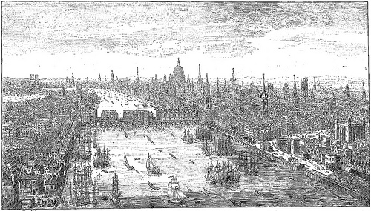
And British aristocrats, unlike their counterparts in Europe, had long been interested in commerce
British political life encouraged commercialization and economic innovation
Its policy of religious toleration, formally established in 1688, welcomed people with technical skills regardless of their faith, whereas France’s persecution of its Protestant minority had chased out some of its most skilled workers
The British government also favored men of business with tariffs to keep out cheap Indian textiles, with laws that made it easy to form companies and to forbid workers’ unions, with that they served to protect the interests of inventors

Slide 17
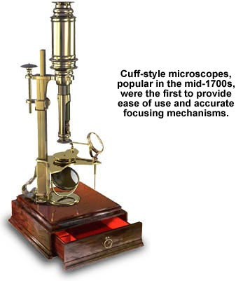
Checks on royal authority – trial by jury and the growing authority of parliament – provided for a freer arena for private enterprise than elsewhere in Europe. Europe’s Scientific Revolution also took a distinctive form in Great Britain in ways that fostered its technological innovation. Whereas science on the continent was largely based on logic, deduction, and mathematical reasoning, in Britain, it was much more concerned with observation and experiment, precise measurements, mechanical devices, and practical commercial applications.

Slide 18
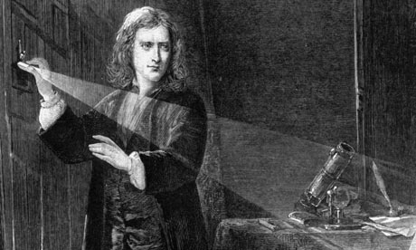
Discoveries about atmospheric pressure and vacuums played an important role in the invention and improvement of the steam engine
Even though most inventors were artisans or craftsmen rather than scientists, in eighteenth-century Britain they were in close contact with scientists, makers of scientific instruments, and entrepreneurs, whereas in continental Europe, these groups were largely separate
The British Royal Society, an association of natural philosophers (scientists) established in 1660, saw its role as one of “promoting useful knowledge”
Finally, several accidents of geography and history contributed something to Britain’s Industrial Revolution

Slide 19
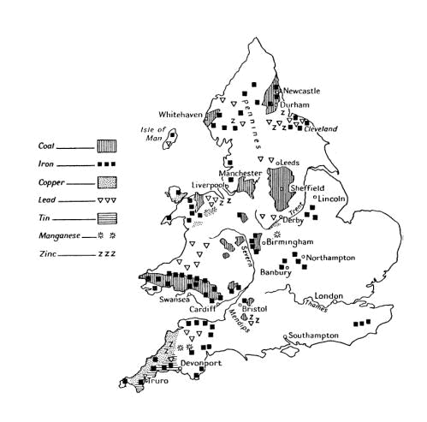
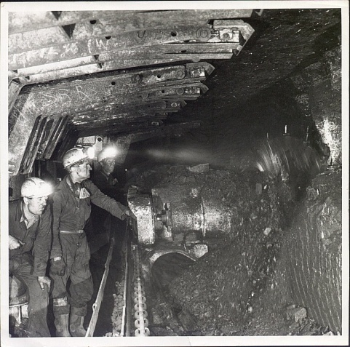
Britain had a ready supply of coal and iron ore, often located close to each other and within easy reach of major industrial centers. Although Britain took part in the wars against Napoleon, the country’s island location protected it from the kind of invasions that so many continental Europeans states experienced during the French Revolution. Moreover, Britain’s relatively fluid society allowed for adjustments in the face of social changes without widespread revolution. By the time the French Revolution ended, Britain was well on its way to becoming the world’s first industrial society.

Slide 20
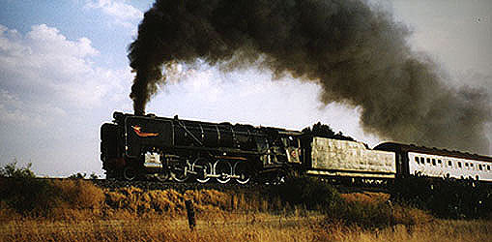
The British textile industry, which used 52 million pounds of cotton in 1800, consumed 588 million pounds in 1850
Britain’s output of coal soared from 5.23 million tons in 1750 to 68.4 million tons a century later
Railroads crisscrossed Britain and eventually much of Europe
As dramatic increases in production occurred in mining, manufacturing, and services, agriculture shrank in relative importance
In Britain, agriculture generated only 8 percent of national income in 1891 and employed fewer than 8 percent of working Britons in 1914
Accompanying this vast economic change was an epic transformation of social life

Slide 21
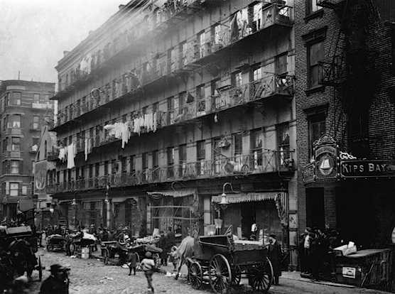
For many people, the Industrial Revolution was an enormously painful change, full of social conflict and insecurity. Eventually, it led to a higher standard of living and greater participation in public life. Of course, not everyone was affected in the same way.

Slide 22
Individual landowning aristocrats, long the dominant class in Britain, suffered little in material terms from the Industrial Revolution
In the mid-nineteenth century, a few thousand families still owned more than half of the cultivated land in Britain, most of it leased to tenant farmers, who in turn employed agricultural wage laborers to work it
Rapidly growing population and urbanization sustained a demand for food products grown on that land
For most of the nineteenth century, landowners continued to dominate the British parliament
As a class, however, the British aristocracy declined

Slide 23
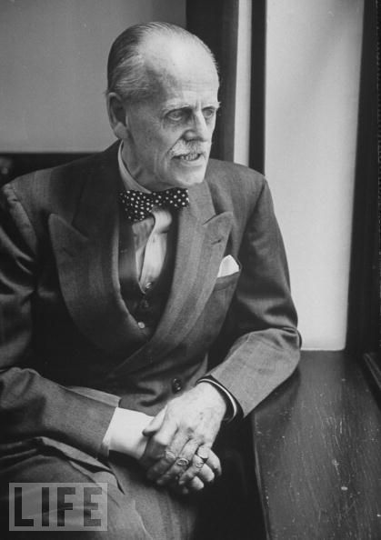
As urban wealth became more important, landed aristocrats had to make way for the up-and-coming businessmen, manufacturers, and bankers who had been newly enriched by the Industrial Revolution. The aristocracy’s declining political clout was demonstrated in the 1840s when high tariffs on foreign agricultural imports, designed to protect the interests of British landlords, were finally abolished. And by the end of the century, landownership had largely ceased to be the basis of great wealth, and businessmen, rather than aristocrats, led the major political parties. Even so, the titled nobility of dukes, earls, viscounts, and barons retained great social prestige and considerable personal wealth.

Slide 24
Those who benefited most from industrialization were merchants of what became known as the “middle classes”
At its upper levels, the middle class contained extremely wealthy factory and mine owners, bankers, and merchants
Far more numerous were the smaller businessmen, doctors, lawyers, engineers, teachers, journalists, scientists, and other professionals required in any industrial society
Such people set the tone for a distinctly middle-class society
Politically, they were liberals, favoring constitutional government, private property, free trade, and social reform within limits

Slide 25
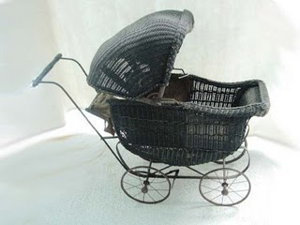
Their agitation resulted in the Reform Bill of 1823, which broadened the right to vote to many men of the middle class, but not to middle-class women. Ideas of thrift and hard work, a rigid morality, and cleanliness characterized middle-class culture. The central value of that culture was “respectability,” a term that combined notions of social status and virtuous behavior. However, women in middle-class families were increasingly cast as homemakers, wives, and mothers, charged with creating an emotional haven for their men and a refuge from the heartless and cutthroat capitalist world.

Slide 26
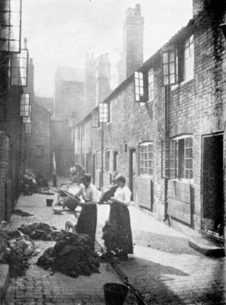
But the overwhelming majority of Britain’s nineteenth-century population – some 70 percent or more – were manual workers in mines, ports, factories, construction sites, workshops and farms
The laboring classes were the people who suffered the most and benefited the least from the epic transformations of the Industrial Revolution
The lives of the laboring classes were shaped primarily by the new working conditions of the industrial era
Chief among those conditions was the rapid urbanization of British society
The population of Liverpool increased from 77,000 to 400,000 in the first half of the nineteenth century

Slide 27
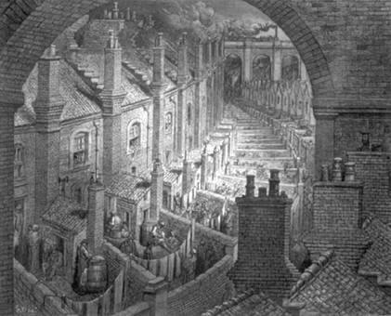
By 1851, a majority of Britain’s population lived in towns and cities, an enormous change from the overwhelmingly rural life of almost all previous civilizations. By the end of the century, London was the world’s largest city, with more than 6 million inhabitants.

Slide 28
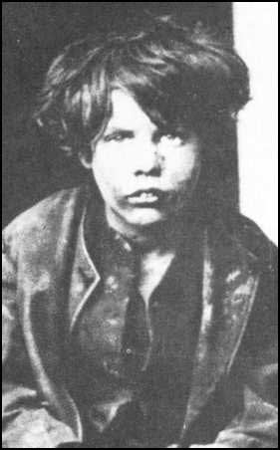
Cities were vastly overcrowded and smoky, with wholly inadequate sanitation, periodic epidemics, endless row houses and warehouses, few public services or open spaces, and inadequate water supplies
Nor was there much personal contact between the rich and the poor of industrial cities
Long hours, low wages, and child labor were nothing new for the poor, but the routine and monotony of work were unwelcome conditions of labor
Also objectionable were the direct and constant supervision and the rules and fines aimed at enforcing work discipline
The ups and downs of a capitalist economy made industrial work insecure as well as onerous

Slide 29
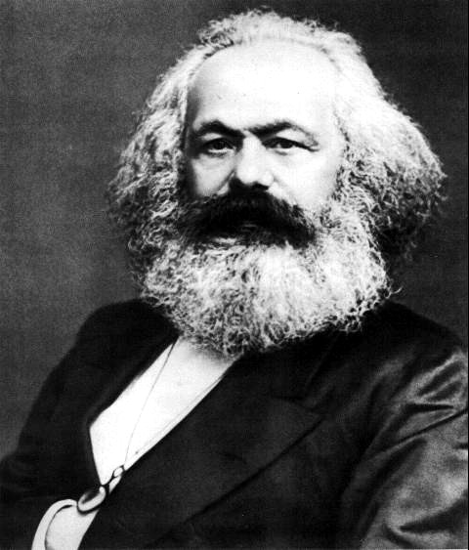
By 1815, about 1 million workers, mostly artisans, had created a variety of “friendly societies.” With dues contributed by members, these working-class self-help groups provided insurance against sickness, a decent funeral, and an opportunity for social life in a bleak environment. Others acted in the political arena and achieved the vote for working-class men by the second half of the nineteenth century. Trade unions were legalized in 1824 and many workers joined. Socialist ideas also began to spread among the laboring classes.

Slide 30
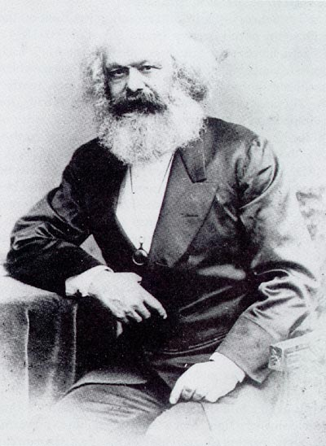
Robert Owen (1771-1858), a wealthy British cotton textile manufacturer, urged the creation of small industrial communities, cooperatively run by workers themselves
Owen established one such community in New Lanark in Scotland
Of more lasting significance was the socialism of Karl Marx (1818—1883)
German by birth, Marx spent much of his life in England, where he witnessed the brutality of the early Industrial Revolution
To Marx, “class struggle” was the motor of historical change
In Marx’s time, the conflict was between the bourgeoisie and the proletariat

Slide 31
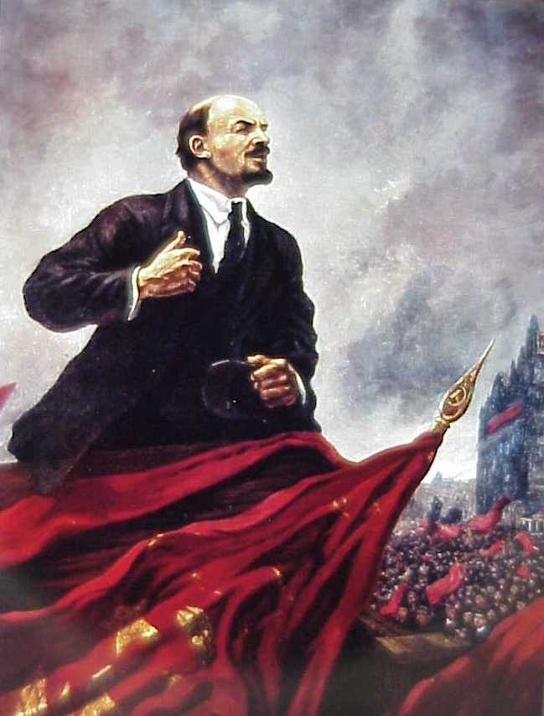
The bourgeoisie owned industrial capital while the proletariat was Marx’s term for the industrial working class. For Marx, class struggle was the central dynamic of industrial capitalist societies. According to Marx, capitalism had great promise for it unleashed great productivity but this promise could never be fulfilled because private property, competition, and class hostility prevented industrial societies from distributing their abundance to the very workers who had created the abundance. Capitalism was flawed, doomed to collapse amid a working-class revolution. After the revolution, Marx looked forward to a communist future where productivity would be placed in service to the entire community.

Slide 32
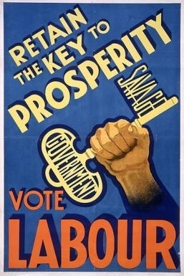
But when a working-class political party, the Labour Party, was established in the 1890s, it advocated a reformist program and a peaceful democratic transition to socialism, largely rejecting the class struggle and revolutionary emphasis of Marxism
A major factor producing a moderate working-class movement lay in improving material conditions during the second half of the nineteenth century
For Marx had not foreseen the development of an intermediate social group, a sizable middle and lower-middle class, nor had he imagined that workers could better their standard of living within a capitalist framework – but they did

Slide 33
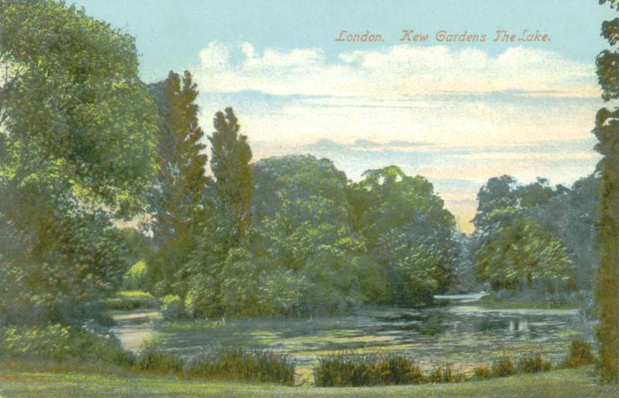
Wages rose under pressure from unions; cheap imported food improved working-class diets; infant mortality rates fell. As English male workers gradually obtained the right to vote, politicians had an incentive to legislate in their favor, by abolishing child labor, regulating factory conditions, and even, in 1911, inaugurating a system of relief for the unemployed. Sanitary reforms considerably cleaned up cities and urban parks made a modest appearance. Contrary to Marx’s expectations, capitalist societies demonstrated some capacity for reform. Yet immense inequalities still separated the classes.

Slide 34
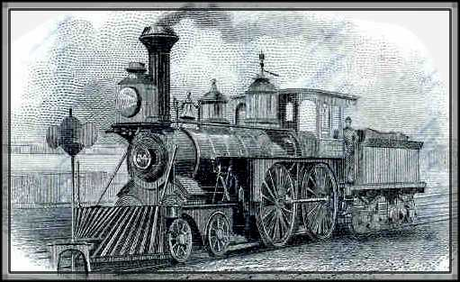
Strayer Questions
In what respects did the roots of the Industrial Revolution lie within Europe? In what ways did that transformation have global roots?
What was distinctive about Britain that may help to explain its status as the breakthrough point of the Industrial Revolution?
How did the Industrial Revolution transform British society?
How did Britain's middle classes change during the nineteenth century?
How did Karl Marx understand the Industrial Revolution? In what ways did his ideas have an impact in the industrializing world of the nineteenth century?

