Slide 1
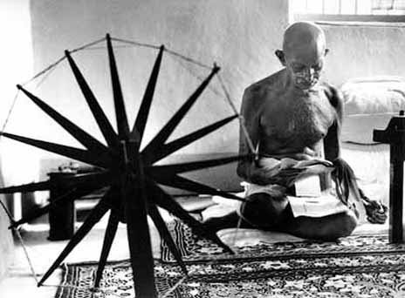
“The spinning wheel represents to me the hope of the masses. The masses lost their freedom, such as it was, with the loss of the Charkha. The Charkha supplemented the agriculture of the villagers and gave it dignity.”
Mohandas K. Gandhi

Slide 2
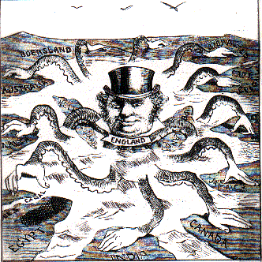
Between roughly 1750 and 1950, much of the Afro-Asian-Pacific world was enveloped in a new wave of European empire building
Policies of the colonial powers sometimes differed sharply and changed over time
And the varied actions and reactions of colonial subjects also shaped the colonial experience
If the earlier takeover of the Americas represented the first phase of European colonial conquests, the century and a half between 1750 and 1900 was a second and distinct round
Now it was focused in Asia and Africa rather than in the Western Hemisphere
It featured several new players – Germany, Italy, Belgium, the United States, and Japan – as well as older players like Great Britain and France

Slide 3
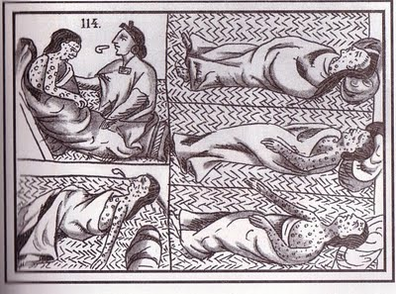
And in mainland Asia and Africa, European conquests nowhere had the devastating demographic consequences that had so sharply reduced the Native American populations.

Slide 4
This second wave of European colonial conquests was also conditioned by Europe’s Industrial Revolution
In general, Europeans preferred informal control, for it was cheaper and less likely to provoke wars
But where rivalry with other European states made it impossible or where local governments were unwilling to cooperate, Europeans proved more than willing to take the expense of colonial rule
These imperial empires involved military force or the threat of using it
Increasingly in the nineteenth century, the Europeans also possessed overwhelming firepower with the recently invented repeating rifles and machine guns

Slide 5
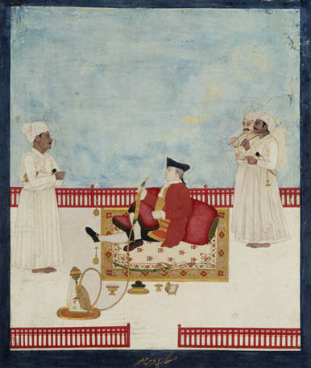
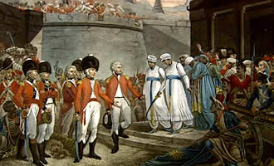
But Europeans still had to fight, often long and hard, to create their new empires, as countless wars of conquest attest. For some, such as Hindus governed by the Muslim Mughal Empire, it was an exchange of one set of foreign rulers for another. For others, it was an entirely new experience.

Slide 6
The passage to colonial status occurred in various ways
For the peoples of India and Indonesia, colonial conquest grew out of earlier interaction with European trading firms
Particularly in India, the British East India Company, rather than the British government directly, played the leading role in the colonial takeover of South Asia
The fragmentation of the Mughal Empire and the absence of any overall sense of cultural or political unity invited and facilitated European penetration
A similar situation of many small and rival states assisted the Dutch acquisition of Indonesia

Slide 7
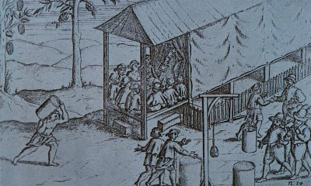
However, neither the British nor the Dutch had a clear-cut plan for conquest. Rather it evolved slowly as local authorities and European traders made and unmade a variety of alliances over a long period of time, lasting roughly a century in India (1750-1850). In Indonesia, a few areas held out until the early twentieth century.

Slide 8
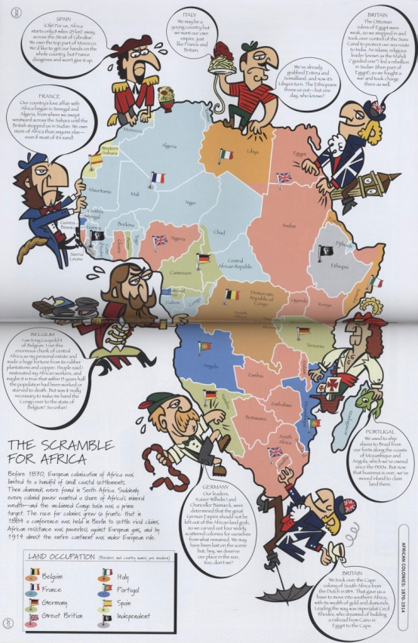
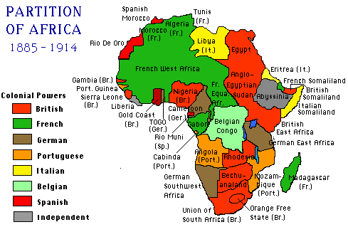
For most of Africa, mainland Southeast Asia, and the Pacific islands, colonial conquest came later, in the second half of the nineteenth century, and rather more abruptly and deliberately. The “scramble for Africa” pitted half a dozen European powers against one another as they partitioned the entire continent among themselves in only about twenty-five years (1875-1900).

Slide 9
The most difficult regions to subdue were those decentralized societies, societies without formal state structures
In such cases, Europeans confronted no central authority with which they could negotiate or that they might decisively defeat
It was a matter of village-by-village conquest
And the South Pacific territories of Australia and New Zealand, both of which were taken over by the British during the nineteenth century, were more similar to the earlier colonization of North America
In both places, conquest was accompanied by massive European settlement and diseases that reduced native numbers by 75 percent or more

Slide 10
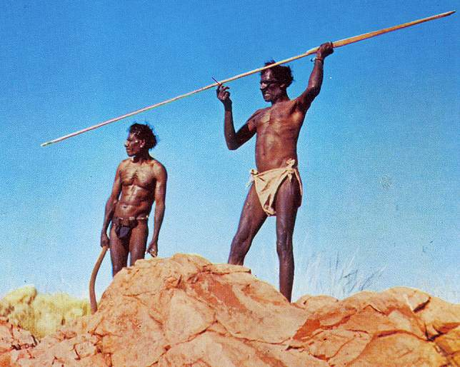
Like Canada and the United States, Australia and New Zealand became settler colonies. Aboriginal Australians constituted only about 2.4 percent of their country’s population in the early twenty-first century, and the indigenous Maori were a minority of about 15 percent in New Zealand. With the exception of Hawaii, nowhere else in the nineteenth-century colonial world were existing populations so decimated and overwhelmed as they were in Australia and New Zealand.

Slide 11
Elsewhere other variations of imperialism unfolded
Japan’s takeover of Taiwan and Korea bore similarities to European actions
The westward expansion of the United States and the Russian penetration of Central Asia brought additional millions under European control
Filipinos acquired new colonial rulers when the United States took over from Spain following the Spanish-American War of 1898
Some 13,000 freed U.S. slaves, seeking greater freedom than was possible at home, migrated to West Africa, where they became, ironically, a colonizing elite in the land they named Liberia

Slide 12
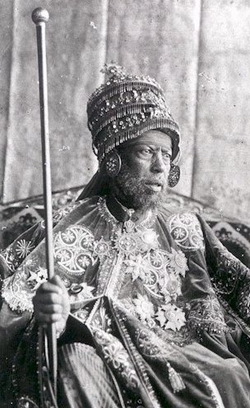
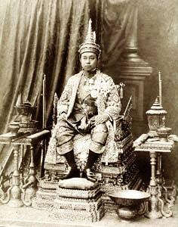
Ethiopia and Siam (Thailand) were notable for avoiding the colonization to which their neighbors succumbed. Those countries’ military and diplomatic skills, willingness to make modest concessions, and ability to exploit imperialist rivalries contributed to these exceptions to the rule of colonial takeover in East Africa and Southeast Asia.

Slide 13
The rulers of the East African kingdom of Buganda saw opportunity in the British presence and negotiated an arrangement that substantially enlarged their state and personally benefitted the kingdom’s elite class
But in many places and for many people, incorporation into European colonial empires was a traumatic experience
The loss of life, homes, cattle, crops, and land could be devastating
Yet the shortage and expense of European administrators and the difficulties of communicating across cultural boundaries made it necessary for colonial rulers to rely heavily on a range of local intermediaries

Slide 14
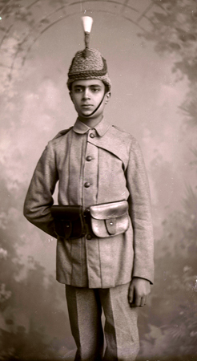
In French West Africa, the colonial state consisted of just 385 French administrators and more than 50,000 African chiefs. Thus colonial rule rested upon and reinforced the most conservative segments of Asian and African societies. But both colonial governments and private missionary organizations had an interest in promoting a measure of European education. From this process arose a small Western-educated class, whose members served the colonial state, European businesses, and Christian missions as teachers, clerks, translators, and lower- level administrators.

Slide 15
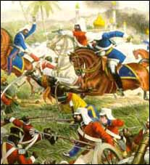
Europeans increasingly depended on the Western-educated class at the expense of the more traditional elites
And while colonial rule enlisted the willing cooperation of some, it provoked the bitter opposition of many others
Thus periodic rebellions punctuated the history of colonial regimes everywhere
The most famous was the Indian Rebellion of 1857-1858, sometimes referred to as the Sepoy Mutiny
This rebellion was triggered by the introduction into the colony’s military forces of a new cartridge smeared with animal fat from cows and pigs

Slide 16
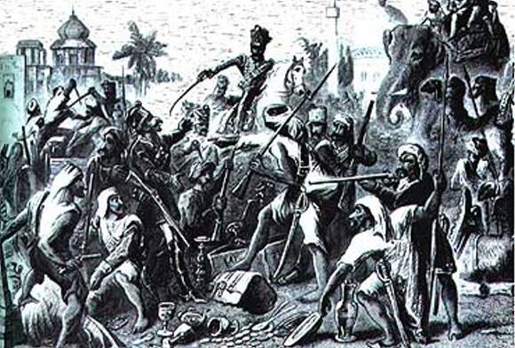
The cow was sacred to Hindus and the pig was deeply offensive to Muslims, and both groups viewed the innovation as a plot to render them defiled and to convert them to Christianity. Behind this incident were many groups of people with a whole series of grievances generated by the British colonial presence. A mutiny among Indian troops in Bengal triggered the rebellion, which soon spread to other regions of the colony and other social groups. Soon much of India was aflame.

Slide 17
Rebel leaders presented their movement as an effort to revitalize the defunct Mughal Empire and thereby attracted many with strong resentments against the British
Although it was crushed in 1858, the rebellion greatly widened the racial divide in colonial India
It also made the British more conservative and cautious about deliberately trying to change Indian society for fear of provoking another rebellion
Moreover, it convinced the British government to assume direct control over India, ending the era of British East India Company rule in the subcontinent

Slide 18
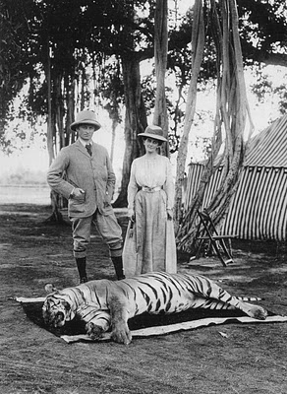
While the nineteenth-century European colonial empires could be viewed as the latest in a very long line of imperial creations, differences existed. One was the prominence of race in distinguishing rulers and ruled, as the high tide of “scientific racism” in Europe coincided with the acquisition of Asian and African colonies.

Slide 19
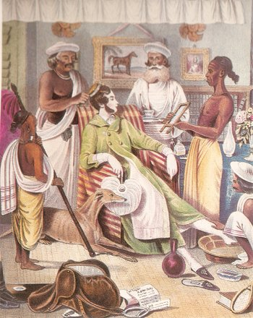
In East Africa, white men were referred to as “bwana” (Swahili for “master”), whereas Europeans regularly called African men “boy”
Education for colonial subjects was both limited and skewed toward practical subjects rather than scientific and literary studies, which were widely regarded as inappropriate for the “primitive mind” of “natives”
Particularly affected by European racism were those whose Western education and aspirations most clearly threatened the racial divide
Europeans were exceedingly reluctant to allow even the most highly educated Asian and Africans to enter the higher ranks of the colonial civil service

Slide 20
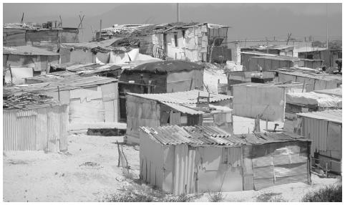
In those colonies that had a large European settler population, the pattern of racial separation was much more pronounced than in places such as Nigeria, which had few permanently settled whites. The most extreme case was South Africa, where a large European population and the widespread use of African labor in mines and industries brought blacks and whites into closer and more prolonged contact than elsewhere.

Slide 21
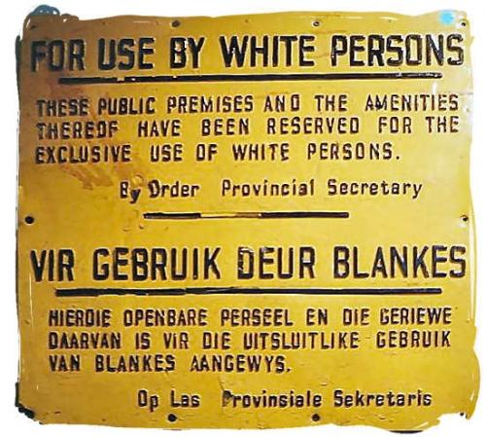
The racial fears that were aroused resulted in extraordinary efforts to establish race as a legal, not just a customary, feature of South African society
This racial system provided for separate “homelands,” educational systems, residential areas, public facilities, and much more
In what was eventually known as apartheid, South African whites attempted the impossible task of creating an industrializing economy based on cheap African labor, while limiting African social and political integration in every conceivable fashion

Slide 22
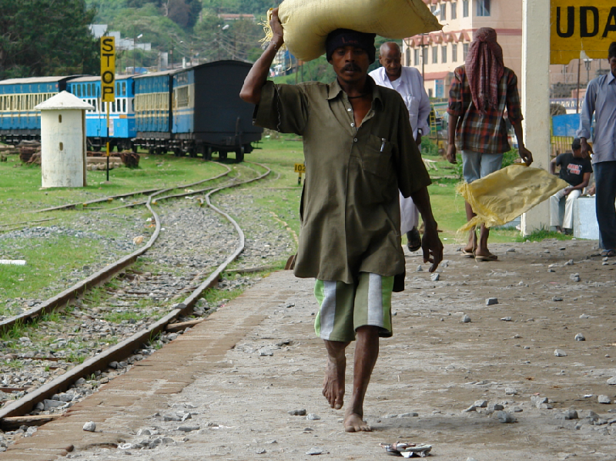
A further distinctive feature of nineteenth-century European empires lay in the extent to which colonial states were able to penetrate the societies they governed. Centralized tax-collecting bureaucracies, new means of communication and transportation, imposed changes in landholding patterns, integration of colonial economies into a global network of exchange, public health and sanitation measures, and the activities of missionaries all touched the daily lives of many people far more deeply than in most earlier empires.

Slide 23
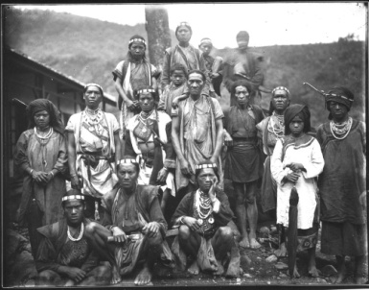
Not only were Europeans foreign rulers, but they also bore the seeds of a very different way of life, which grew out of their own modern transformation
Nineteenth-century European colonizers were also extraordinary as well in their penchant for counting and classifying their subject people
With the assistance of anthropologists and missionaries, colonial governments collected a vast amount of information, sought to organize it “scientifically,” and used it to manage the unfamiliar, complex, varied, and fluctuating societies that they governed
In African colonies, Europeans identified, and sometimes invented, distinct tribes

Slide 24
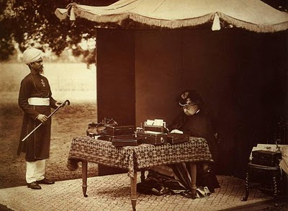
Finally, European colonial policies contradicted their own core values and their practices at home to an unusual degree. While nineteenth-century Britain and France were becoming more democratic, their colonies were essentially dictatorships. Empire, of course, was wholly at odds with European notions of national independence, and ranked racial classifications went against the grain of both Christian and Enlightenment ideas of human equality. Furthermore, many Europeans were distinctly reluctant to encourage within their colonies any kind of modernization.

Slide 25
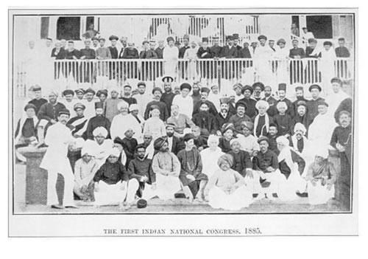
Europeans feared that this kind of social change, often vilified as “detribalization,” would encourage unrest, challenging colonial rule
Europeans much preferred “traditional” rural society, with its established authorities and social hierarchies, though shorn of abuses such as slavery and sati (widow-burning)
Such contradictions between what Europeans preached at home and what they practiced in the colonies became increasingly apparent to many Asians and Africans and played a major role in undermining the foundations of colonial rule in the twentieth century

Slide 26
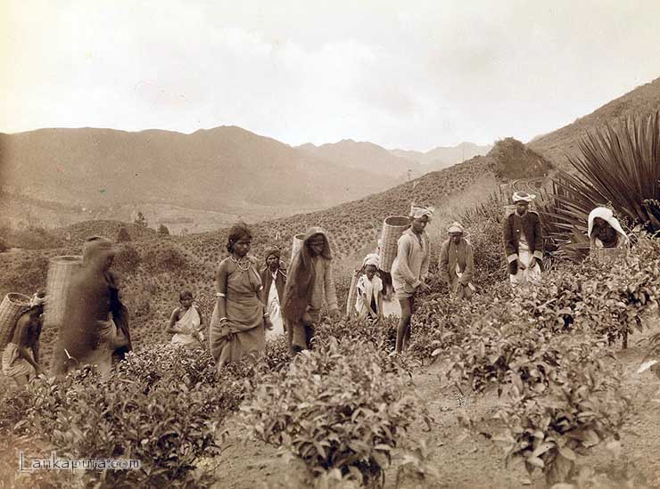
Colonial rule affected the lives of its subject people in many ways, but the most pronounced change was in their ways of working.

Slide 27
To various degrees, old ways of working were eroded almost everywhere in the colonial world
Subsistence farming, in which peasant families produced largely for their own needs, diminished as growing numbers directed at least some of their energies to working for wages or selling what they produced for a cash income
As in Europe, artisans suffered greatly when cheaper machine-manufactured merchandise displaced their own handmade goods
A flood of inexpensive textiles from Britain’s new factories ruined the livelihood of tens of thousands of India’s handloom weavers
Furthermore, Asian and African merchants were squeezed out by well-financed European commercial firms

Slide 28
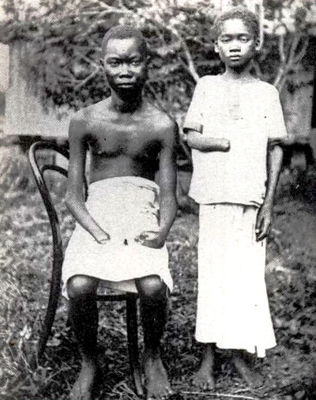
In French Africa, all “natives” were legally obligated for “statute labor” of ten to twelve days a year, a practice that lasted through 1946. It was much resented. But the most infamous cruelties of forced labor occurred during the early twentieth century in the Congo Free State, then governed personally by Leopold II of Belgium.

Slide 29
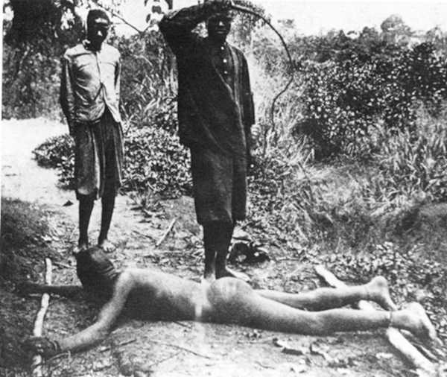
Private companies in the Congo, operating under the authority of the state, forced villagers to collect rubber, which was much in demand for bicycle and automobile tires, with a reign of terror and abuse that cost millions of lives
Eventually these abuses were widely publicized in Europe, where they created a scandal, forcing the Belgian government to take control of the Congo in 1908 and ending Leopold’s reign of terror
A variation on the theme of forced labor took shape in the so-called cultivation system of the Netherlands East Indies (Indonesia) during the nineteenth century

Slide 30
Peasants were required to cultivate 20 percent or more of their land in cash crops such as sugar or coffee to meet their tax obligation to the state. According to one scholar, the cultivation system “performed a miracle for the Dutch economy,” enabling it to avoid taxing its own people and providing capital for its Industrial Revolution. It also enriched and strengthened the position of those “traditional authorities” who enforced the system, on behalf of the Dutch. For the peasants of Java, however, it meant a double burden of obligations to the colonial state as well as to local lords.

Slide 31
Many became indebted to moneylenders when they could not meet those obligations
Those demands, coupled with the loss of land and labor now excluded from food production, contributed to a wave of famines during the mid-nineteenth century in which hundreds of thousands perished
But the forced cultivation of cash crops was widely and successfully resisted in many places
In German East Africa, forced labor and brutal beatings prompted a massive rebellion in 1905 which persuaded the Germans to end the forced growing of cotton
In such ways the actions of the colonized did alter or frustrate the plans of the colonizers

Slide 32
Strayer Questions
In what different ways did the colonial takeover of Asia and Africa occur?
Why might subject people choose to cooperate with the colonial regime? What might prompt them to rebel or resist?
What was distinctive about European colonial empires of the nineteenth century?
How did the power of colonial states transform the economic lives of colonial subjects?

