Slide 1
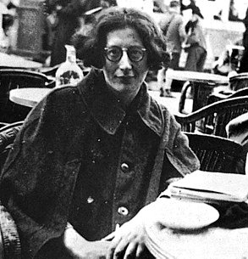
“Just as a person who is always asserting that he is too good-natured is the very one from whom to expect, on some occasion, the coldest and most unconcerned cruelty, so when any group sees itself as the bearer of civilization this very belief will betray it into behaving barbarously at the first opportunity.”
Simone Weil

Slide 2
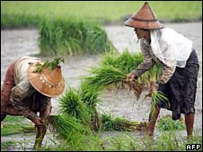
Many Asian and African peoples had produced quite willingly for an international market long before they were enclosed within colonial societies
But in some places, colonial rule created conditions that facilitated and increased cash-crop production
British authorities in Burma encouraged rice production among small farmers by ending a prohibition on rice exports and providing irrigation and transportation facilities
It was a very different situation from that of peasants forced to grow crops that seriously interfered with their food production
Profitable cash-crop farming also developed in the southern Gold Coast (present-day Ghana)

Slide 3
Unlike Burma, it was African farmers themselves who took the initiative to develop export agriculture. Planting cacao trees in huge quantities, they became the world’s leading supplier of cocoa by 1911. Cacao was an attractive crop because, unlike cotton, it was compatible with the continued production of foods and did not require so much labor time.

Slide 4
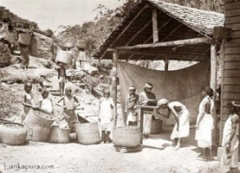
Yet when many colonies came to specialize in one or two cash crops, it created an unhealthy dependence when world market prices dropped
Thus African and Asian farmers were increasingly subject to the uncertain rhythms of the international marketplace as well as to those of the seasons and the weather
Also a new way of working in colonial societies developed based on wage labor in European enterprises
Driven by the need for money, by the loss of land adequate to support their families, or sometimes by the orders of colonial authorities, millions of colonial subjects across Asia and Africa sought employment in European-owned plantations, mines, construction projects, and homes

Slide 5
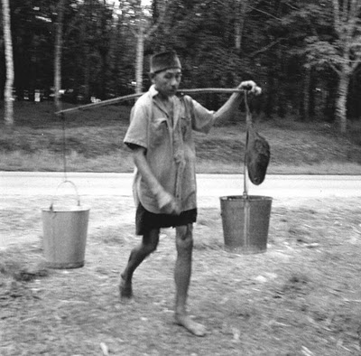
All across Southeast Asia in the later nineteenth and early twentieth centuries, huge plantations sprouted, which were financed from Europe and which grew sugarcane, rubber, tea, tobacco, sisal, and more. Impoverished workers by the hundreds of thousands came from great distances – India, China, Java – finding their way to these plantations, where they were subject to strict control, often housed in barracks, and paid poorly, with women receiving 50 to 75 percent of a man’s wage.

Slide 6
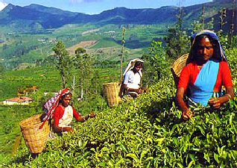
Disease was common, and death rates were twice or more that of the colony as a whole
In southern Vietnam in 1927 alone, one in twenty plantation workers died
British colonial authorities in India facilitated the migration of millions of Indians to work sites elsewhere in the British Empire
Some Indians labored as indentured workers and others as independent merchants
In Africa more than Asia, people migrated to European farms or plantations because they had lost their own land
In the settler colonies of Africa – Algeria, Kenya, Southern Rhodesia (Zimbabwe), and South Africa – permanent European communities obtained huge tracts of land

Slide 7
A 1913 law in South Africa legally defined 88 percent of the land as belonging to whites, who were then about 20 percent of the population. Much of highland Kenya, an enormously rich agricultural region that was home to the Gikuyu and Kamba peoples, was taken over by some 4,000 white farmers.

Slide 8
Mines were another source of wage labor for many
The British-ruled Malay states (Malaysia) produced some 55 percent of the world’s tin by 1895
These mines drew many millions of impoverished Chinese workers on strictly controlled three-year contracts
Appalling living conditions, disease, and accidents generated extraordinarily high death rates
The gold and diamond mines of South Africa likewise set in motion a huge pattern of labor migration that encompassed all of Africa south of the Belgian Congo

Slide 9
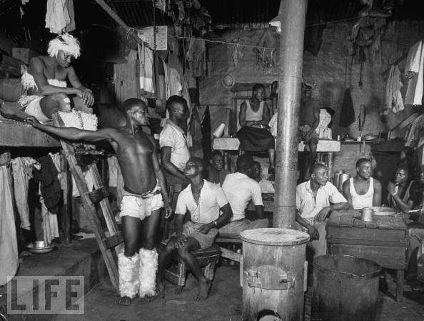
With skilled and highly paid work reserved for white miners, Africans were relegated largely to unskilled labor at a fraction of white wages. Furthermore, they were recruited on short-term contracts, lived in all-male prisonlike barracks that were often surrounded by barbed wire, and were forced to return home periodically to prevent them from establishing a permanent family life near the mines.

Slide 10
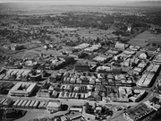
The rapidly swelling cities of the colonial world – Lagos, Nairobi, Cairo, Calcutta, Rangoon, Batavia, Singapore, Saigon – required no coercion to attract would-be wage earners, particularly from the late nineteenth century on
Racially segregated, often unsanitary, and greatly overcrowded, these cities nonetheless were seen as meccas of opportunity for people all across the social spectrum
The high cost of housing in cities relative to the wages of the majority of African workers made even British authorities acknowledge that normal family life in the colony’s major urban centers proved out of reach for the vast majority of people

Slide 11
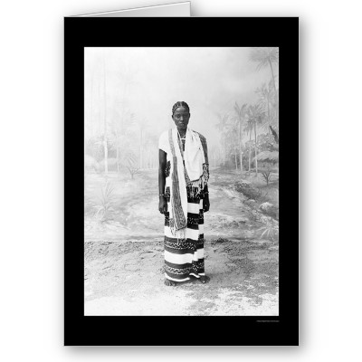
If economic life in European empires varied greatly from place to place, even within the same colony, it also offered a different combination of opportunities and hardships to women than it did to men.

Slide 12
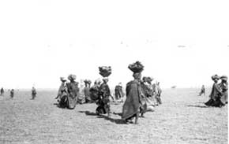
In precolonial times, African women were almost everywhere active farmers
Women were expected to feed their own families and were usually allocated their own fields for that purpose
Many women were also involved in local trading activity
Though clearly subordinate to men, African women nevertheless had a measure of economic autonomy
As the demands of the colonial economy grew, women’s lives diverged more and more from those of men
In colonies where cash-crop agriculture was dominant, men often withdrew from subsistence production in favor of more lucrative export crops

Slide 13
Among the Ewe people of southern Ghana, men almost completely dominated the highly profitable cacao farming, whereas women assumed near total responsibility for domestic food production. In neighboring Ivory Coast, women had traditionally grown cotton for their families’ clothing; but when that crop acquired a cash value, men insisted that cotton grown for export be produced on their own personal fields. Thus men acted to control the most profitable aspects of cash-crop agriculture and in doing so greatly increased the subsistence workload of women.

Slide 14
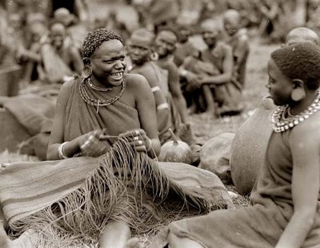
One study from Cameroon estimated that women’s working hours increased from forty-six per week in precolonial times to more than seventy by 1934
Further increasing women’s workload and differentiating their lives from those of men was labor migration
As more and more men sought employment in the cities, on settler farms, or in the mines, their wives were left to manage the domestic economy almost alone
In many cases, women also had to supply food to men in the cities to compensate for very low urban wages

Slide 15
Women also often took over such traditionally male tasks as breaking the ground for planting, milking the cows, and supervising the herds, in addition to their normal responsibilities. In South Africa, where the demands of the European economy were particularly heavy, some 40 to 50 percent of able-bodied adult men were absent from the rural areas, and women headed 60 percent of households. In Botswana, which supplied much male labor to South Africa, married couples by the 1930s rarely lived together for more than two months at a time.

Slide 16
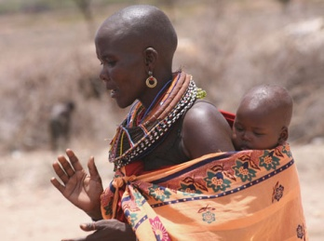
Women coped with these difficult circumstances in a number of ways
Many sought closer relations with their families of birth rather than with their absent husband’s families
Yet the colonial economy sometimes provided a measure of opportunity for enterprising women, particularly in small-scale trade and marketing
Some women took advantage of new opportunities in mission schools, towns, and mines to flee the restrictions of rural patriarchy
Such challenges to patriarchal values elicited various responses from men, including increased accusations of witchcraft against women and fears of impotence

Slide 17
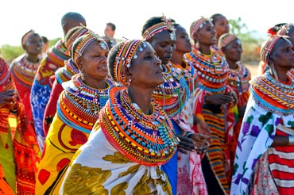
The control of women’s sexuality and mobility was a common interest of European and African men.

Slide 18
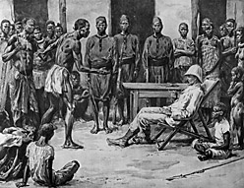
Beyond the many and varied changes that transformed the working lives of millions in the colonial world lies the difficult and controversial question of the overall economic impact of colonial rule on Asian and African societies
It is clear that colonial rule served, for better or worse, to further the integration of Asian and African economies into a global network of exchange, now centered in Europe
Second, Europeans could hardly avoid conveying to the colonies some elements of their own modernizing process
Modern administrative and bureaucratic structures facilitated colonial control

Slide 19
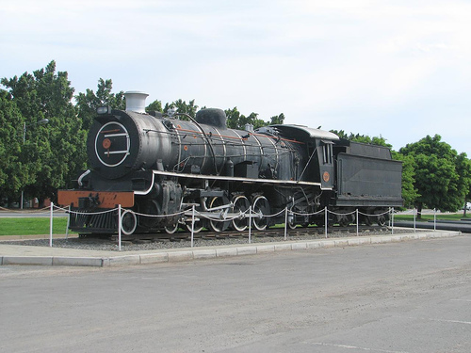
Communication and transportation infrastructure (railroads, motorways, ports, telegraphs, postal services) moved products to the world market but also introduced elements of modernization.

Slide 20
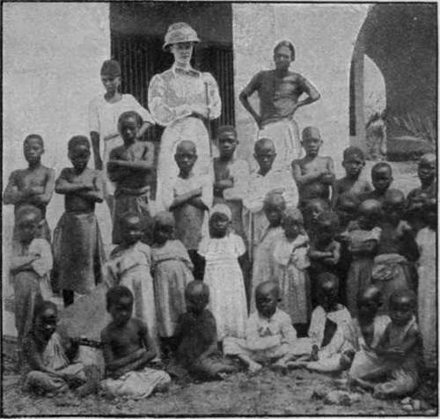
Finally, nowhere in the colonial world did a breakthrough to modern industrial society of Japanese dimensions occur
Yet for an important minority, it was the acquisition of Western education, obtained through missionary or government schools, that generated a new identity
To previously illiterate people, the knowledge of reading and writing often suggested an almost magical power
Within the colonial setting, it could mean an escape from some of the more onerous obligations of living under European control, such as forced labor
More positively, it meant access to better-paying positions

Slide 21
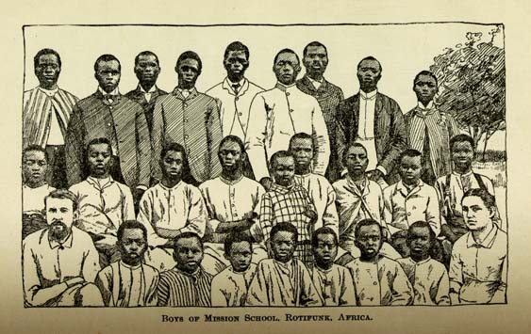
Education often provided social mobility and elite status within communities. Many educated colonial subjects embraced European culture, dressing in European clothes, speaking French or English, building European-style houses, getting married in long white dresses, and otherwise emulating European ways. Asian and African colonial societies now had a new cultural divide: between the small number who had mastered to varying degrees the ways of their rulers and the vast majority who had not.

Slide 22
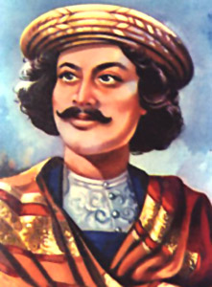
Many among the Western-educated elite saw themselves as a modernizing vanguard who were leading the regeneration of their societies, in association with colonial authorities
For them, at least initially, the colonial enterprise was full of promise for a better future
In nineteenth-century India, Western-educated people organized a variety of reform societies, which sought a renewed Indian culture that was free of idolatry, child marriages, caste, and discrimination against women, while drawing inspiration from the classical texts of Hinduism
Ram Mohan Roy (1772-1833) was perhaps the foremost of these Indian reformers

Slide 23
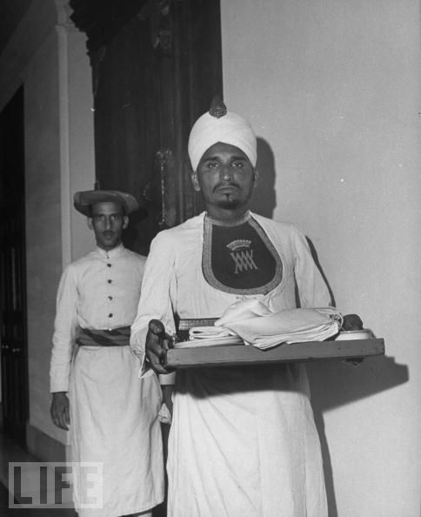
But such fond hopes for the renewal of Asian and African societies through colonial rule would be bitterly disappointed. Europeans generally declined to treat their Asian and African subjects – even those with a Western education – as equal partners in the enterprise of renewal.

Slide 24
Religion too provided the basis for new or transformed identities during the colonial era
Most dramatic were those places where widespread conversion to Christianity took place, such as New Zealand, the Pacific islands, and especially non-Muslim Africa
As in the Americas centuries earlier, military defeat shook confidence in the old gods and local practices, fostering openness to new sources of supernatural power that could operate in the wider world now impinging on their societies
Christianity was also widely associated with modern education, and, especially in Africa, mission schools were primary providers of Western education

Slide 25
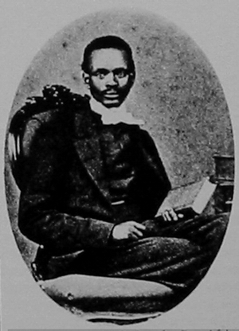
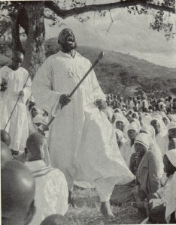
The young, the poor, and many women – all of them oppressed groups in many African societies – found new opportunities and greater freedom in some association with missions. Moreover, the spread of the Christian message was less the work of European missionaries than those of many thousands of African teachers and pastors who brought the new faith to remote villages. As elsewhere, Christianity in Africa soon became Africanized.

Slide 26
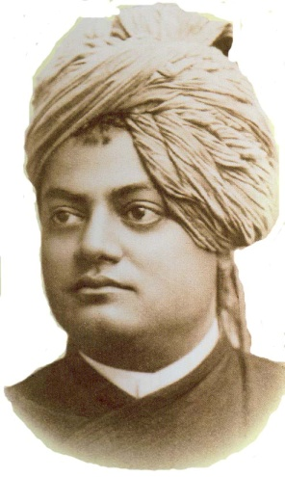
In India, where Christianity made only very modest inroads, leading intellectuals and reformers began to define their region’s endlessly varied beliefs as a more distinct, unified, and separate religion that we now know as Hinduism
It was in part an effort to provide for India a religion wholly equivalent to Christianity
To Swami Vivekananda (1863-1902), one of nineteenth-century India’s most religious figures, a revived Hinduism, shorn of its distortions, offered a means of uplifting the country’s village communities, which were the heart of Indian civilization
Moreover, it could offer spiritual support to a Western world mired in materialism and militarism

Slide 27
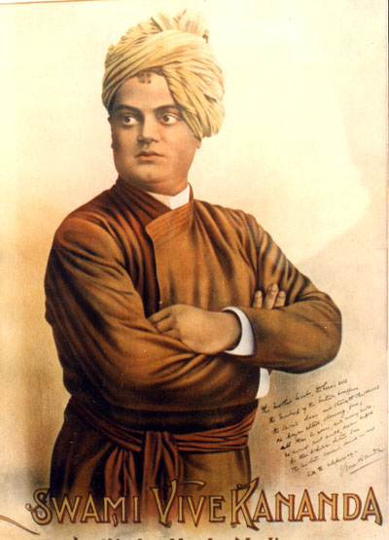
Swami Vivekananda brought his message to the First World Parliament of Religions held in 1893 in Chicago.

Slide 28
This new notion of Hinduism provided a cultural foundation for emerging ideas of India as a nation, but it also contributed to a clearer sense of Muslims as a distinct community in India
The British also created separate inheritance laws for all Muslims and all Hindus
And as some anti-British patriots began to cast India in Hindu terms, the idea of Muslims as a separate community, which was perhaps threatened by the much larger number of Hindus, began to make sense to some who practiced Islam
Here were the beginnings of what became in the twentieth century a profound religious and political division within the South Asian peninsula

Slide 29
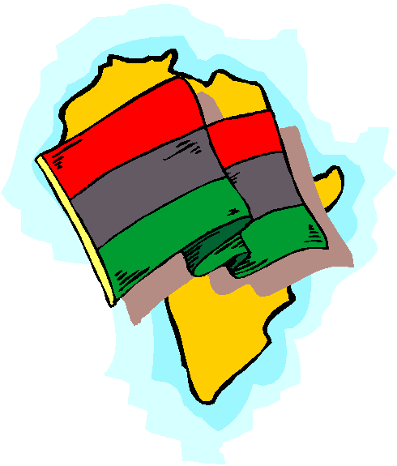
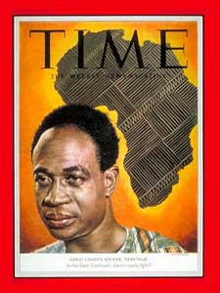
In Africa as well, intellectuals and ordinary people alike forged new ways of belonging as they confronted the upheavals of colonial life. Central to these new identities were notions of race and ethnicity. By the end of the nineteenth century, a number of African thinkers, familiar with Western culture, began to define the idea of an “African identity.” Previously, few if any people on the continent had regarded themselves as Africans. Rather they were members of particular local communities, usually defined by language.

Slide 30
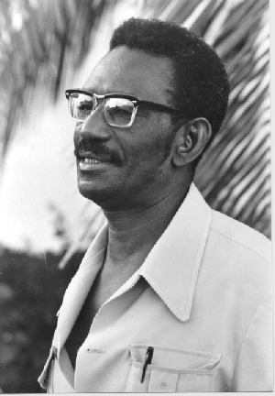
It was an effort to revive the cultural self-confidence of their people by articulating a larger, common, and respected “African tradition,” equivalent to that of Western culture
African intellectuals pointed with pride to the ancient kingdoms of Ethiopia, Mali, Songhay, and others
C.A. Diop, a French-educated scholar from Senegal, insisted that Egyptian civilization was in fact the work of black Africans
Turning European assumptions on their head, Diop argued that Western civilization owed much to Egyptian influence and was therefore derived from Africa

Slide 31
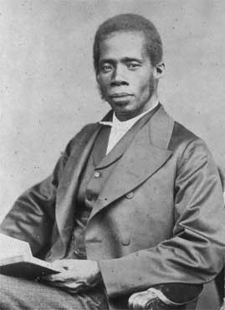
Black people, in short, had a history of achievement fully comparable to that of Europe and therefore deserved just as much respect and admiration. Others praised the differences between African and European cultures. Edward Blyden (1832-1912), a West African born in the West Indies and educated in the United States, who later became a prominent scholar and political official in Liberia believed that the uniqueness of African culture lay in its communal, cooperative, and egalitarian societies which contrasted sharply with Europe’s highly individualist, competitive, and class-ridden societies.

Slide 32
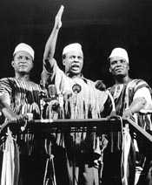
In the twentieth century, hundreds of Africans also took part in World War I
There they encountered other Africans as well as the ideas of American black leaders such as Booker T. Washington, W.E.B. DuBois, and Marcus Garvey and West Indian intellectuals. This further stimulated a sense of belonging to an even larger pan-African world
Such notions underlay the growing nationalist movements that contested colonial rule as the twentieth century unfolded
But for the vast majority, the most important new sense of belonging that evolved from colonial rule was the idea of “tribe” or ethnic identity

Slide 33
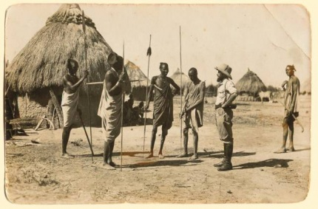
Africans had long recognized differences among themselves but the idea of an Africa sharply divided into separate and distinct “tribes” was in fact a European notion that facilitated colonial administration and reflected Europeans’ belief in African primitiveness. By requiring people to identify their tribe on applications for jobs, schools, and identity cards, colonial governments spread the idea of tribe widely within their colonies. One historian summed up the process of creating African ethnic identities in this way: “European believed Africans belonged to tribes; Africans built tribes to belong to.”

Slide 34
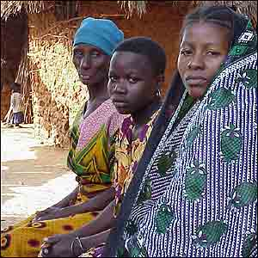
Strayer Questions
How did cash-crop agriculture transform the lives of colonized peoples?
What kinds of wage labor were available in the colonies? Why might people take part in it? How did doing so change their lives?
How were the lives of women altered by colonial economies?
Did colonial rule bring "progress" in its wake?

Slide 35
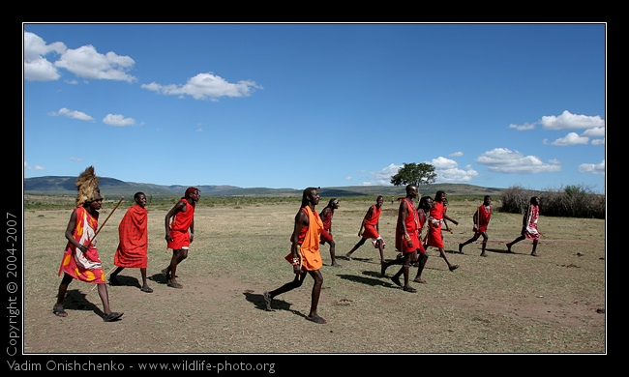
What impact did Western education have on colonial societies?
What were the attractions of Christianity within some colonial societies?
How and why did Hinduism emerge as a distinct religious tradition during the colonial era in India?
In what way were "race" and "tribe" new identities in colonial Africa?

