Slide 1
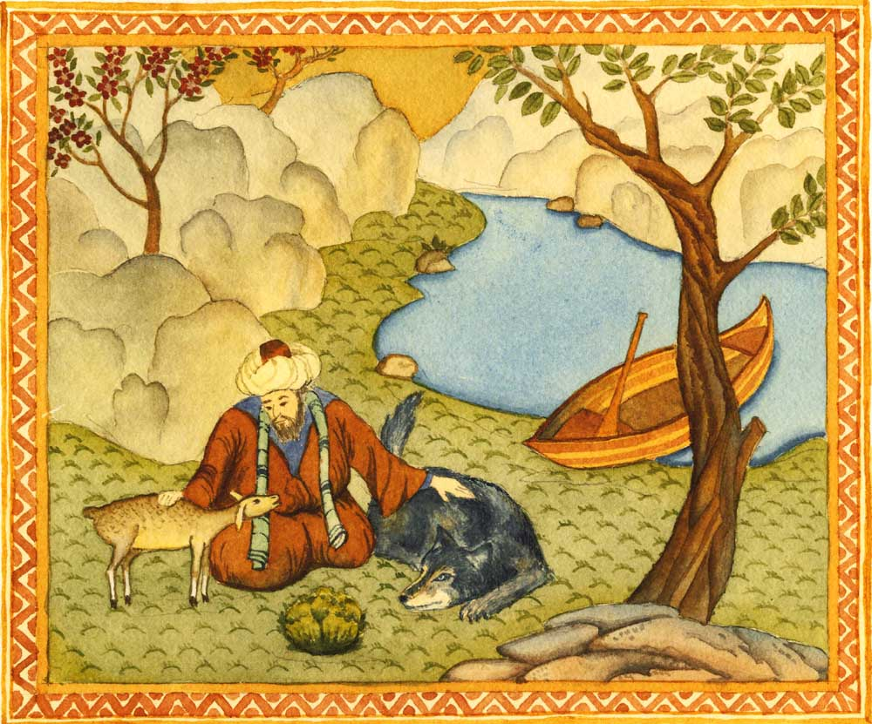
“Reason is the shadow cast by God; God is the sun.”
Jalal al-Din Muhammad Rumi

Slide 2
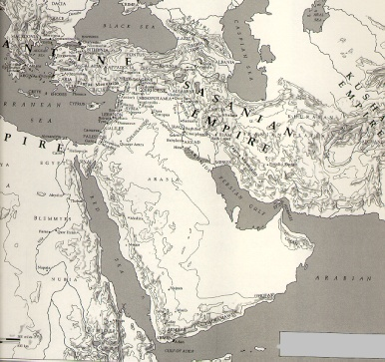
The Birth of Islam
The central region of the Arabian Peninsula has long been inhabited by nomadic Arabs, known as Bedouins
-Fiercely independent clans and tribes, which often engaged in bitter blood feuds and recognized a variety of gods
But there were also scattered oases
And Arabia was located on important trade routes which connected the Indian Ocean world with that of the Mediterranean Sea
-This gave rise to commercial cities

Slide 3
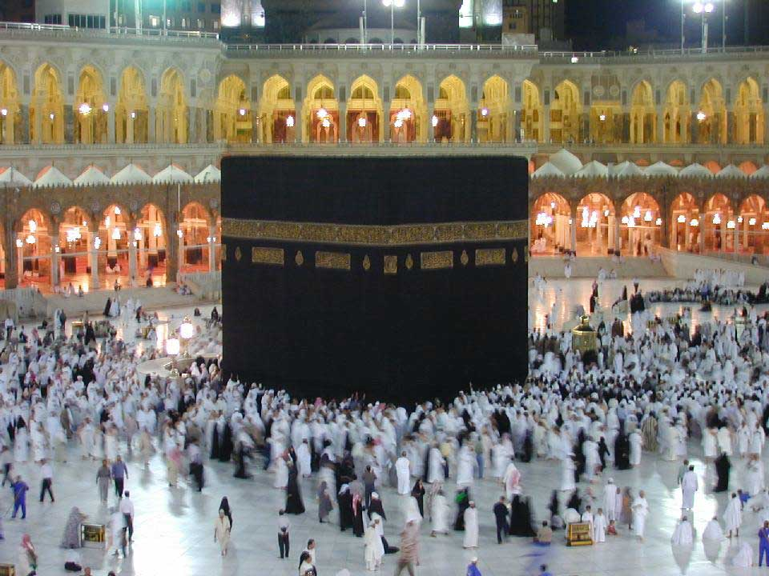
One of those cities, Mecca, though somewhat off the major long-distance trade routes, was the site of the Kaaba, the most significant shrine in Arabia, which housed representations of some 360 deities and was the destination of many pilgrims.

Slide 4
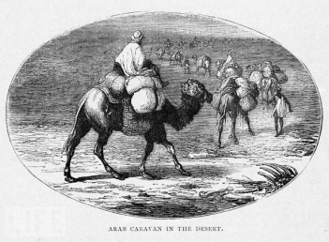
Mecca’s dominant tribe, the Quraysh, came to control access to the Kaaba and grew wealthy by taxing the local trade that accompanied the pilgrimage
Arabia was also located on the periphery of two established and rival civilizations – the Byzantine Empire and the Sassanid Empire in Persia
Arabia’s location coupled with long-distance trade ensured some familiarity with the larger world
A few Arabs explored the possibility that Allah, the supreme god of the Arab pantheon, was the only God (influenced by the Jewish conception of God)

Slide 5
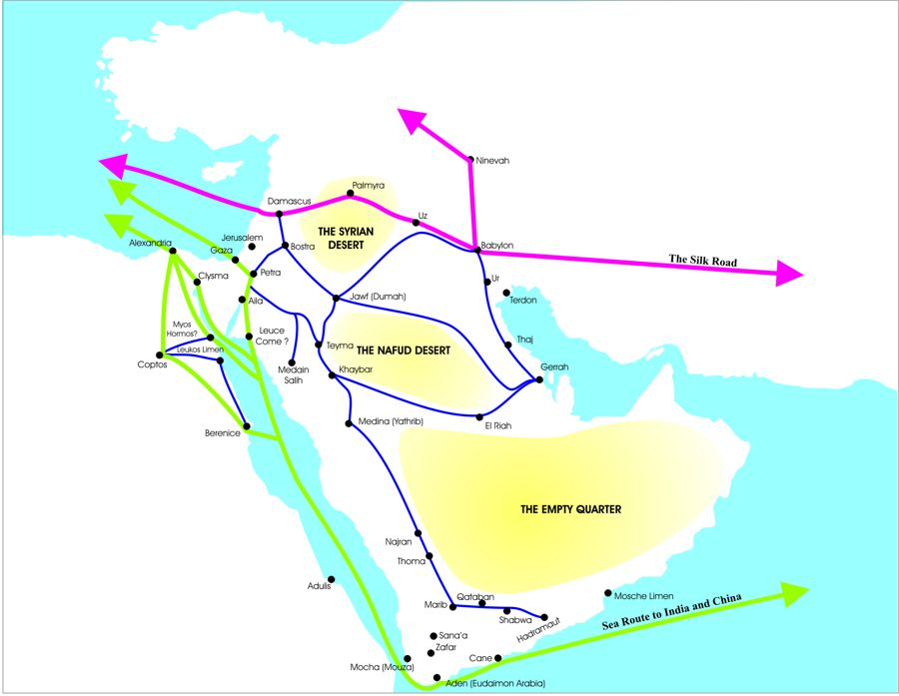
To an outside observer around 600, it might well have seemed that the Arabs were moving toward Judaism religiously or that Christianity, the most rapidly growing religion in western Asia, would encompass Arabia as well but the dramatic events of the seventh century led to the birth of a new monotheistic religion, Islam.

Slide 6
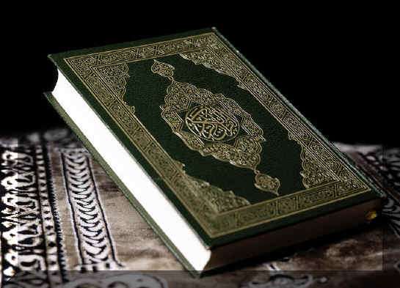
Muhammad Ibn Abdullah (570-632 CE) was born in Mecca
Orphaned, adopted by an uncle, a widely traveled trader, and eventually married to a wealthy widow, Khadija, Muhammad changed world history
A highly reflective man deeply troubled by the religious corruption and social inequalities of Mecca, Muhammad often prayed and meditated in the arid mountains outside the city
Muhammad had an overwhelming religious experience that left him convinced that he was Allah’s messenger to the Arabs
-Commissioned to bring the Arabs a scripture in their own language

Slide 7
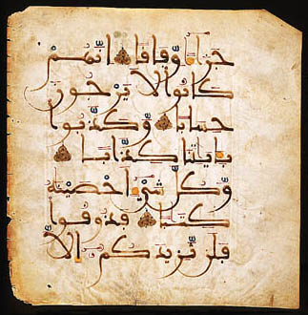
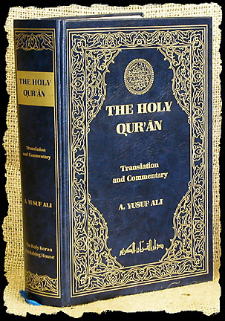
According to Muslim tradition, Muhammad’s revelations began in 610 and continued periodically over the next twenty-two years.

Slide 8
Intended to be recited, the Quran (the holy book of Islam), attracted many followers
Muhammad’s message
-Radically monotheistic
-Muhammad was the “Seal of the Prophets” or the final prophet in a long line of prophets beginning with Abraham
-A invitation to return to the old and pure religion of Abraham that Arabs, Jews, and Christians had deviated from
-Submission to Allah (“Muslim” means “one who submits to God”) was the primary obligation of believers
-The Quran demanded social justice and a return to older values of solidarity, equality and concern for the poor

Slide 9
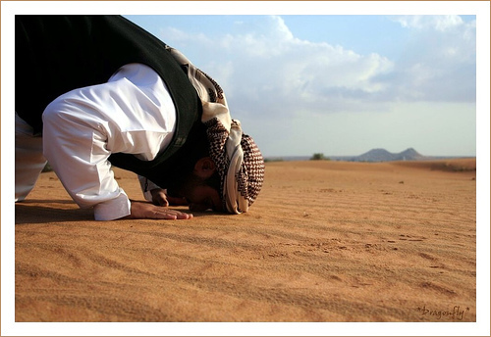
Solidarity, equality, and concern for the poor had been undermined, particularly in Mecca, by growing wealth and commercialism.

Slide 10
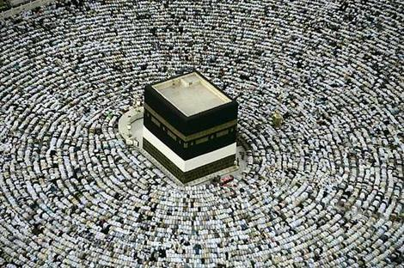
The core message of the Quran was summarized in a set of five requirements for believers, known as the Pillars of Islam
-Absolute monotheism and a final revelation
-Prayer, preferably five times a day facing Mecca
-To give generously to maintain the community and to help the needy (Charity)
-A month of fasting from sunrise to sunset during the month of Ramadan
-Pilgrimage to Mecca (Hajj)
A further requirement, sometimes called the sixth pillar, was “struggle” or jihad
-The “greater jihad” was personal effort against greed and selfishness
-The “lesser jihad” was of the sword

Slide 11
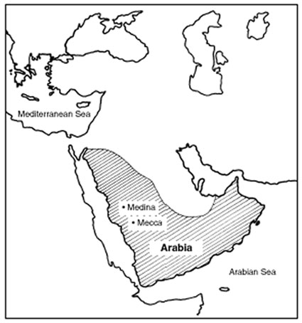
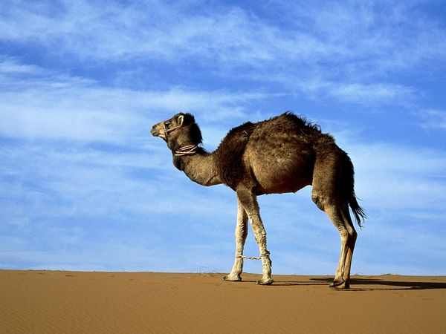
Muhammad attracted a small following of some close relatives, a few prominent Meccan leaders, and an assortment of lower-class dependents, freed slaves, and members of poorer clans. But his teachings also attracted vociferous opposition from Mecca’s elite families.

Slide 12
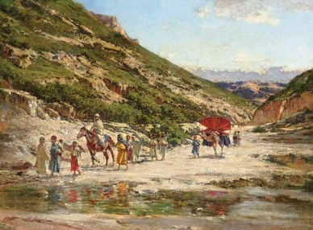
Muhammad’s apparent disloyalty to his own tribe enraged the wealthy and ruling families of Mecca
By 622, Muhammad and his small band of followers emigrated to the more welcoming town of Yathrib, soon to be called Medina, the city of the Prophet
-An agricultural settlement of mixed Arab and Jewish population had invited Muhammad to serve as an arbitrator of their intractable conflicts
-This emigration known as the hijra was a momentous turning point in the early history of Islam and thereafter marked the beginning of a new Islamic calendar

Slide 13
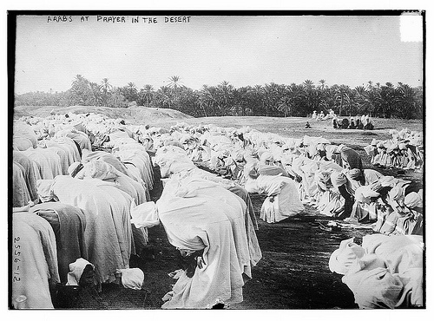
The Islamic community, or umma, that took shape in Medina was a kind of “supertribe,” but very different from the traditional tribes of Arab society. Membership was a matter of belief rather than birth, allowing it to expand rapidly.

Slide 14
All authority, both political and religious, was concentrated in the hands of Muhammad, who proceeded to introduce radical changes
-Usury was outlawed
-Tax-free marketplaces were established
-Mandatory payment to support the poor was imposed
In Medina, Muhammad not only began to create a new society but also declared Islam’s independence from its earlier affiliation with Judaism
-When some Jewish groups allied with his enemies, Muhammad acted harshly to suppress them, exiling some and enslaving or killing others

Slide 15
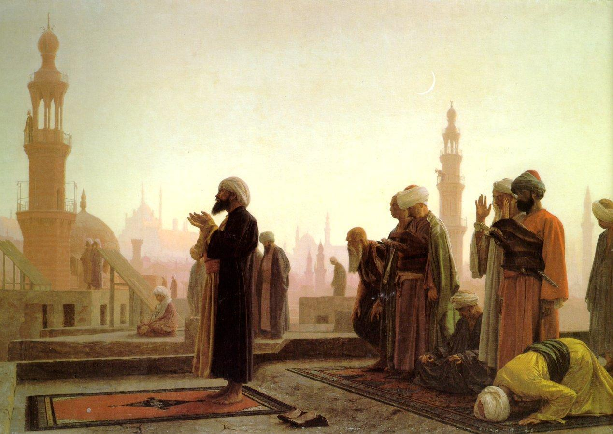
This was not, however, a general suppression of Jews, since others among them remained loyal to Muhammad’s new state. But now Muslims redirected their prayer. Given the common monotheism of Jews, Christians, and Muslims, Muhammad originally had directed followers to pray facing Jerusalem. Now, Muslims were to pray facing Mecca.

Slide 16
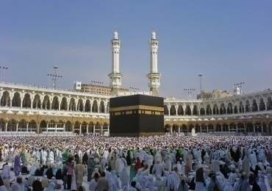
From its base in Medina, the Islamic community rapidly extended its reach throughout Arabia
Early military successes against Muhammad’s Meccan opponents convinced other Arab tribes that the Muslims and their God were on the rise
The religious appeal of the new faith, its promise of material gain, the end of incessant warfare among feuding tribes, periodic military actions skillfully led by Muhammad, and the Prophet’s willingness to enter into marriage alliances with leading tribes contributed to the consolidation of Islamic control throughout Arabia
In 630, Mecca voluntarily surrendered and Muhammad purged the Kaaba of its idols, declaring it a shrine to the one God, Allah

Slide 17
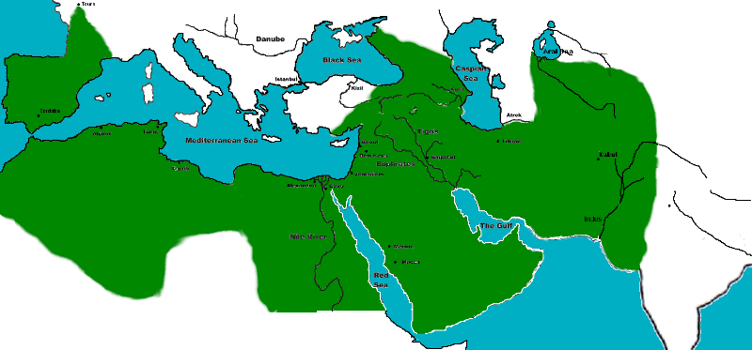
Unlike Christianity, where early Christians faced persecution by Roman authorities and therefore established a separate church hierarchy and the concept of two coexisting authorities, one religious and one political, the young Islamic community found itself constituted as a state, and soon as a huge empire, at the very beginning of its history.

Slide 18
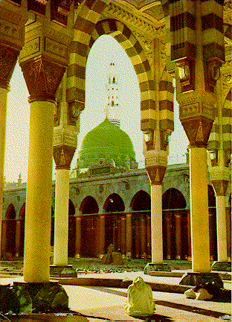
Muhammad was not only a religious figure, but a political and military leader able to implement his vision of an ideal Islamic society
Nor did Islam give rise to a separate religious organization
No professional clergy mediating between God and humankind emerged
No distinction between religious law and civil law developed
One law, known as the sharia, regulated every aspect of life
-The sharia (literally, a path to water, which is the source of life) evolved over the several centuries following the birth of Islam

Slide 19
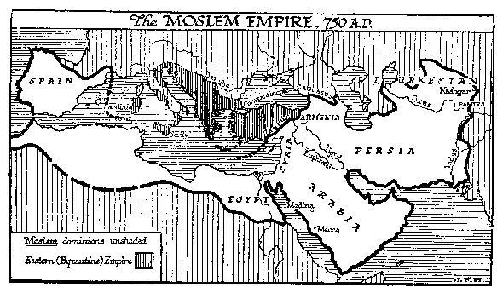
In little more than twenty years (610-632), a profound transformation had occurred in the Arabian Peninsula. A new religion had been born, though one that had roots in earlier Middle Eastern traditions.

Slide 20
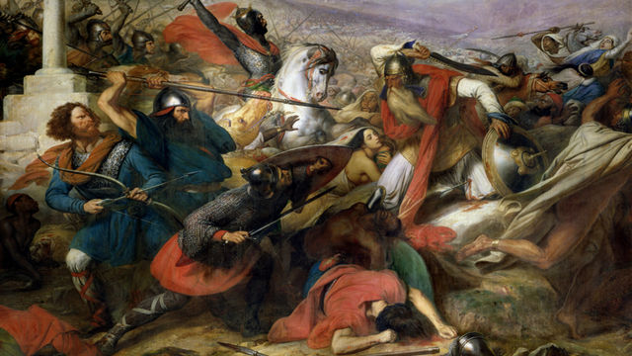
Within a few years of Muhammad’s death in 632, Arab armies engaged the Byzantine and Persian Sassanid empires, the great powers of the region
An Islamic/Arab empire stretching from Spain to India and penetrating both Europe and China while governing most lands between them emerged
The Sassanid Empire was defeated by Arab forces during the 650s, and Byzantium soon lost the southern half of its territories
Arab forces conquered North Africa and in the early 700s, conquered Spain and even attacked southern France
Arab forces reached the Indus River

Slide 21
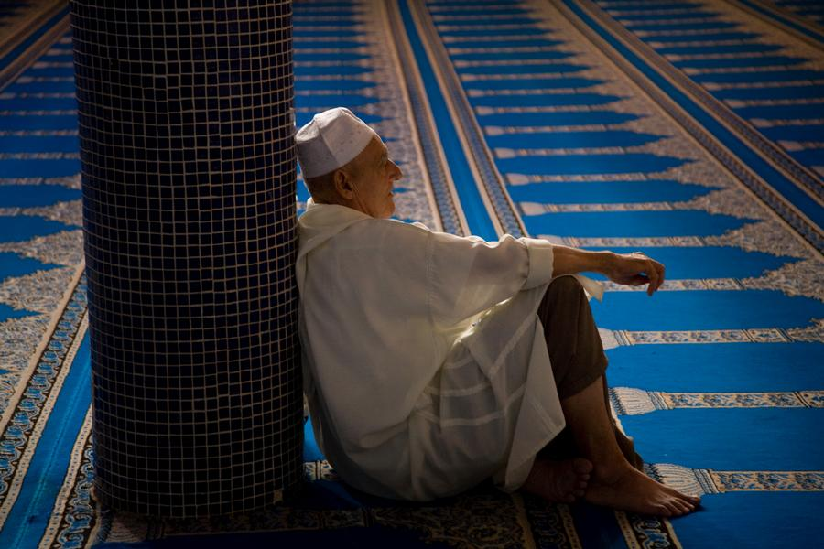
The empire worked many changes on its subjects, the most enduring was the mass conversion of Middle Eastern peoples to Islam. Converts to Islam could avoid the jizya, a tax imposed on non-Muslims.

Slide 22
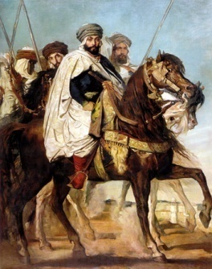
In Persia, between 750 and 900, about 80% of the population had made the transition to a Muslim religion
But the ideal of a unified Muslim community, so important to Muhammad, proved difficult to realize as conquest and conversion vastly enlarged the Islamic umma
A central problem was that of leadership and authority in the absence of Muhammad
The first four caliphs (successors to Muhammad), known as the Rightly Guided Caliphs (632-661) were close “companions of the Prophet,” selected by the Muslim elders of Medina
The third and fourth caliphs, Uthman and Ali, were both assassinated

Slide 23
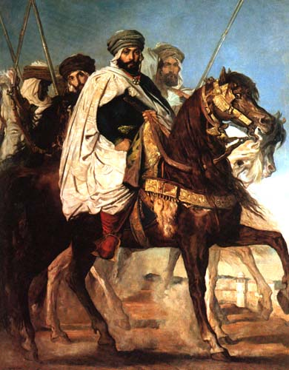
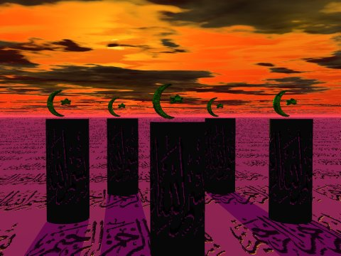
By 656, less than twenty-five years after the death of Muhammad, civil war pitted Muslim against Muslim. Out of that conflict emerged one of the deepest and most enduring rifts within the Islamic world. On one side were the Sunni Muslims, who held that the caliphs were rightful political and military leaders, selected by the Islamic community. On the other side was the Shia (an Arabic word meaning “party” or “faction”) branch of Islam.

Slide 24
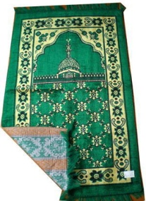
The Shia felt strongly that leadership in the Islamic world should derive from the line of Ali and his son Husayn, blood relatives of Muhammad, both of whom died at the hands of their political or religious enemies
In the beginning, this divide was simply a political conflict without serious theological or religious meaning
But over time, the Sunni and Shia split acquired deeper significance
For Sunni Muslims, religious authority in general emerged from the larger community, particularly from the religious scholars known as the ulama
Shia Muslims invested their leaders or imams with a religious authority that the caliphs lacked

Slide 25
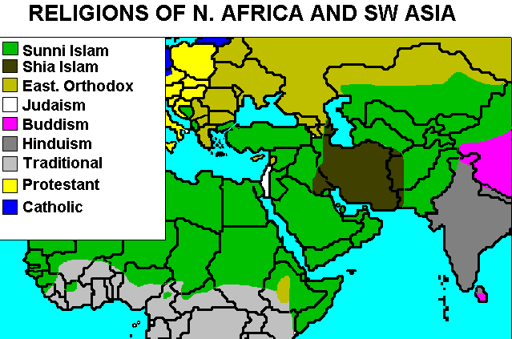
According to the Shia Muslims, only an imam could reveal the true meaning of the Quran and the wishes of Allah. For much of early Islamic history, Shia Muslims saw themselves as the minority opposition within Islam.

Slide 26
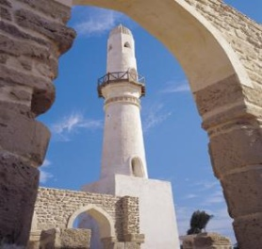
Various armed revolts by Shias led to a distinctive conception of martyrdom and to the expectation that their defeated leaders were merely in hiding and not really dead and that they would return in the fullness of time
Thus a messianic element entered Shia Islam
As the Arab Empire grew, its caliphs were transformed from modest Arab chiefs into absolute monarchs
They were also subject to the dynastic rivalries and succession disputes common to other empires
The first dynasty, following the Rightly Guided Caliphs, came from the Umayyad family (ruled 661-750)
The capital was moved from Medina to Damascus

Slide 27
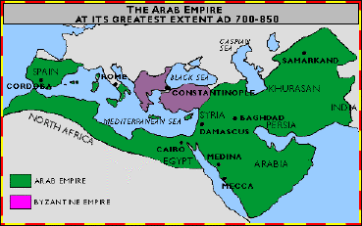
But the Shia viewed the Umayyad caliphs as illegitimate usurpers and non-Arab Muslims resented their second-class citizenship. The Umayyads were overthrown in 750 and were replaced by a new Arab dynasty, the Abbasids. The capital was moved to Baghdad and a golden age of Islamic civilization occurred.

Slide 28
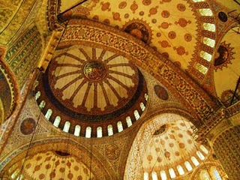
Strayer Questions
In what ways did the early history of Islam reflect its Arabian origins?
How does the core message of Islam compare with those of Judaism and Christianity?
In what ways was the rise of Islam revolutionary, both in theory and in practice?
Why were Arabs able to construct such a huge empire so quickly?

Slide 29
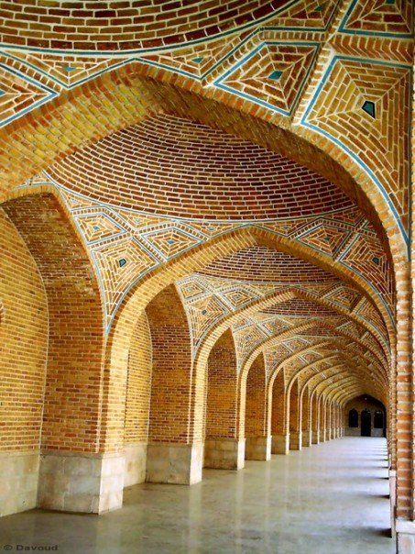
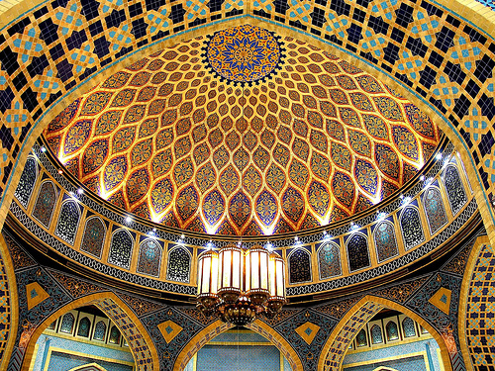
What accounts for widespread conversion to Islam?
What's the difference between Sunni and Shia Islam?

