Slide 1
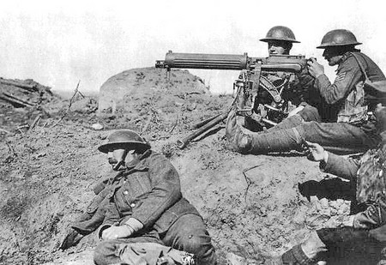
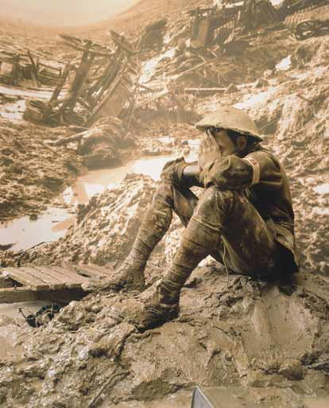
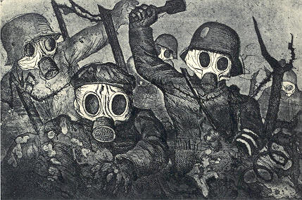
“The War to End All Wars?”
World War I

Slide 2
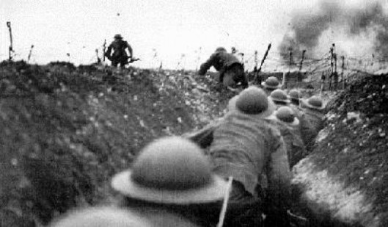
Overview
In the late summer of 1914, the nations of Europe went to war
All parties involved expected that the conflict would be short and decisive – that, as the British press was fond of claiming, “the boys” would be “home by Christmas”
Instead, World War I (July 1914 - November 1918), known simply to the people who experienced it as the Great War, lasted more than four years
More than 30 nations joined in the fighting

Slide 3
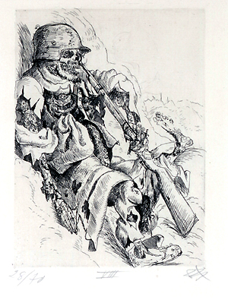
In that time, the war killed up to 10 million soldiers
Between 3 to 5 million civilians perished as well, mainly of disease and starvation caused by the war, but also as a result of direct military action
Approximately 28 million to 30 million people were wounded or disabled by the war
According to the prices of the time, World War I is estimated to have cost $32 billion (almost $400 billion in current economic terms)
At the war’s end, Europe’s economies lay in ruins, even those of the countries that had won

Slide 4
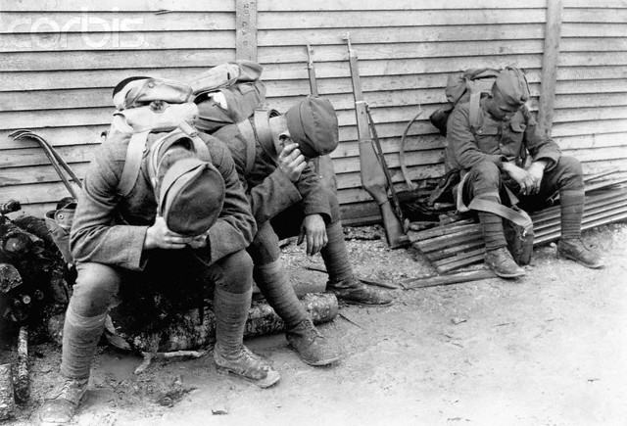
It is no exaggeration to say that World War I also shattered Europe politically and culturally
Four great empires – the German Reich, Russia’s tsarist regime, Austria-Hungary’s Habsburg dynasty, and the Ottoman Empire – were thoroughly destroyed
Even most of the victors, Britain, France, and Italy, were exhausted and demoralized
The barbarity and bloodshed caused by the war brought about a huge shift in European cultural attitudes

Slide 5
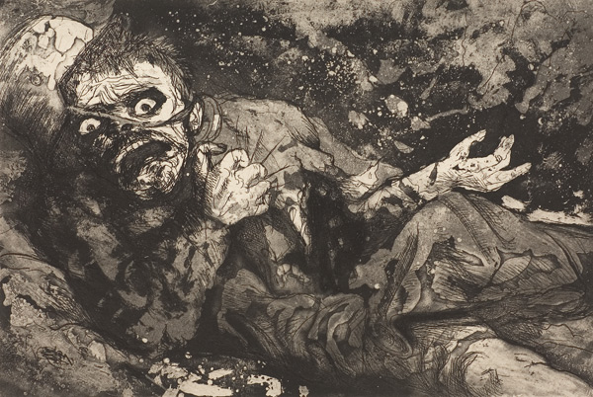
The spirit of optimism and faith in progress that had been so prevalent during the nineteenth century vanished, only to be replaced by fear, anxiety, and gloom
The European’s view of themselves as models of civilized behavior and cultural superiority was exposed as a foolish illusion
The only major nation in the West to escape this malaise was the United States, which remained comparatively undamaged by the war – and even managed to profit from it economically

Slide 6
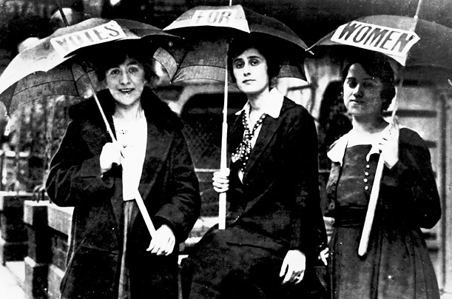
Far-reaching social changes resulted from, or were at least sped up by, the war
These included the final decline of the aristocracy, the rise of the middle and lower classes, the greater democratization of European politics, the complete industrialization and modernization of European economies, and the granting of suffrage to women

Slide 7
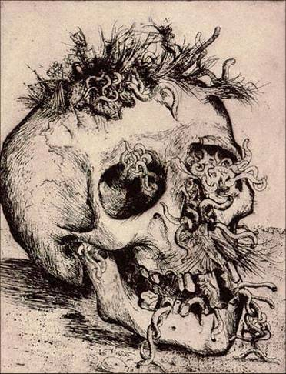
In global terms, World War I brought about a fundamental shift in power
Europe had gained tremendous global might during the last half of the 1700s
In the nineteenth century, it had become the dominant civilization on the planet, and it reached the absolute zenith of its power from 1870 to 1914
After World War I, however, it was becoming clear that Europe would not be able to continue in its position of economic, political, and imperial preeminence for much longer

Slide 8
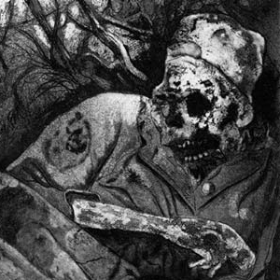
The United States was on its way to becoming the world’s military and economic powerhouse
Europe’s imperial possessions were becoming increasingly restless, and although countries like Britain and France held on to their empires for a while longer, the process of decolonization was unavoidable – the only question was when, not whether, it would happen
Clearly, World War I was much more than a straightforward armed conflict
It truly ended one age and began another
For all these reasons and more, World War I, rather than the calendar year 1900, is generally considered to be the true beginning of the 20th century

Slide 9

The Causes
Militarism, alliance systems, imperialism, and nationalism (MAIN) were all causes of World War I
Competition over empire during the end of the 1800s (especially in Africa); Anglo-German rivalry over empire, industrial competition, and naval superiority; the rising intensity of nationalism in Europe (especially in the Balkans); and the conflicting interests of Italy, Austria-Hungary, Russia, and the Ottoman Empire in the Balkans increased the likelihood of a larger conflict

Slide 10
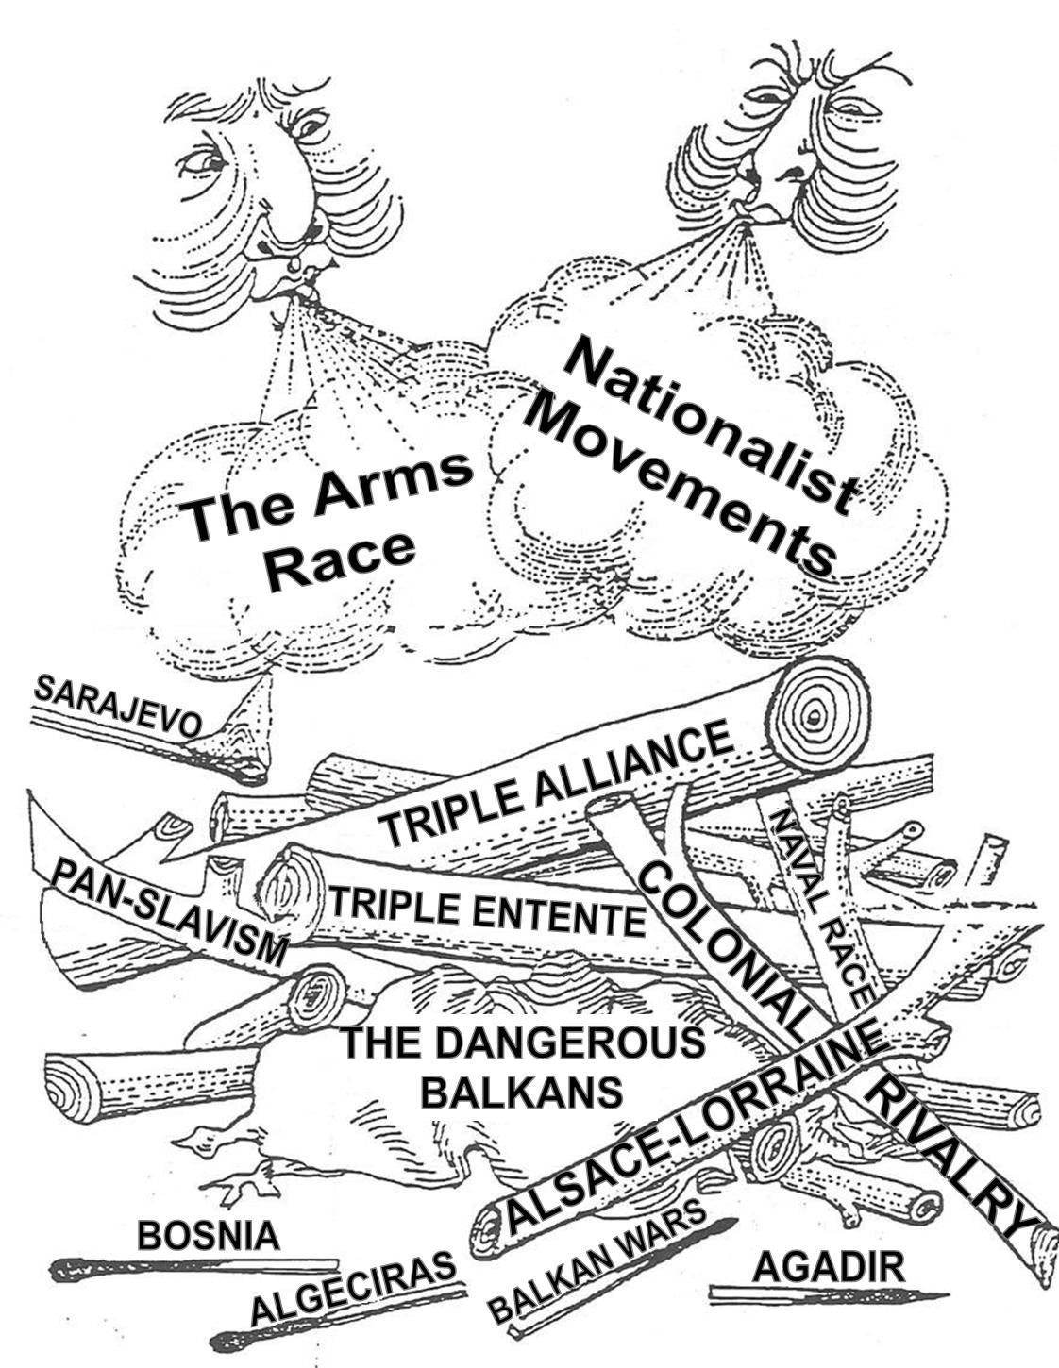
Overlaying all that was the alliance system that had emerged during the late 1800s and early 1900s
Locked into place were two sides: the Triple Alliance (Germany, Austria-Hungary, and Italy) versus the Triple Entente (France, Russia, and Britain)
It should be noted that Italy was a weak link in the former, and would actually change sides during World War I
Also, Britain’s commitment to the Triple Entente was informal, although it honored that commitment once war began

Slide 11
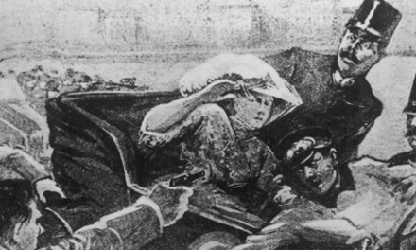
The Assassination of Francis Ferdinand
The war began in the Balkans, famously known as the “powder keg of Europe”
The actual spark that exploded the powder keg was the assassination of the Archduke Francis Ferdinand, heir to the Austrian throne, and his wife Sophie, on June 28, 1914, in the Bosnian city of Sarajevo
Austria’s 1908 annexation of this Slavic province, with its large Serbian population, had angered not only Russia, but Serbia, which was by now an independent nation with ambitions to grow larger
The killer was a Bosnian student of Serb descent and a member of a terrorist group that received money and arms from Serbia

Slide 12
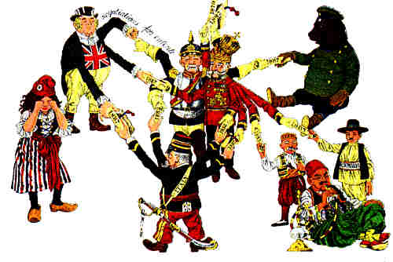
The assassination caused an international outrage
Austria blamed Serbia for the murders and determined to use them as a pretext to humble its troublesome neighbor once and for all
On July 23, Austria handed Serbia an ultimatum, a list of humiliating demands, and threatened to declare war if Serbia did not agree to all them
Because of the European alliance system and a general spirit of nationalist belligerence, this regional quarrel quickly escalated into a continental war
Slavic Russia, “big brother” to the Serbs, was bound to intervene

Slide 13
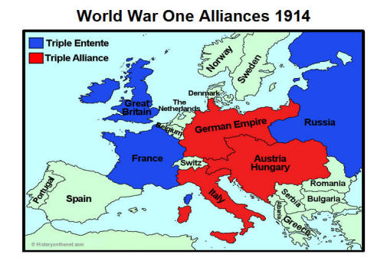
Kaiser Wilhelm II of Germany backed up his ally with the so-called blank check, an assurance of German support of any action Austria might take against Serbia, even if Russia became involved
France, of course, was pledged to aid Russia in the event of hostilities
On July 28, Austria declared war on Serbia
Russia mobilized for war
Like clockwork, the alliance system went into operation
Between July 28 and August 4, Serbia, Austria, Russia, Germany, France, and Britain entered the war

Slide 14
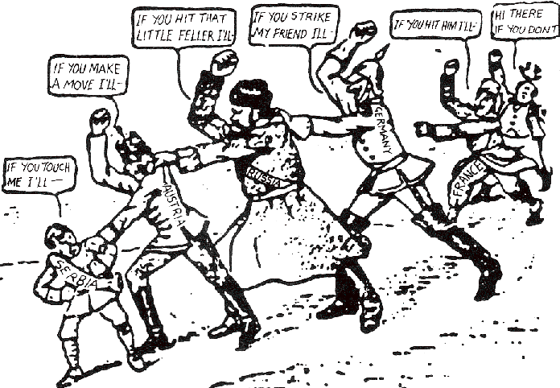
Ultimately, although blame for the war was later assigned solely to Germany, it can be seen that many factors contributed to the beginning of the war
Likewise, a number of countries bear at least part of the blame for starting the conflict

Slide 15
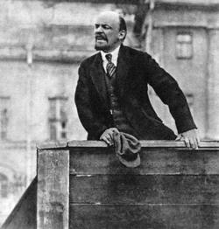
During the war, the members of the Triple Entente were known as the Allies
Many of the colonial possessions of the Europeans also participated in the war
But Italy abandoned Germany and Austria-Hungary and eventually joined the Allies
Italy had been promised Austrian territory by Britain and France
In 1917, the United States also joined the Allied war effort
However, Russia dropped out of the war when the Bolsheviks came to power after a revolution in Russia

Slide 16
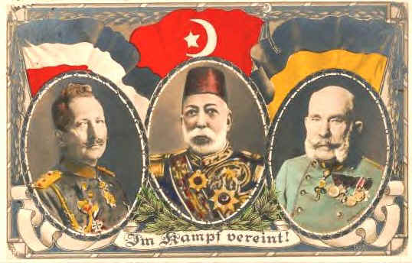
On the other side were the Central Powers
Germany and Austria-Hungary were the members of the Triple Alliance, minus Italy
They were joined by Bulgaria and the Ottoman Empire

Slide 17
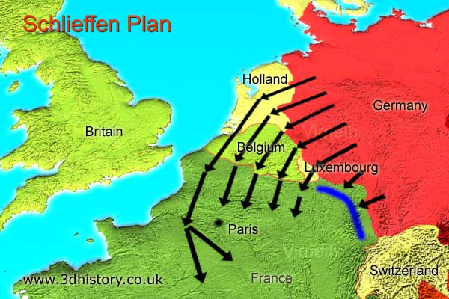
The Schlieffen Plan
Germany’s war plan – the Schlieffen Plan – and its failure determined how the first phase of World War I proceeded
Germany’s difficulty lay in a two-front ground war
On one front, Germany fought France and the Allied forces
On the other front, Germany fought Russia and the Allied forces
In addition, there was the threat of the mighty British navy
Germany realized that the longer the war lasted, the more likely it would lose

Slide 18
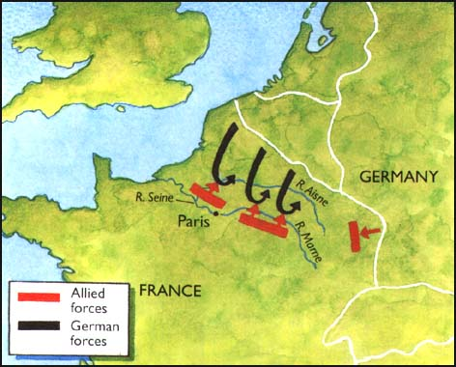
The Schlieffen Plan called for a daring gamble: Germany would send 75 percent of its army against France, in order to capture Paris and knock France out of the war in six weeks
The rest of the army, along with the Austrians, would defend against Russia, which was expected to take months to mobilize fully
To catch the French off guard, the main attack force would move through Belgium, which was neutral

Slide 19
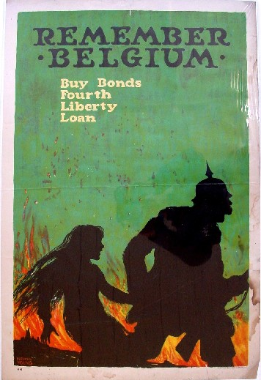
The illegal invasion of Belgium, which resulted in the deaths of many civilians, ensured that Britain would join the war on the side of the Allies
After the German invasion of Belgium, allied propaganda presented the Germans as aggressors, “barbarians,” and “Huns”
The Schlieffen Plan was put into effect in August
By early September, it had failed
The Belgians resisted more stoutly than the Germans had expected
The Russians had mobilized more quickly than expected
And the Germans had to divert troops to the east to keep them from invading

Slide 20
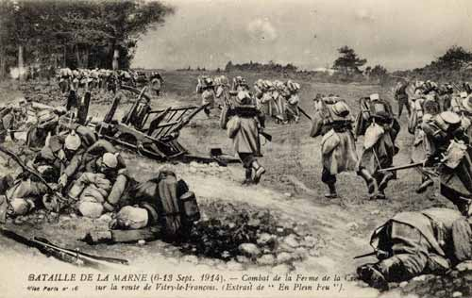
Although German troops came within sight of Paris, the French army made a heroic stand at the Marne River
The Battle of the Marne saved Paris and ended the Schlieffen Plan’s chances of success
The Battle of the Marne also destroyed any hope that the war would end quickly
During the rest of 1914, two European fronts, the Western Front and the Eastern Front, developed
The two fronts were very different

Slide 21
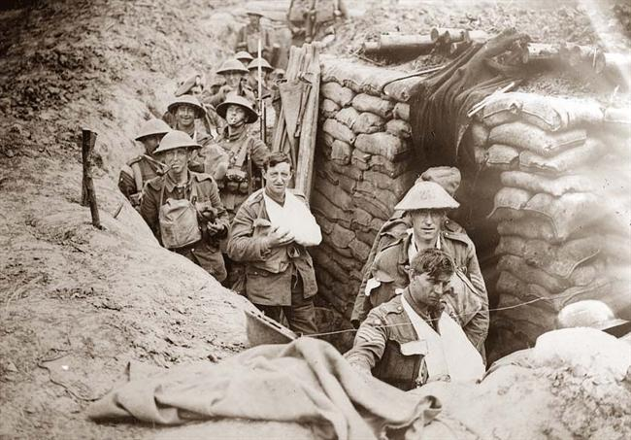
The Western Front
In the west, stalemate prevailed
Both sides were evenly matched and armed with the latest in industrial-era weaponry
Artillery, machine guns, and modern rifles were used and these new deadly weapons made charging the enemy no longer feasible
Military technology disproportionately favored the defensive
The result was trench warfare, one of the most horrific styles of combat in human history
By the end of 1914, 500 miles of trenches, bunkers, and barbed wire, separating the Germans from the Allied forces, stretched from the English Channel to the Swiss border

Slide 22
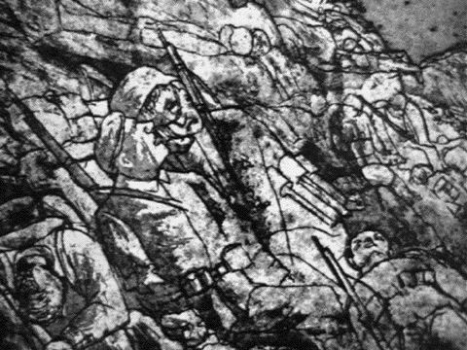
For the next three years, fighting on the Western Front, while exceptionally bloody, resulted in almost no movement at all
Battles such as the battle of Verdun and the Battle of the Somme, both in 1916, rank among the most futile operations of all time, resulting in hundreds of thousands of casualties, but no useful outcome
Life in the trenches could be as miserable as combat
Mud, lice, rats, disease, and the smell of dead bodies all combined to make the trench experience maddeningly terrible
Not until 1917 and 1918 did tactical changes and new weaponry start to bring an end to the painful stalemate of trench warfare

Slide 23
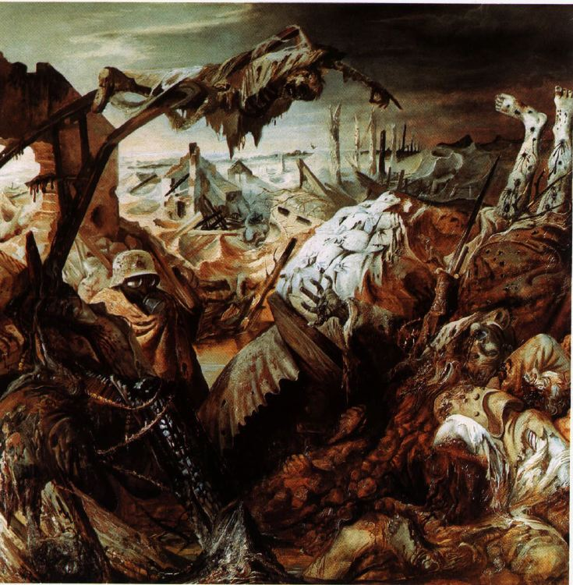
"We have lost all feeling for one another. We can hardly control ourselves when our hunted glance lights on the form of some other man. We are insensible, dead men, who through some trick, some dreadful magic, are still able to run and to kill.“
~All Quiet on the Western Front

Slide 24
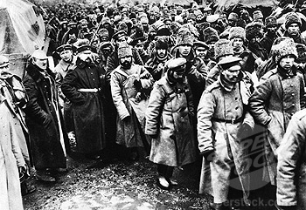
The Eastern Front
Fighting on the Eastern Front was very different
The front was much longer, extending over a thousand miles
It was much more fluid, and battles were decisive
After some initial setbacks, the Germans and Austrians moved quickly and efficiently against the Russians, killing, wounding, and capturing millions
From the beginning, the Russians found themselves in terrible trouble

Slide 25
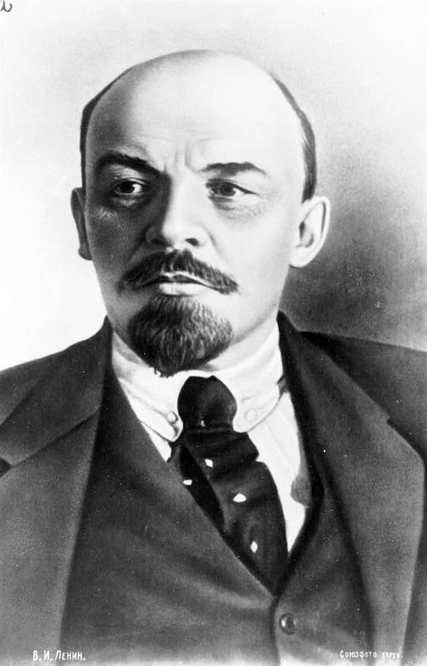
The fact that Bulgaria and the Ottoman Empire joined the war on the side of the Central Powers meant that Russia was cut off from its allies and had to fight the war without supplies or assistance
By 1917, Russia was nearing the end of its capacity to fight
And when Vladimir Lenin and the Bolsheviks promised, “bread, peace, and land” – and came to power after a second revolution in Russia within one year – the Russians quickly pulled out of the war

Slide 26
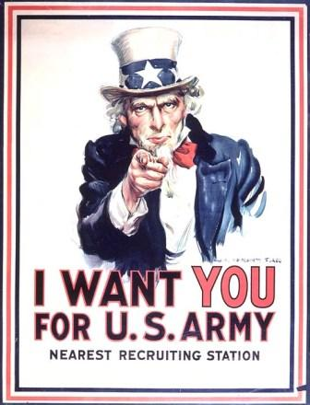
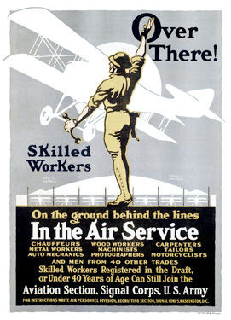
Britain’s Royal Navy imposed a blockade on Germany and Austria
In response, Germany made use of its most effective naval weapon: the submarine, or U-boat
The submarine enabled the German navy to do tremendous economic damage to Britain, which, as an island nation was at risk of running out of food
However, submarine warfare carried with it the danger of destroying neutral ships or killing civilians from neutral countries, so it was a diplomatically risky course of action
Over time, Germany’s success with submarine warfare would backfire, bringing the United States into the war in 1917

Slide 27
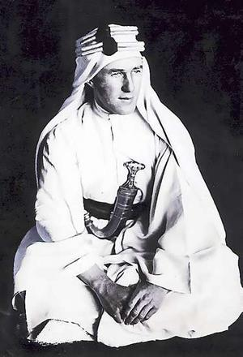
The most important non-European theater of war was the Middle East
In 1915, the British, using Australian and New Zealand troops, tried to knock Ottoman Turkey out of the war by landing Gallipoli, southwest of Istanbul
This campaign proved to be an utter disaster, resulting in 50 percent casualties (and the disgrace of Winston Churchill, whose idea the campaign had been)
More successful was the effort of the officer T.E. Lawrence, better known as Lawrence of Arabia, who persuaded Arab princes to rise up against their Ottoman masters
By 1917 and 1918, the Ottoman Empire was dismantled

Slide 28
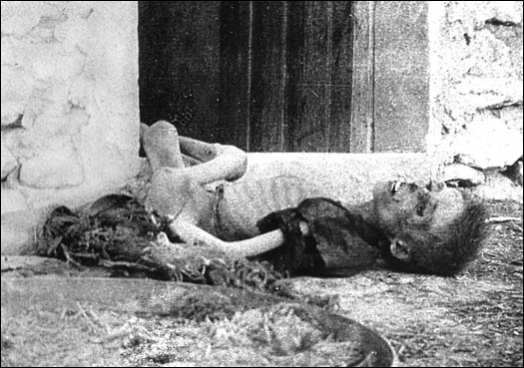
Before that, in 1915, the Ottoman Empire carried out the twentieth century’s first campaign of genocide, massacring somewhere between 500,000 and 2 million Armenians

Slide 29
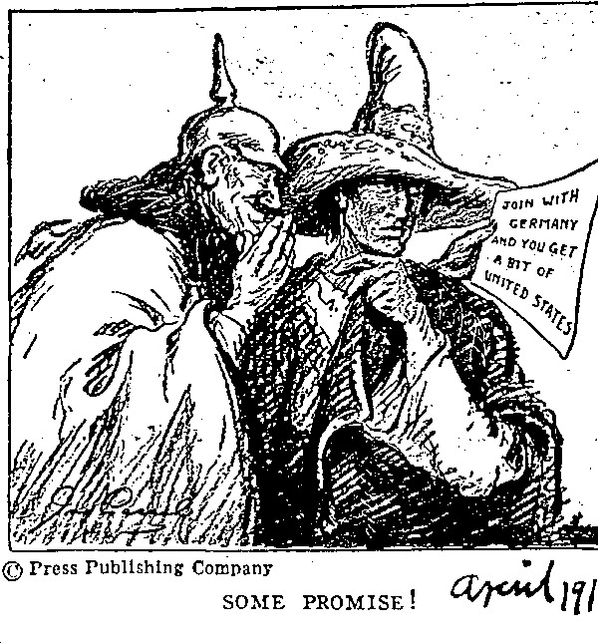
The year 1917 was a crucial turning point
American opinion turned even more against Germany with the revelation of the Zimmerman telegram, in which Germany tried to convince Mexico to declare war on the United States
In April 1917, the U.S. declared war on Germany
On the other had, Russia’s tsarist regime fell in March and in November 1917, the Bolsheviks staged a Communist takeover of Russia and pulled their country out of the war
Germany was now free to send large numbers of troops to the Western Front
But eventually, the Allies started to push the Germans back and strikes and mutinies convinced Austria and Germany to surrender

Slide 30
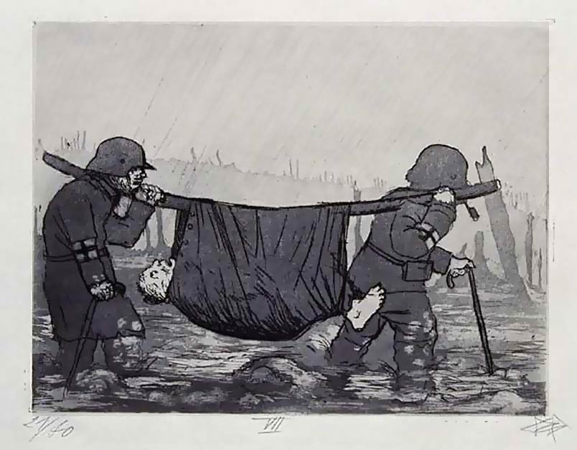
The war came to an end on November 11, 1918
World War I had been a total war in that it required nations to involve their populations and mobilize their resources completely
The most immediate way in which the home front was affected by the war was conscription
The belligerent nations of World War I drafted more than 70 million men
And with so many men serving in the armed forces, farms, factories, and workplaces of all types were left understaffed, just as wartime economic pressures required greater, not lesser, production
So, women stepped up to take the place of men in the workplace

Slide 31
The Paris Peace Conference
After the war, peace terms were decided at the Paris Peace Conference, which lasted from 1919 to 1920
All decisions were made by the leaders of the Allied nations
The major players were President Woodrow Wilson of the United States, Prime Minister David Lloyd George of Britain, Premier Georges Clemenceau of France, and Prime Minister Vittorio Orlando of Italy
The Allies drew up five treaties, one for each defeated power: Germany, Austria, Hungary, Bulgaria, and the Ottoman Empire

Slide 32
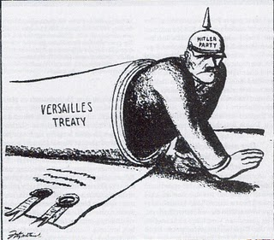
The Treaty of Versailles
The Treaty of Versailles was the agreement reached with Germany and signed on June 28, 1919
While Wilson had wanted his “Fourteen Points” or a call to end secret treaties, freedom of the seas, free trade, decolonization, arms reduction, “self-determination,” and a peacekeeping League of Nations, the British and French wanted to make Germany pay for the war
Germany was blamed for the war (a “war guilt” clause), forced to pay reparations, and lost its colonies
The failure of the Treaty of Versailles paved the way to another world war

