Slide 1
Unit Four (sort of)
By: Jonathan Xu (Always Late) &
Jack Roswell (Never Late)

Slide 2
Big Ideas
Globalizing Networks of Communication and Exchange
New Forms of Social Organization & Production
State Consolidation and Imperial Expansion
Improved transportation technologies and commercial practices led to an increased volume of trade, and expanded the geographical range of existing and newly active trade networks.
The movement of peoples caused environmental and linguistic effects.
Empires collapsed and were reconstituted; new states emerged.
Innovations stimulated agricultural and industrial production in many forms.

Slide 3
European Exploration
Portugal (headed by Prince Henry the Navigator) begin exploration
Portuguese, beginning in the 1400s, move along African coastline, find India, as well as colonize Brazil
Spain sends out Columbus, Magellan
Power shifts north with defeat of Spanish Armada at hands of British
French reach Canada
British explore Hudson bay and colonize East Coast of America
Holland sets up way stations in Africa and competes with Portuguese in Asia

Slide 4
Trade
Intensification of regional trade networks in Indian Ocean, Mediterranean, Sahara, Overland Eurasia
European innovations in mapmaking and navigation as well as Islamic & Chinese innovations led to transoceanic trade possible
New maritime exploration happening, Vasco de Gama, Columbus, Zheng He
Facilitation of new markets by European chartered monopolies
Immense amounts of silver dumped into economy
Use of the astrolabe and compass, as well as larger ship designs stimulated commercial growth

Slide 5
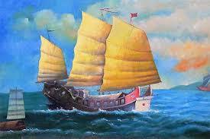
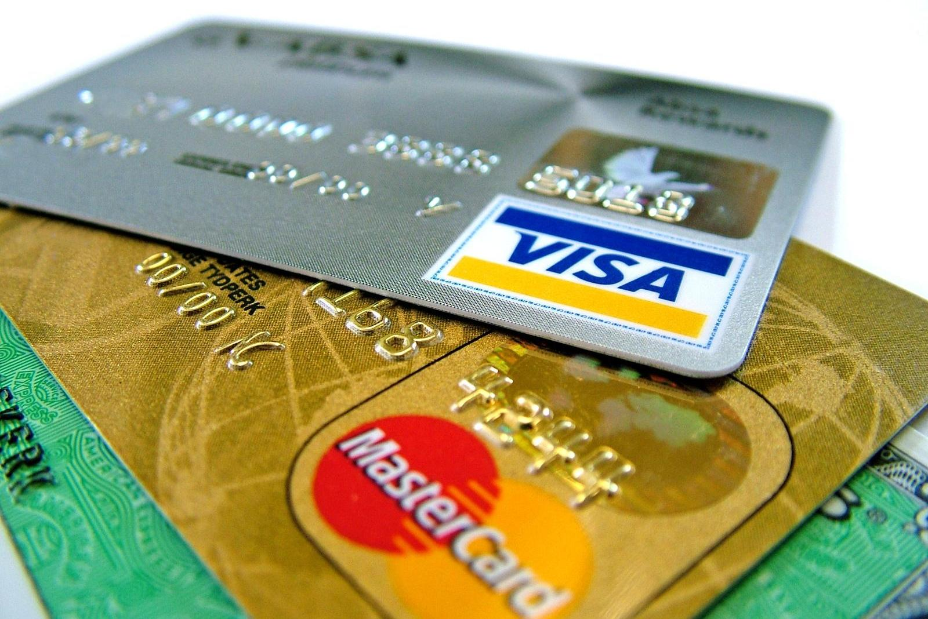
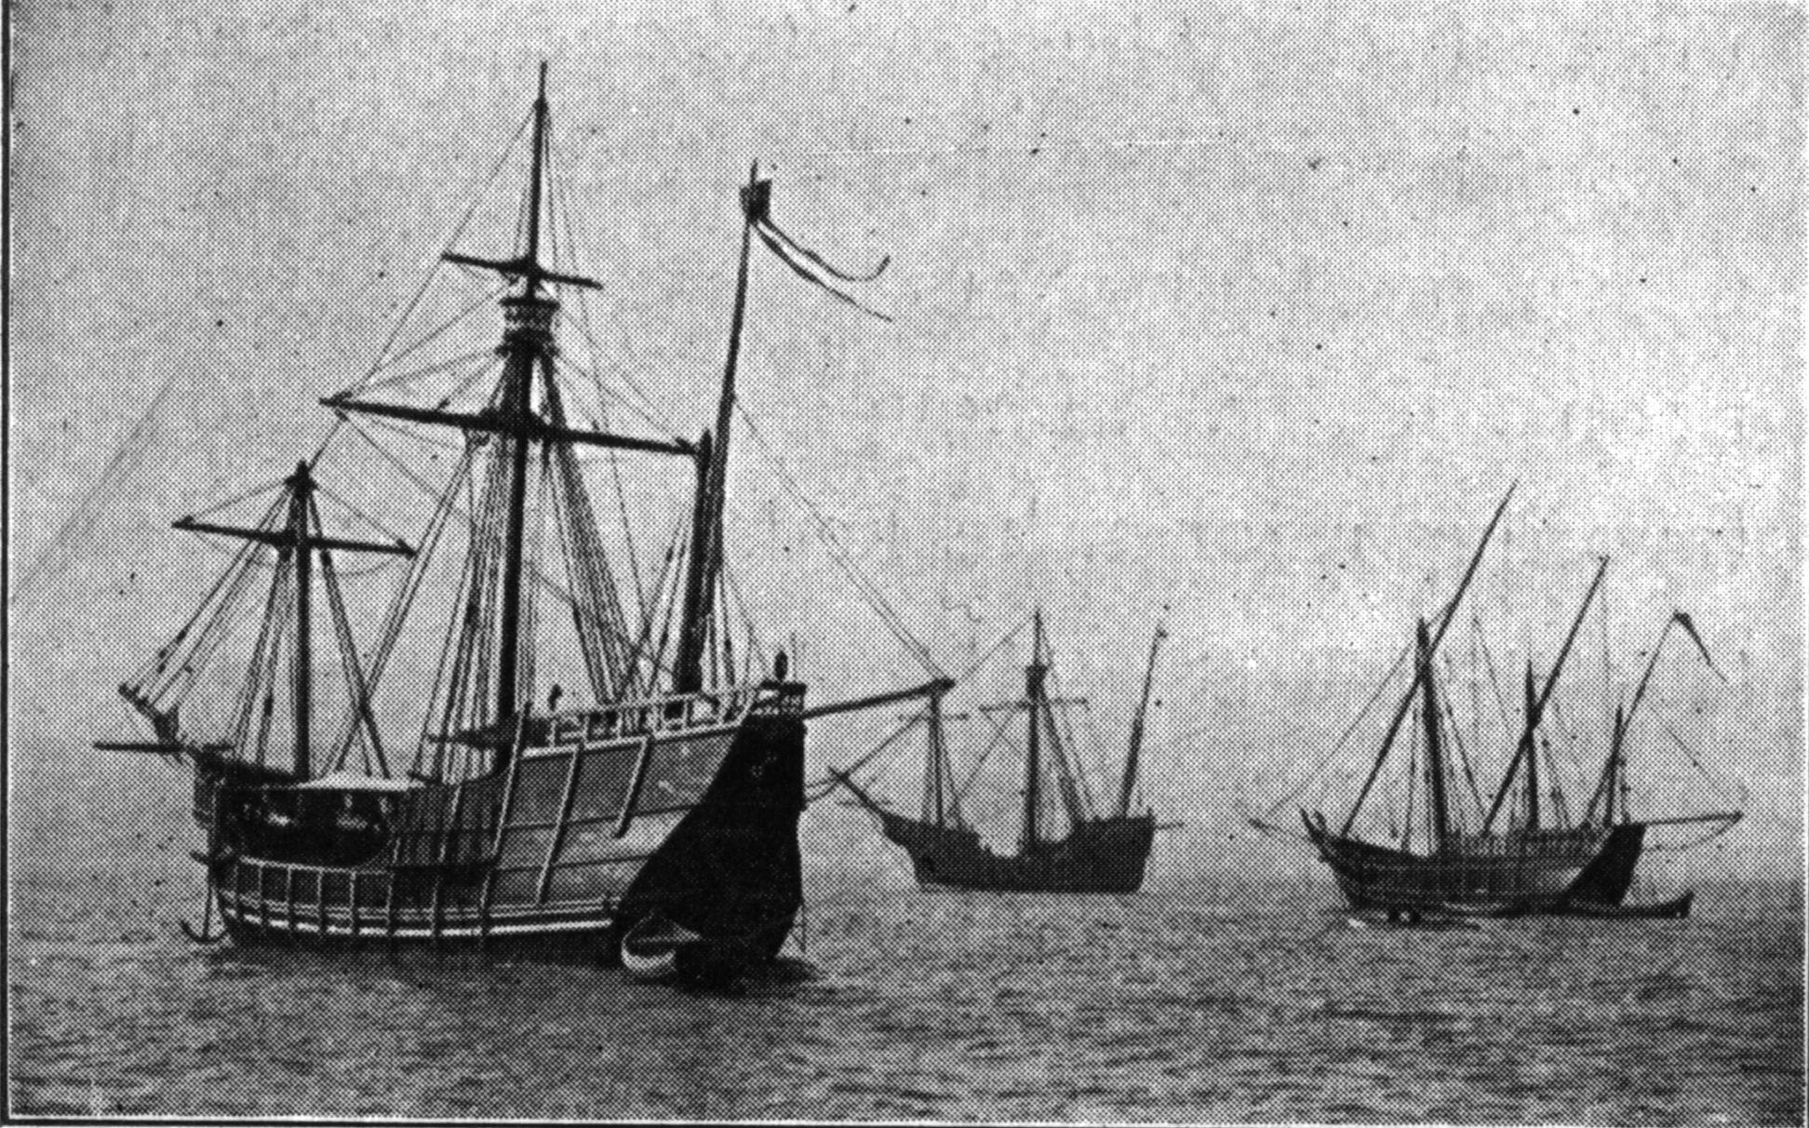
Tech Advancements
European innovations in mapmaking and navigation as well as Islamic & Chinese innovations made transoceanic trade possible
Larger & faster ships also facilitated exploration and increased trade
New forms of credit and monetization allowed for faster exchange of money
State sponsored commercial infrastructures

Slide 6
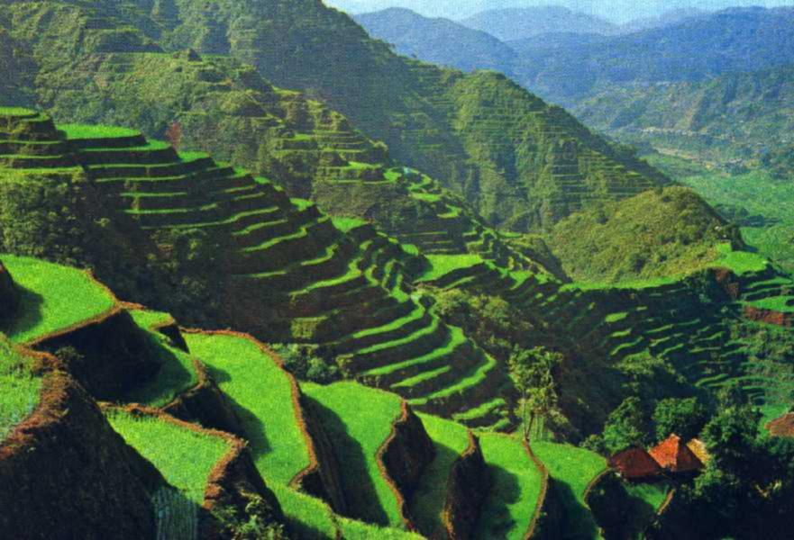
Agricultural Innovations
New strain of Champa rice introduced
from Vietnam to China, cut cultivation
times and facilitated population increases
Chinampas- “floating” gardens that
provided at least ⅔ of food to Tenochtitlan
Terracing- created arable land from
mountainsides and prevented erosion

Slide 7
Columbian Exchange
New World crops created a huge population boom in Old World because of the high calories per acre in each crop
New World crops imbedded themselves in Old World cultures
Diseases were exchanged, although Old World impacts on the New were much higher because of the quantity of destructive diseases dumped on the Americas (more than half of New World population killed)
Old World livestock played a huge role in changing lives of those in the New World; horses became key to North american Plains Indians, cows and pigs quickly reproduced, more animal labor introduced

Slide 8
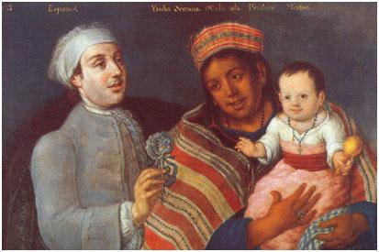
Labor Systems
Economies begun to depend on cheap production of unprocessed goods
Coerced Labor began to become the norm
Loss of Amerindians to disease led to huge importations of Spanish slaves to New world
Mestizos were also subjugated to forced labor

Slide 9
Labor Systems Cont.
Free-Peasant Agriculture: majority of the population; peasants are usually small farm owning rural farmers. It later took on a negative connotation by the upper classes.
Nomadic Pastoralism: (peasants without arable land) pastoralists follow their animals from pasture to pasture; usually associated with warrior-based cultures that became fearsome settled people.
Guilds: are a collection of craftsmen of a similar trade. The goal of guilds are to regulate their industry.
Coerced Labor: in both Europe and Japan, serfs work a specific plot of land in return for protection from a lord. (lowest class of the feudal society)

Slide 10
Live long and prosper….

