Slide 1
2.3 Planned Cities on the Indus
Main Idea: The first Indian civilization built well-planned cities on the banks of the Indus River.
Why it matters now: The culture of India today has its roots in the civilization of the early Indus cities.

Slide 2
Vocabulary
subcontinent: Land mass that is a distinct part of a continent. Example: Indian subcontinent.
monsoon: Seasonal wind
Harappan civilization: Ancient settlements in the Indus River Valley

Slide 3
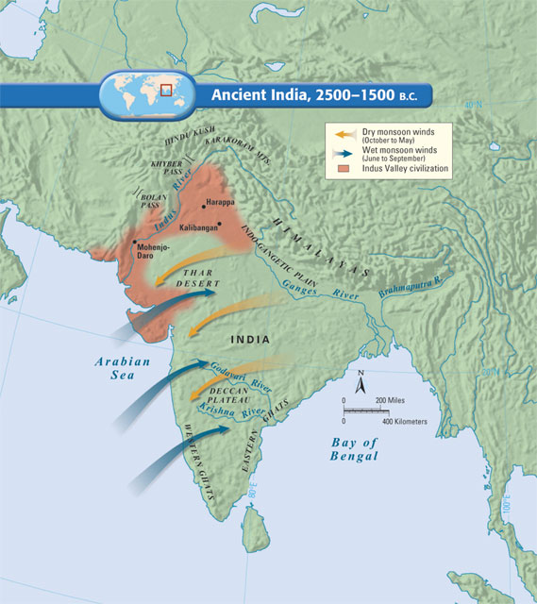
The Geography of the Indian Subcontinent
Indian Subcontinent
Landmass that includes India, Pakistan, and Bangledesh
World’s tallest mountain ranges separate it from the rest of Asia

Slide 4
The Geography of the Indian Subcontinent
Rivers, Mountains, and Plains
Mountains to north, desert to east, protect Indus Valley from invasion
Southern India, a dry plateau flanked by mountains
Narrow strip of tropical land along coast

Slide 5
The Geography of the Indian Subcontinent
Monsoons
Seasonal winds—monsoons– dominate India’s climate
Winter winds are dry; summer winds bring rain—can cause flooding

Slide 6
The Geography of the Indian Subcontinent
Environmental Challenges
Floods along the Indus unpredictable; river can change course
Rainfall upredictable; could have droughts or floods

Slide 7
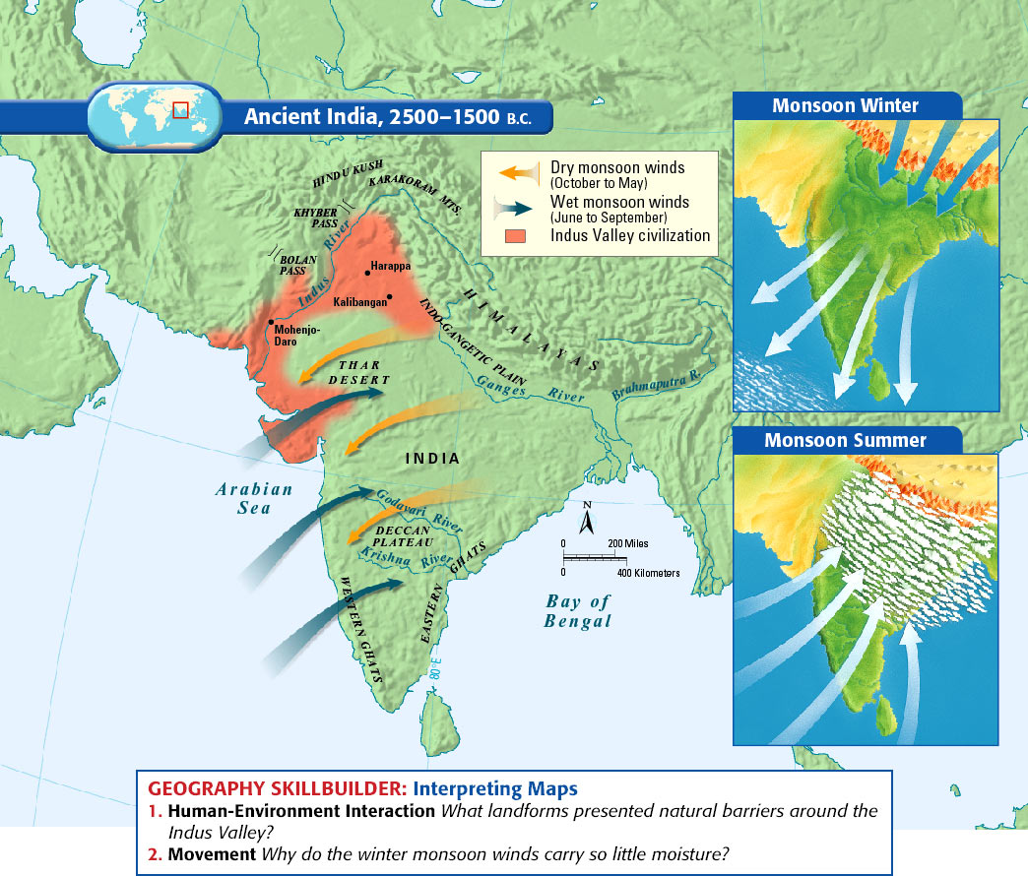

Slide 8
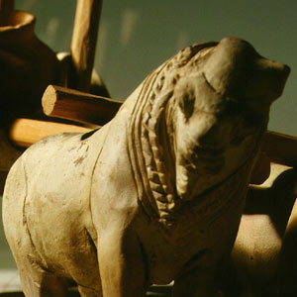
Civilization Emerges on the Indus
Indus Valley Civilization
Influenced an area larger than Mesopotamia or Egypt
Earliest Arrivals
About 7000 B.C.E., evidence of agricultural and domesticated animals
By 3200 B.C.E., people farming in villages along Indus River

Slide 9
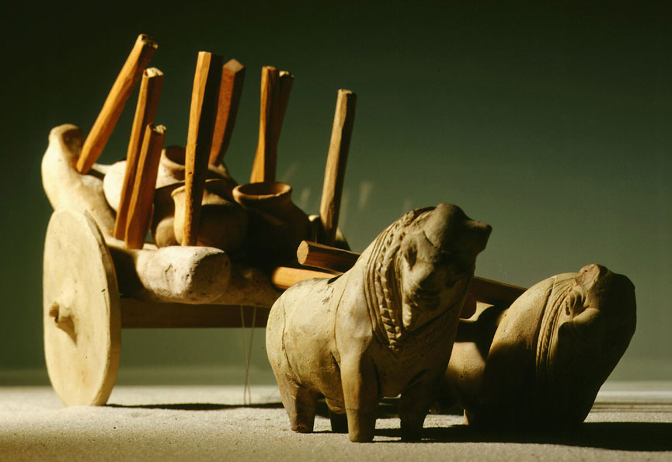

Slide 10
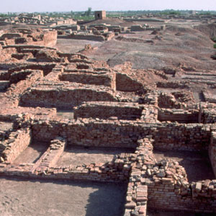
Planned Cities
By 2500 B.C.E., people build cities of brick laid out on a grid system.
Engineers create plumbing and sewage systems
Indus Valley called Harrapan civilization after Harappa, a city.

Slide 11
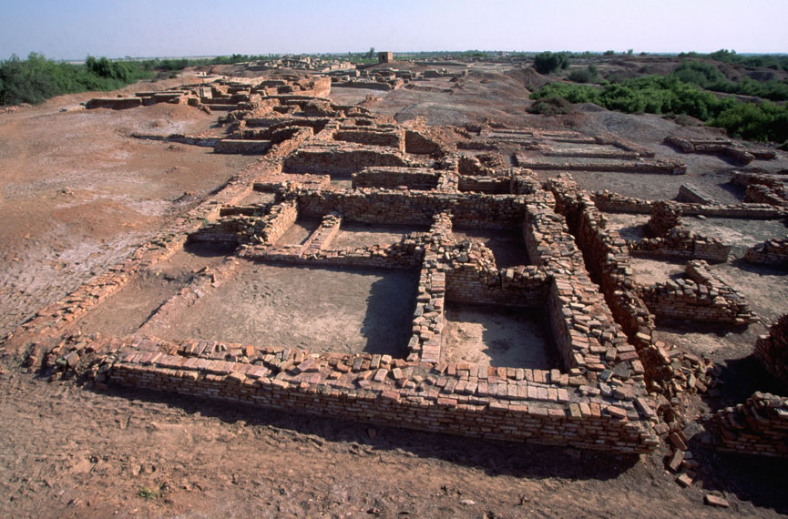

Slide 12
Harappan Planning
City built on mud-brick platform to protect against flood waters
Brick walls protect city and citadel—central buildings of the city
Streets in grid system are 30 feet wide
Lanes separate rows of houses (which feature bathrooms)

Slide 13
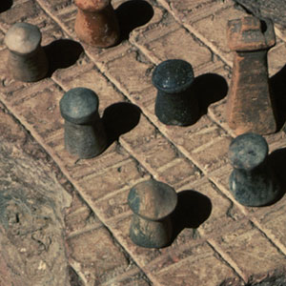
Language
Had writing system of 300 symbols, but scientists cannot decipher it
Culture
Harappan cities appear uniform in culture, no great social divisions
Animals importance to the culture; toys suggest prosperity

Slide 14
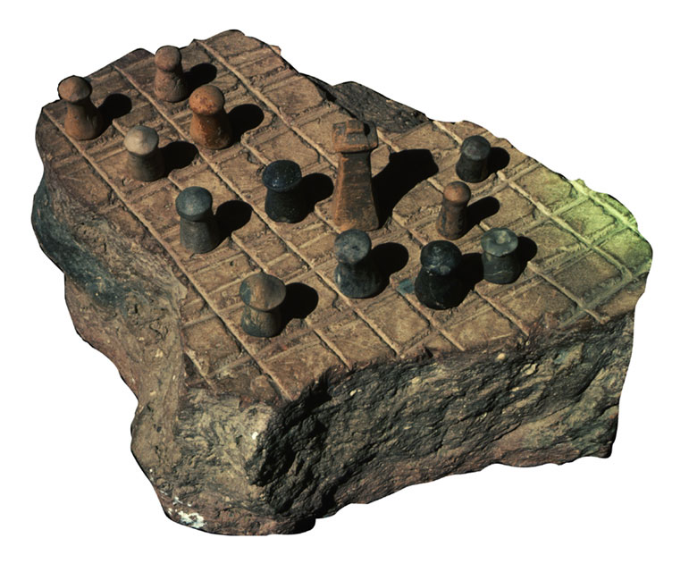

Slide 15
Role of Religion
Priests closely linked to rulers
Some religious artifacts reveal links to modern Hindu Culture
Trade
Had thriving trade with other peoples, including Mesopotamia.

Slide 16
Indus Valley Culture Ends
Harappan Decline
Signs of decline begin around 1750 B.C.E.
Earthquakes, floods, soil depletion may have caused decline
Around 1500 B.C.E., Aryans enter area and become dominant

Slide 17
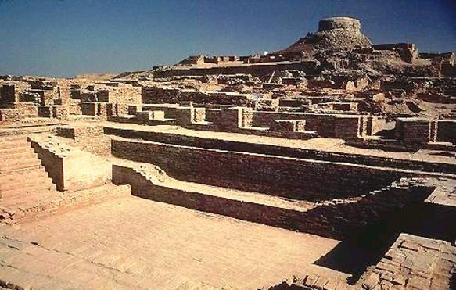
Mohenjo-Daro

Slide 18
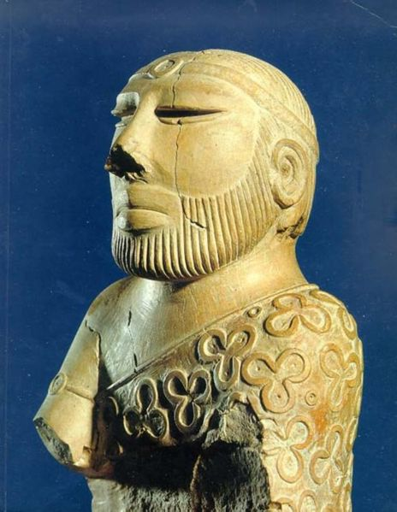

Slide 19
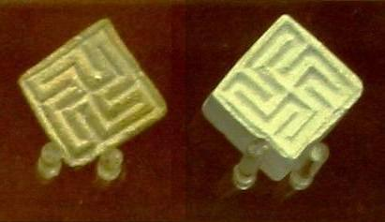
Ancient Swastika symbol from the Indus Valley

