Slide 1
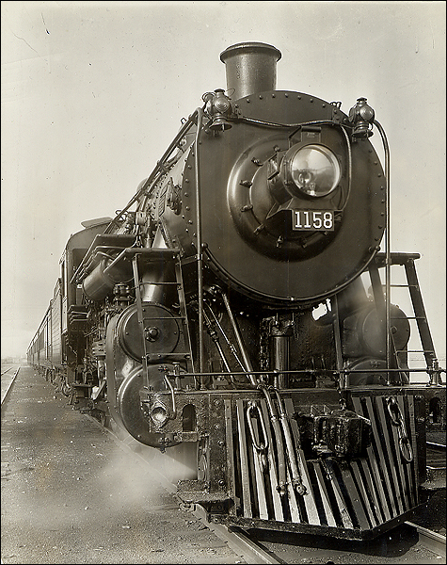
Chapter 23: The Emergence of Industrial Society in the West
APWH

Slide 2
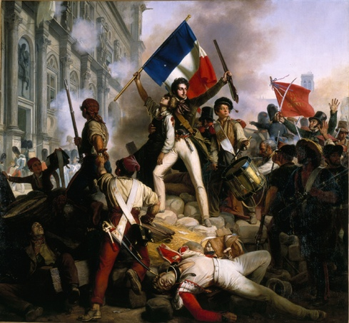
The Age of Revolution
Age of Revolution (1776-1848)
American Revolution (1776)
French Revolution (1789)
Revolutions of 1830
1848 Revolutions
Most Western nations had a parliamentary system by 1870s as revolutions rid countries of absolute monarchs
What contributes?
Intellectual challenges from the Enlightenment
Commercial growth and a new middle class of businessmen
Population pressure: threats to upper-class families and a growing proletariat

Slide 3
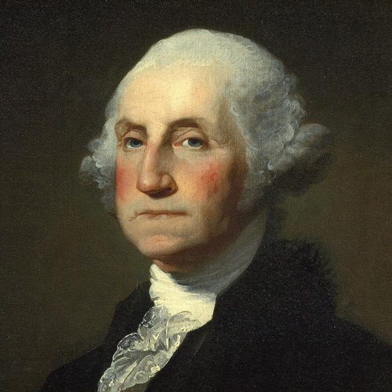
The American Revolution
Result of:
Enlightenment philosophies (social contract, rights of man)
American colonies develop unique identities separate from Britain
Colonists angered by new taxes and trade controls after Seven Years’ War ends in 1763 (Taxation without Representation)
Declaration of Independence of 1776 issued by the new American government
Life, liberty, and the pursuit of happiness
American Constitution in 1789
Separation of powers; checks and balances
Bill of Rights

Slide 4
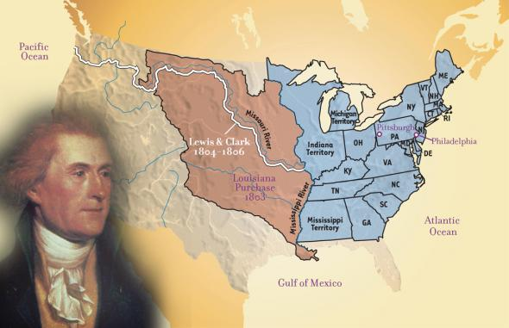
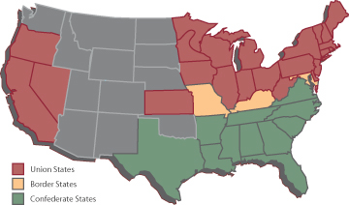
The growing U.S.
Manifest Destiny: American settlers are destined to expand to the Pacific
1803: Louisiana Purchase
1823: Monroe Doctrine
“Hands off” policy regarding European colonization in Americas
1861-1865: American Civil War
Industrial North vs. a slave-holding, plantation-growing South
Disputes over slaveholding
First modern war: industrially produced weapons
Accelerated industrialization

Slide 5
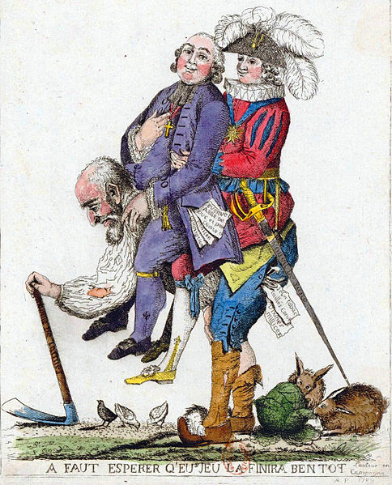
French Revolution of 1789
In 1789, Estates General had not been called by a French monarch in 175 years.
The bourgeoisie (middle class) in the 3rd Estate becomes the driving force of the revolution.
Louis XVI forced to call for an Estates-General meeting about tax reform; loses control
Bourgeoisie members insist on one vote per representative rather than one vote per estate
June 14, 1789: Storming of Bastille
New National Assembly issues Declaration of Rights of Man and Citizen
Liberty, property, security, and resistance to oppression
New constitution with new individual rights

Slide 6
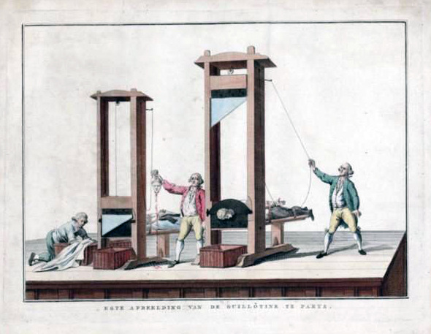
French Radicals and the reign of terror
Reign of Terror (1792-1795)
Led by Maximilien Robespierre and Jacobins
Use of the guillotine
Regicide: executed Louis XVI and Marie Antoinette in 1792
“Cult of the Supreme Being”
Pushed revolutionary reforms in new constitution
Universal male suffrage
Military conscription: all male citizens

Slide 7
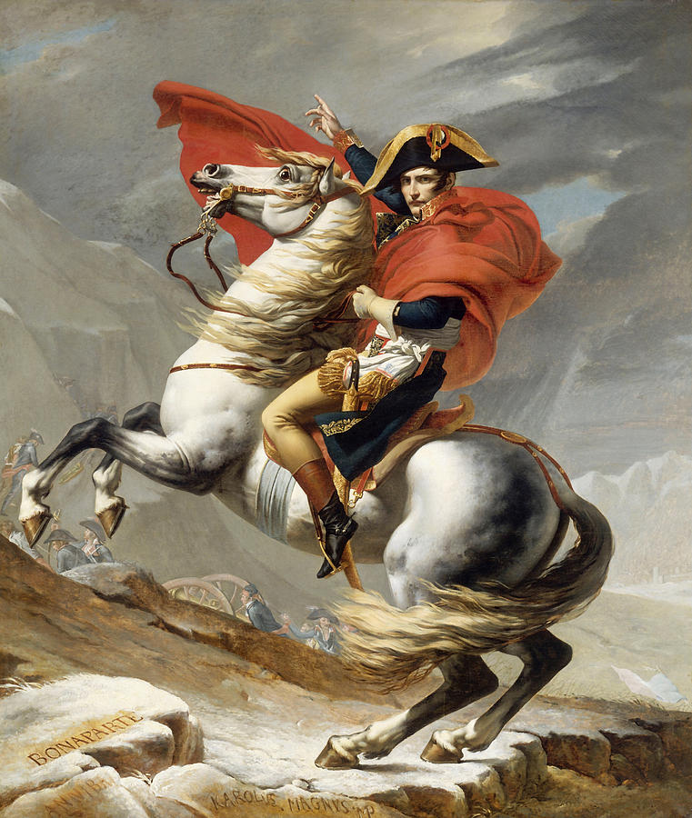
Napoleon Bonaparte
1799: Army general Napoleon Bonaparte rises to power
1804: Napoleon converted French republic to authoritarian empire by limiting power of assembly
Napoleonic Code
Censors press; religious freedom; universities
By 1812, controlled most of Western Europe
France begins to fall after a failed 1812 invasion of Russia (result of harsh Russian winter)
1814: Defeated at Battle of Leipzig and exiled to Elba in Treaty of Fontainebleau
1815: Escaped, returned to power, finally defeated at Battle of Waterloo
Duke of Wellington led British forces
Exiled to St. Helena
Encouraged nationalism throughout Europe

Slide 8
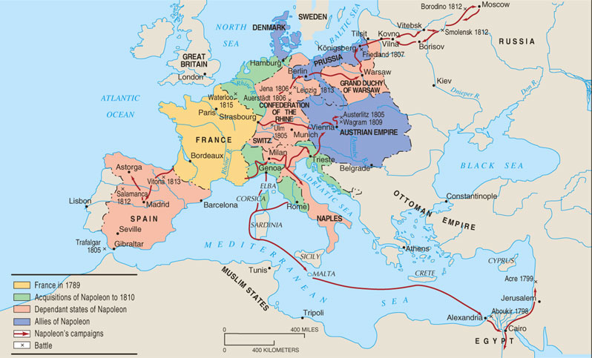
Napoleon’s Empire in 1812

Slide 9
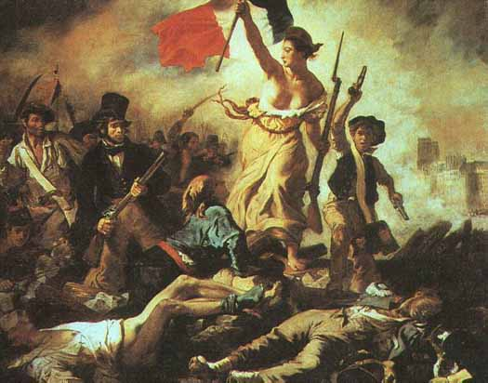
Aftermath of napoleon
1815: Congress of Vienna
Restore balance of power between European countries to prevent any European country from dominating continent again
More revolutions follow
Greek Revolution of 1820
Revolutions of 1830
Belgian Revolution of 1830
July Revolution in France
1848 Revolutions (France, Germany, Poland, Italy, Austrian Empire)
Failures of revolutions: no permanent reform
Eugene Delacroix, Liberty Leading the People, 1830

Slide 10
New Political movements and nationalism
Growing political movements:
Conservatism; Liberalism; Radicalism
Conservative Western leaders worked to reduce the occurrence of political revolution after 1850
Nationalism: intense belief in pride in one’s national culture which is associated with the territory in which they reside
Will cause countries/empires to break up
Example: Austria-Hungary; British Empire
Will cause nations to be created
Example: Italy (1870) and Germany (1871)

Slide 11
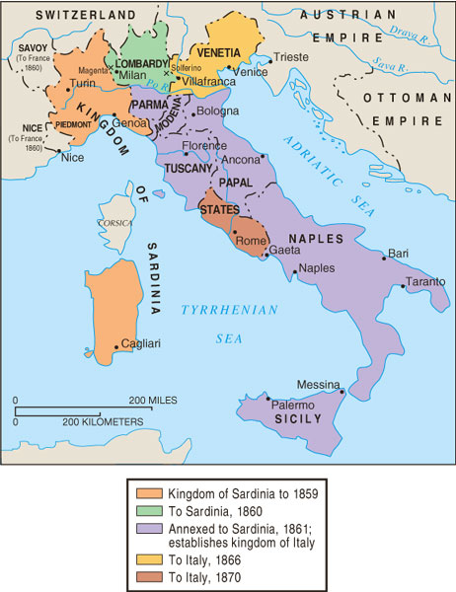
Unification of Italy 1859-1870
Italy was divided into 9 states
Barriers to unification: geography; illiteracy; the Pope; lack of consensus; lack of European support
Factors supporting unification: geography; pride in heritage; Italian culture
Count Camillo di Cavour leads nationalist movement
Parliamentary monarchy created under King Victor Emmanuel II
Problems: right to vote was limited to upper/middle class property holders; Catholics upset by new nation; disagreements over imperialism; lacked industry and natural resources

Slide 12
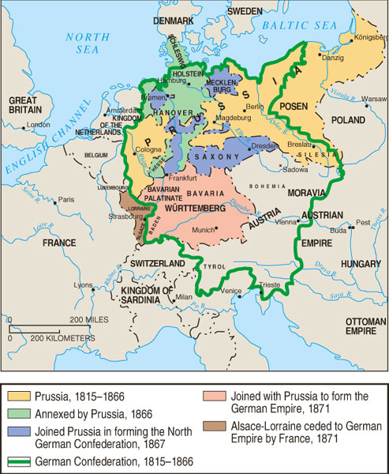
Unification of Germany 1815-1871
Holy Roman Empire dissolved in 1806
After Congress of Vienna, German Confederation of 39 territories created → feelings of German nationalism
Barriers to unification: Europe fears a united Germany; Protestant/Catholic tensions (Thirty Years’ War)
Factors supporting unification: common culture; intellectual support (Goethe)
Otto van Bismarck, Prime Minister of Prussia and leader of German Confederation
Franco-Prussian War (1870-1871) leads to French concession of Alsace and Lorraine (Treaty of Frankfurt)
German states unified under Wilhelm I, King of Prussia and now German Emperor
First Reich: German Empire (1871-1918)
Second Reich: Weimar Republic (1919-1933)
Third Reich: Nazi Germany (1933-1945)

Slide 13
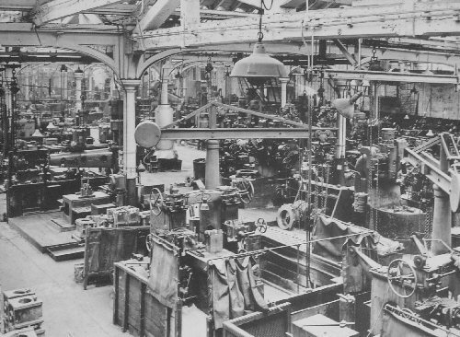
Industrial Revolution
Industrial Revolution led to production of goods that occurred in the factory rather than the home
Began in 18th c. English textile industry → growing demand in global trade
England has entrepreneurs, money to invest, dispossessed farmers to work, farm land and natural resources
Factors of industrialization
Agricultural changes: enclosure movement; rotating crops; fertilizers; breeding livestock.
After 1850: Second Industrial Revolution (use of steel and electricity)
Technological changes: steam engine (1770s); railroads; canals; steamships; telegraphs

Slide 14
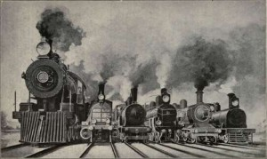
Industrial Revolution: Economic effects
Economic changes:
Insurance; stock markets; gold standard
1860-1873: corporations in Europe doubled
Transnational companies
Supported by laissez-faire economics (Adam Smith) and economic liberalism (John Stuart Mill)
Railroads and canals were constructed; linked cities throughout Europe
1820s: France, Belgium, US, Germany industrialize
End of 19th c.: Russia, Egypt, Japan industrialize

Slide 15
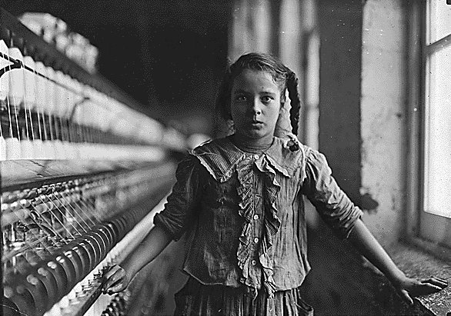
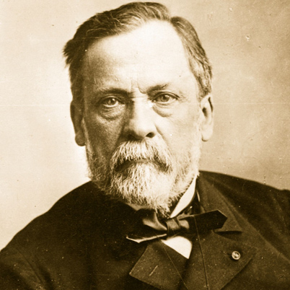
Industrial Revolution: Social effects
Factory workers
Conform to factory schedules, long hours
Health concerns: noise; pollution; loss of limbs
Child labor
Social status: determined by wealth rather than social class
Industrial cities: rural → urban migration
Crowded; unsanitary; coal-produced smoke
Population increase in mid-18th c.
End of epidemic diseases
Improved diets (potatoes, etc.)
Infant mortality decreases, higher birth rate; lower death rate
1880s: Louis Pasteur’s germ theory of disease; hygienic practices in childbirth

Slide 16
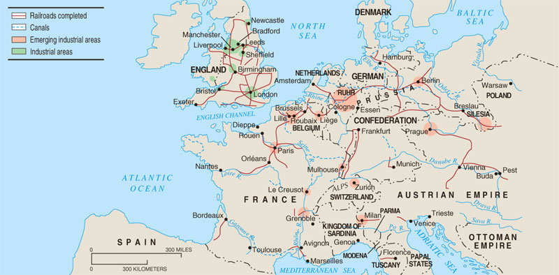
Industrialization in Europe, 1850

Slide 17
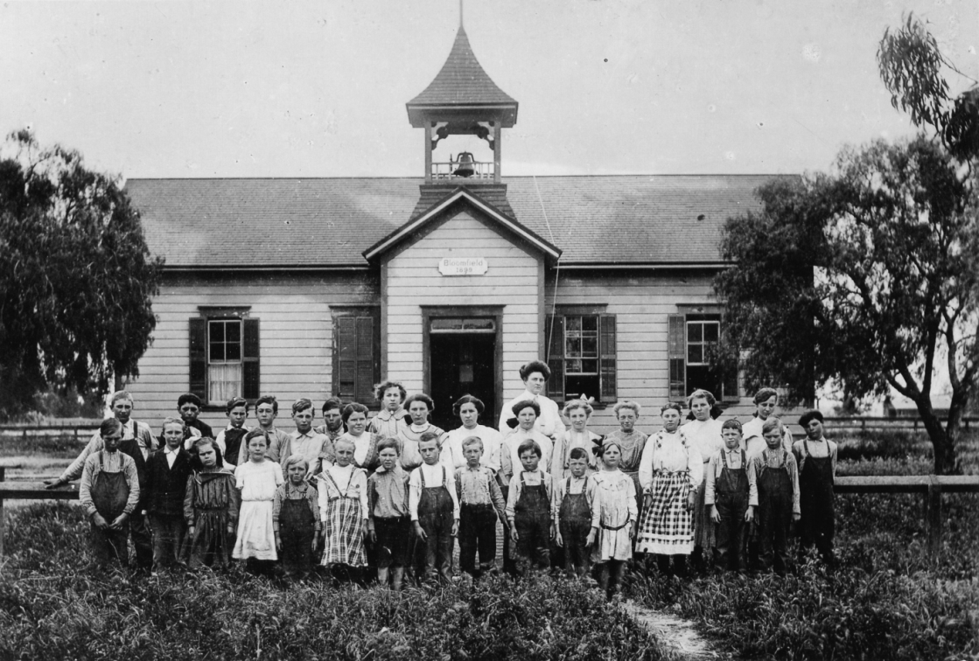
Government Functions
Civil service examinations in governments
Governments extended regulations into new areas
British PM Benjamin Disraeli granted vote to working men in 1867
Higher wages; shorter working hours
Welfare measures: accidents, illness, old age
The “Social Question” – what is the government’s responsibility in this area?
Schooling expanded
Often mandatory until age 12
By 1900, 90-95% of Western Europeans and Americans were literate

Slide 18
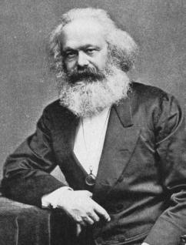
Socialism
Karl Marx’s The Communist Manifesto (1848)
Class struggle = group out of power (property-less proletariat) vs. group controlling the means of production (bourgeoisie)
Grievances of proletariat will lead to revolution; full freedom will be achieved
Class struggle would end because class systems would be eliminated
Rise of socialism in Germany, then extend to Austria, France by 1880s
Revisionism: Marx’s ideas were wrong and success regarding political/societal harmony could be achieved by peaceful means; support parliamentary monarchies to achieve goals

Slide 19
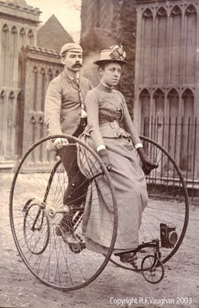
Cultural Changes
White-collar labor force grows in the working class
Secretaries, clerks, salespeople
Sometimes fulfilled by unmarried women
Widespread advertising promoted products in new consumer culture
Product crazes
Higher wages led to increased spending
Mass leisure culture shows growing secularism
Bicycle fad of the 1880’s
Vacations
Theatre, comedy routines, entertainment
Team sports (soccer, football, baseball)
1896: Olympic games

Slide 20
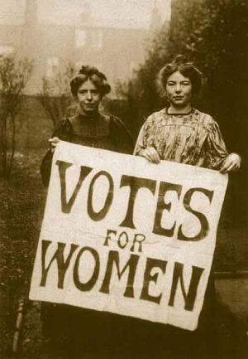
Feminist movement
Feminist movements by 1900s
Also called first-wave feminism
Emerges out of liberal and radical politics
Primarily focused on women’s suffrage (right to vote)
Seneca Falls Convention, 1848: outlines movement’s ideology and political strategies
Suffrage in 1918 for USA, Germany, Britain, Austria
Most participants were middle class women
Often joined with temperance and abolitionist movements
Challenged “cult of domesticity”

Slide 21
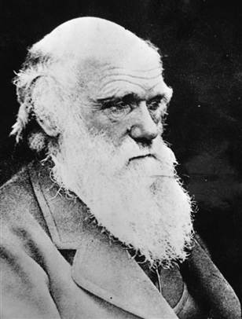
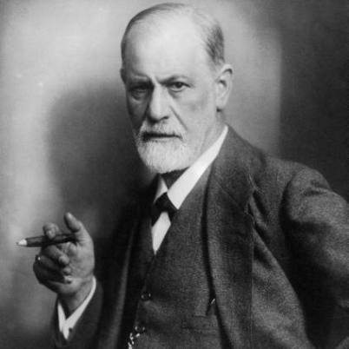
Scientific advances
Built on traditions of rationalism and empiricism: Renaissance, Scientific Rev
Charles Darwin’s On the Origin of the Species (1859)
Theory of natural selection: all current living species evolved and adapted in order to survive
Controversy with Judeo-Christian Bible
Albert Einstein’s theory of relativity
Time as a factor in physical measurement
Sigmund Freud: human subconscious and psychoanalysis

Slide 22
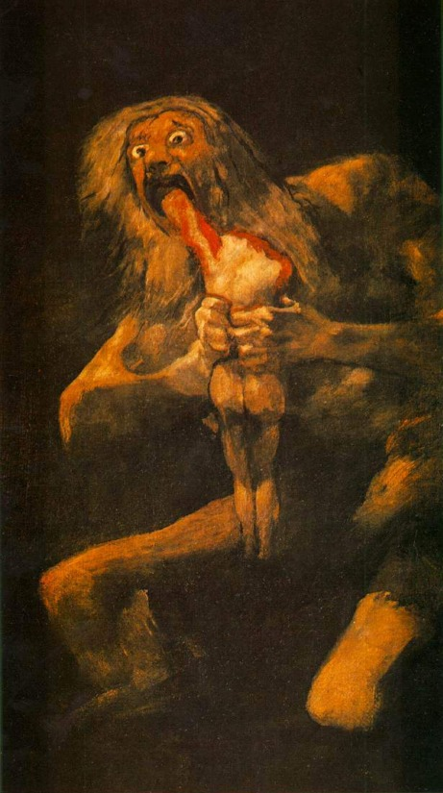
19th century art and literature
Diverges from the order and rationality that science presented
Romanticism: emotion is key to human experience, not reason and generalization.
Art: intense passion, madness, interest in literature
Literature: move readers to tears, not to debate
Poetry: no need to rhyme, reveal emotion
Music: evocative, expressive
Goya’s Saturn Devouring His Children

Slide 23
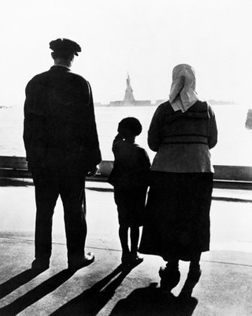
New western societies
Western power and influence rose
Industrial Revolution created the need for new markets and the need for new raw materials.
New European colonies
Industrialization of the West’s military
Repeating rifle and machine gun
Enables spread of Western empires
Steamships enable massive European emigration
Many societies became immigrant majorities

Slide 24
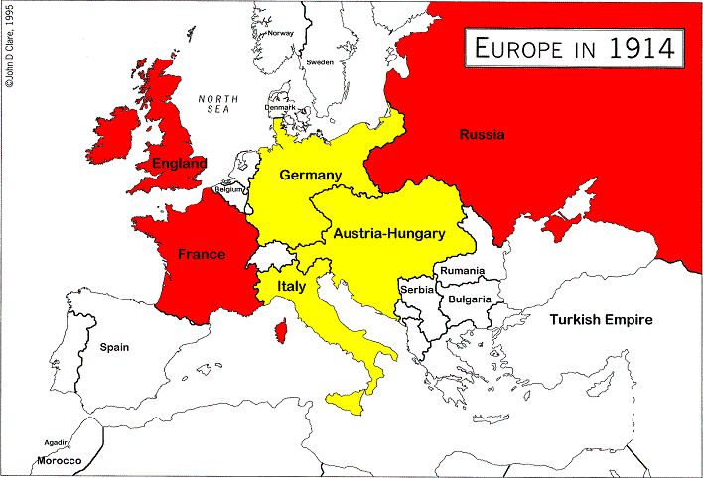
M.A.I.N. Causes of WWI
Militarism: Artillery levels and naval forces grew steadily
Alliances: Emergence of new Germany disrupts power balance in Europe → complex alliance system created
By 1907, most European nations were in an alliance
Triple Alliance: Germany, Austria-Hungary, Italy
Triple Entente: Britain, Russia, France
Imperialism: Imperialist expansion fed the sense of rivalry between nation-states
Nationalism: Balkan independence from Ottomans; new Germany and Italy

Slide 25
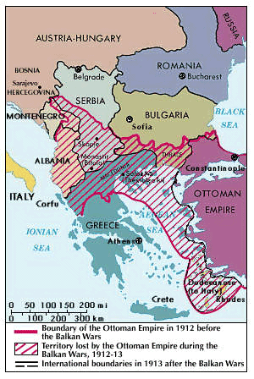
Balkan Wars for independence, 1912-1913

Slide 26
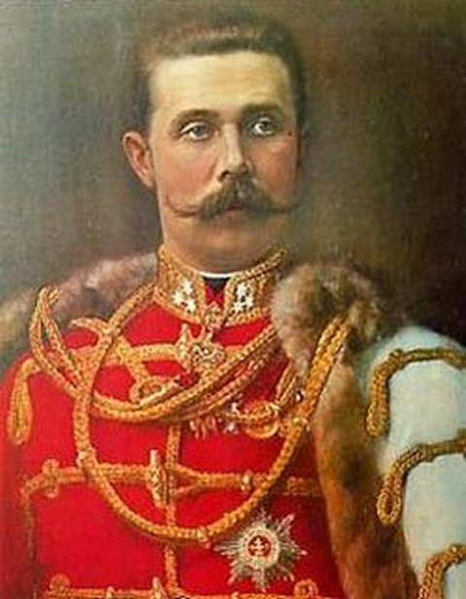
World War I
1912-1913: Small Balkan nations created after winning independence from the Ottoman Empire
Serbia did not gain as much territory as it thought it should have been granted
Hostilities in Balkans persist as new and unstable countries are plagued by ethnic nationality disputes
1914: Archduke Francis Ferdinand of Austria-Hungary was assassinated by a Serbian nationalist
Russia mobilized its troops against Austria, as alliances engage
World War I begins on August 1st, 1914

