Slide 1
Networks of Exchange
Silk Roads, Indian Ocean Basin, Trans-Saharan, and the American Network

Slide 2
Objectives:
Consider significance of trade in human history
Explore the interconnections created by long-distance trade during 500-1500
Examine a full range of what was carried along trade routes (goods, culture, disease)
Explore the differences between the commerce of the Eastern Hemisphere and that of the Western Hemisphere and the reasons behind those differences

Slide 3
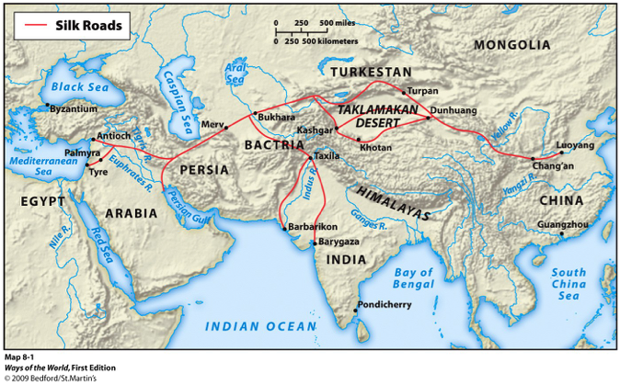
The Silk Roads

Slide 4
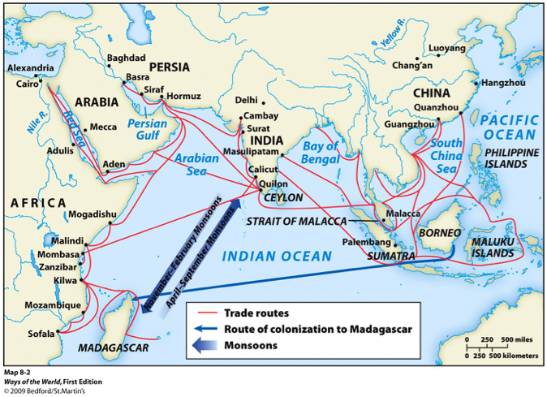
Indian Ocean Trade

Slide 5
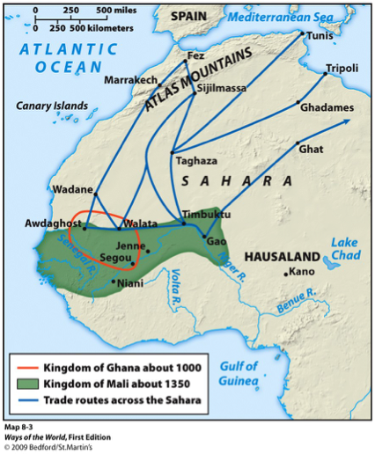
Trans-Saharan Routes

Slide 6
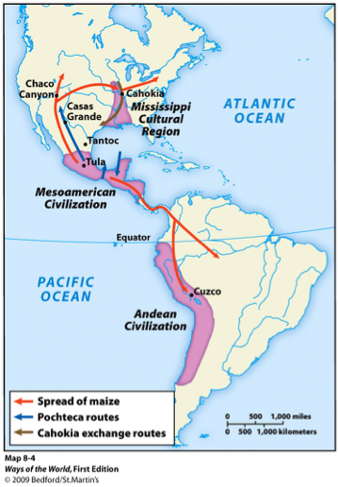
The American Network

Slide 7
Directions:
Draw the Silk Roads (pg. 210), Indian Ocean Routes (pg. 210), Trans-Saharan (pg. 218), and the American Networks on the blank map.
Label major trading cities, ports, and bodies of water
Make a key representing each route
Jigsaw
Read your assigned section with a partner and take notes in the chart
Find two other people- make a group of four- who read the same section as you did. Share your information.
Find three people who did not read what you did. Each group should consist of one EXPERT on SR, IO, TS, and AN. Share your info by explaining your trade route.
Together, make a list of ways in which these trade routes are similar
Using your notes, address the conclusion questions as a group.

Slide 8
Silk Roads
Origins/Geography
Separate societies and diverse climate
cold, harsh, dry in north vs. warm, suitable for agriculture in ME, China, Med.
Pastoral and agricultural people exchange goods and idea
Rise of Classical civilizations facilitate connection between places like Han China, Persia, and the Roman Empire
Operations
Land based, “relay trade”
Pastoral and agricultural people involved
Better trade when security provided during Rule of Empires or Mongols
Camel caravans
LUXURY GOODS=elite market
silk monopoly by China at first; sacred to Buddhists
Monasteries set up along the route by Buddhists=common meeting place
Exchanged Goods...
China= silk, bamboo, paper, gunpowder
India=spices, cotton
ME= dates, nuts, dries fruit
Central Asia=walrus tusks, furs, horses
Med. Basin=Gold coins, glassware, jewelry
Buddhism and Christianity, religious texts, architecture
DISEASE=strengthened Christianity/Buddhism(compassion)= EURO advantage!!!
Technology...
Camels, horses=stirrups and saddles make it easier to travel and fight
Silk worm production

Slide 9
The Indian Ocean Basin
Origins/Geography
Mediterranean always place of trade: Phoenicians, Egyptians, etc.
Venice became a trading center
Most important route before the 1500s
Largest sea-based trade
Environmental diversity (China, Malay Peninsula, India, Africa, Europe, ME)
Monsoons are key to trade and evidence of advanced understanding of trade winds
Began in Indus RV
Operations
Cheaper than land trade
Trade in bulk b/c its heavier=mass goods to market like rice and spices
Commerce between towns not cities=development of port towns and cultures
Usually hugged the coast for short distances except the Malay sailors--> long stretches of open ocean
India became the center between all the trade (Location)
Exchange of goods... and Technology
China: silk tea; India: spices and cotton; Arabia: perfumes; East Africa: ivory, gold, slaves; Med. Basin: glassware, wine, olive oil
Islam!! and other religions
Writing, language, music
intermarrying of different cultures
Big ships=faster and cheaper transportation of goods and heavier goods=MASS MARKET
Monsoons=better navigation (compasses) and ship building (Chinese treasure ships known as junks)
Dug-canoes (Malay-Polynesians)

Slide 10
Trans-Saharan Route
Origins/Geography
Environmental diversity= desert, savanna, forests
North Africa= Manufactured goods/South=Agricultural goods
Earliest trade in Sudan
Operations
Camels made long-distance trade possible
influence of Arabs=caravans
Donkeys then transferred to camels (days without water)
Sahara Desert no longer a barrier but an international trade route
Travel at night out of heat for 15-25 miles a day
Exchange of goods...
GOLD, SALT, ivory, kola nuts, slaves, textiles, horses, cloth, dates
Creation of new states
Technology
camel and stirrup=long-distance trade
linked interior of Africa to the Med. Basin

Slide 11
American Network
Origins/Geography
No sustained interaction between East and West until Columbus=isolated from rest of the world
Not dense civilizations and populations like on the Afro-Eurasia
Diverse geographic environment
Significant changes in climate and agriculture moving from N to S compared to Afro-Eurasia moving from E to W
Many different vegetation zones
Operations
local and regional trade flourishes BUT not long-distance
little direct contact with each other (three civilizations)
“loosely interconnected web”
major trade in Mesoamerica and in Andes
land based
Maya=seaborne
Aztec- private trade while Andean trade=state run
Mostly luxury over basic commodities
Exchange of goods...
cultural traditions spread gradually like writing and use of llamas
Maize from Meso to North America and South
Rubber ball game
pottery, architecture, copper, shells
Technology
lack of domesticated animals, wheeled vehicles, and large ships limited trade
dug-out canoes
lateral roads built

Slide 12
Quiz...
In a group of FOUR answer the following questions:
How did the operations of the Indian Ocean trading network differ from that of the Silk Roads?
Why did the Eastern Hemisphere develop long-distance trade more extensively than did the societies of the Western Hemisphere?
How did geography and technology affect the different trade routes? Choose three out of the four to explain your answer.
Which trading network do you believe was most significant to human history? Explain your answer using examples from the readings.

Slide 13
Questions to Consider:
What motivated and sustained the long-distance commerce of the Silk Roads, Sea Roads, and Sand Roads?
Why did the Eastern Hemisphere develop long-distance trade more extensively than did the societies of the Western Hemisphere?
In what ways did commercial exchange foster/facilitate other exchanges?
In what ways was Afro-Eurasia a single interacting zone, while in other ways in was a vast region of separate cultures and civilizations?

