Slide 1
Unit 3 Part 1
by Dakota, Lucinda, Theo, and Max

Slide 2
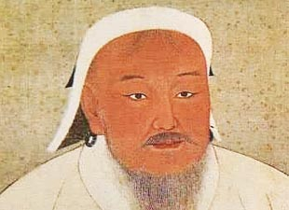
Mongols
Origins:
nomads from steppes of Central Asia
horses, powerful military, archers
tribes
traded for what they couldn’t produce
women had right to participate in tribal councils
Chinggis (Genghis) Khan: united Mongol tribes
adopted weapons tech. from Chinese
conquering Central Asia, China, Middle East

Slide 3
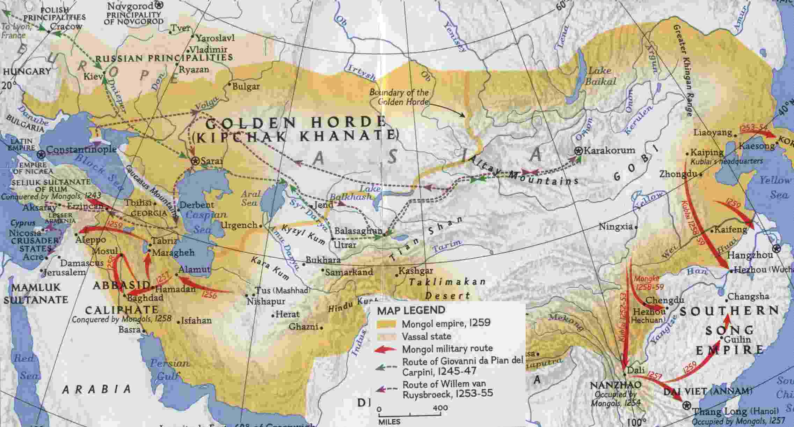
Mongols in Russia:
called Tartars by Russians
destroyed resisting cities, killed people or sold them into slavery
tribute empire (Golden Horde)
feudalism, peasants sought protection from Mongols
Moscow= main tribute collector
Orthodox Church became dominant
isolated from Western Europe
Mongols tried to push further west but couldn’t

Slide 4
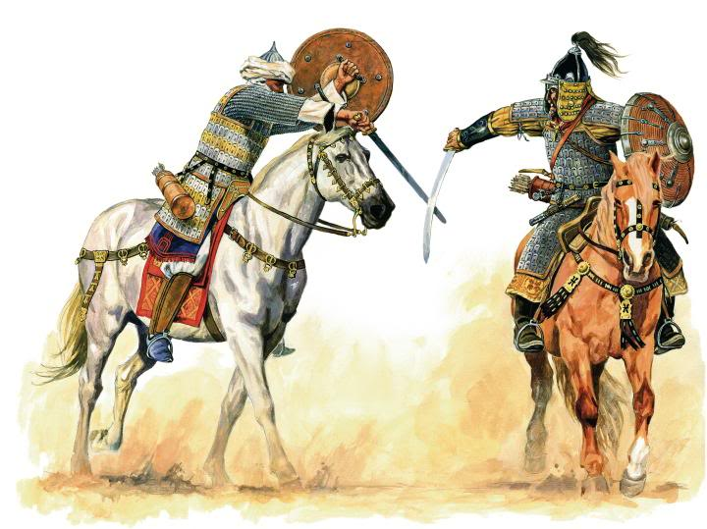
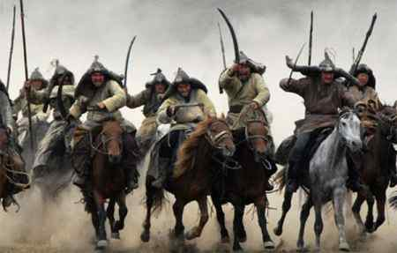
Mongols in Persia:
burned Baghdad in 1258
executed Abbasid ruler, ended caliphate
expelled from Middle East by Mamluks of Egypt

Slide 5
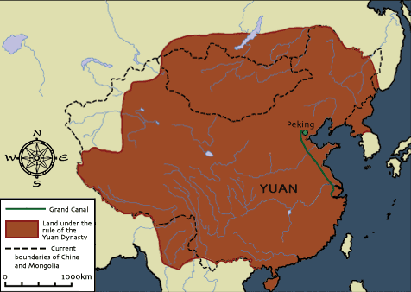
Mongols in China:
Kublai Khan controlled most of China by 1271, established Yuan dynasty
Chinese not allowed to learn Mongol language, intermarriage illegal
religious toleration, end of civil service exams
Mongol women had more freedoms than Chinese women
used foreigners in gov. positions
merchants gained status, trade encouraged
attempted to expand China by conquering Japan and Vietnam but failed both
In rule following, trade still encourage until China again became chinese (Ming Dynasty- treasure ships)

Slide 6
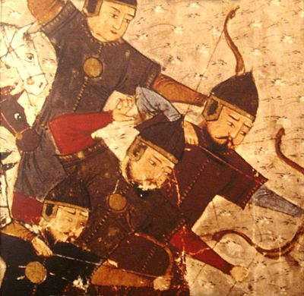
Impact of Mongol rule:
trade along Silk Roads protected/encouraged
spread of plague
foreign rule in China, revival of Confucianism
Russia cut off from Western Europe, serf labor developed/advanced
brought world culture to Europe without foreign rule allowing for Europe to become a world power

Slide 7
Islam
Nomadic warring Bedouin tribes worshiped various gods prior to Islam
Muhammad, a merchant, received revelations from Gabriel that there is one god (Allah)
the last of the prophets
Wrote the Quran-- the word of God himself
demanded social justice and returned to classical values
Created a new society: the umma (community of all believers regardless of tribe/race/ethnicity)
Muhammad fled to Medina with his followers, returned to Mecca to visit the Ka’aba (hajj), conquered Mecca, and died without a successor

Slide 8
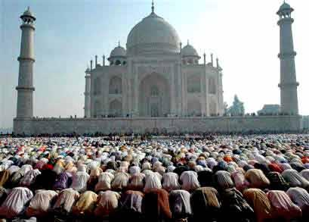
The Five Pillars
There is no god but Allah; Muhammad is the messenger of God
Prayer five times a day facing Mecca
Giving wealth to the needy
Fasting during the month of Ramadan
Pilgrimage to Mecca at least once in a lifetime (hajj)

Slide 9
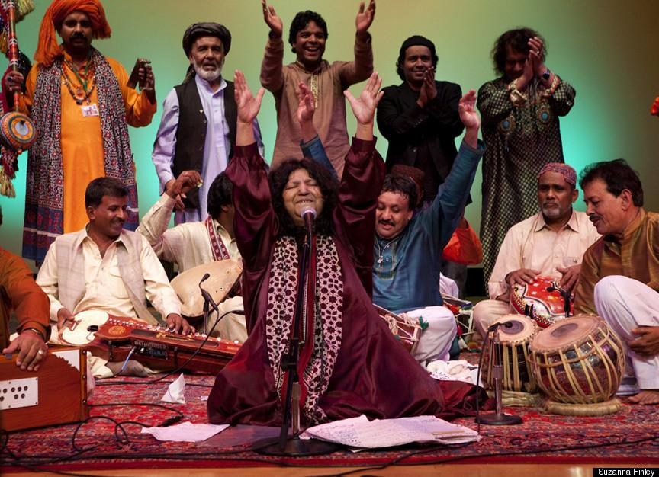
Divisions in Islam
Sunni Muslims
After Muhammad’s death believed
caliphs rightfully held power
Selected by Islamic community
Shia Muslims
Believe power should rest in the
bloodline of Muhammad
Lineal descent
Sufis
Mystic muslims
Sought a direct, personal experience with Allah through music, meditation, and dance

Slide 10
Unifying Factors
Accessibility
Spread by belief, not birth
Importance of social justice appeals to all
Brought peace to warring Bedouin tribes
Inspires moral devotion
Friendly to commerce (unlike Buddhism or Christianity)
Social mobility (unlike Hinduism)
Jihad
The Quran justifies armed struggle against unbelief and evil
Sharia
One law regulating every aspect of life
Focuses on correct behaviour rather than belief

Slide 11
The Spread of Islam
India
Appealed to low-caste Hindus and disillusioned Buddhists
Some converted to avoid the tax imposed on non-Muslims
Sufis accommodated local gods and developed a “popular Islam” closer to Hinduism
Anatolia
Islam overthrew the Byzantine Empire and converted entirely by 1500
Common monotheism with Christianity fostered conversion
Sufis established public works that drew converts
West Africa
Brought by muslim trans-Saharan traders
Took hold in the urban elites of large cities
Spain
coexisted with Christianity but toleration eroded by late 10th century

Slide 12
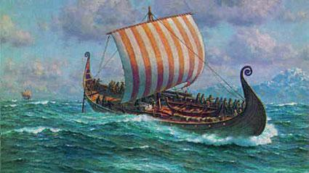
Vikings: Migrating Peoples
Northern Coastal Europe
Seafaring originally raiding and pillaging culture
Norway, Sweden, Denmark, the Netherlands
First went east and attacked Russia
Then went south east and raided England, Ireland, Scotland, Germany, France
Then went west and found Iceland and Greenland and ‘discovered’ Newfoundland in Canada
Migratory culture
advanced ships but that’s about the extent of their advanced technology
eventually William the Conqueror took England

Slide 13
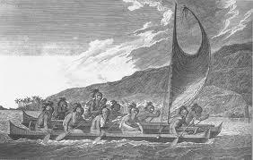
Polynesian: Migrating Peoples
Probably Originated in Southeast Asia and Australia/ Zew Nealand
Advanced oversea travel, island discovery, and settling technologies
Traveled into Pacific Ocean
Used advanced dual canoe-like boats
Techniques
Followed birds, used tides, navigated via stars, organized expedition distances, brought livestock and agriculture to settle islands
Possibly ‘discovered’ Americas]
Colonized Majority of Pacific Islands
Originally ignored by historians

Slide 14
Bantu: Migrating Peoples
around 2000 BCE Bantu people migrate southward into Sub-Saharan Africa
spread agriculture and ironworking knowledge
trade with Southeast Asia
mixed with Arab merchants, created Swahili
stateless societies, based around kinship groups
animistic religion, oral traditions (storytellers)
each age level and gender had specific duties
women were valued as mothers but also worked on farms and sometimes in military
economic status measured in acquisition of slave rather than property

Slide 15
Trade
Indian Ocean = very important
China: increased trade during Tang, Song, Yuan, Ming dynasties; Ming sent expeditions to display wealth of “Middle Kingdom” (Zheng He); traveled to Middle East; expeditions stopped by Confucian scholars; trade continued
Middle East: merchants used monsoon winds to travel to India/ Spice Islands; merchants blended with Bantu to from Swahili; established wealthy city-states; attempted to prevent European gains in Indian Ocean
Europe: technology advanced (navigation, better boats, mapmaking, etc.) leading to more extensive trade; especially interested in spices from East Indies; no one wanted/needed European goods
India: broken into small kingdoms; establishment of trading ports for Chinese, Arabs, and Europeans

